Slide 1
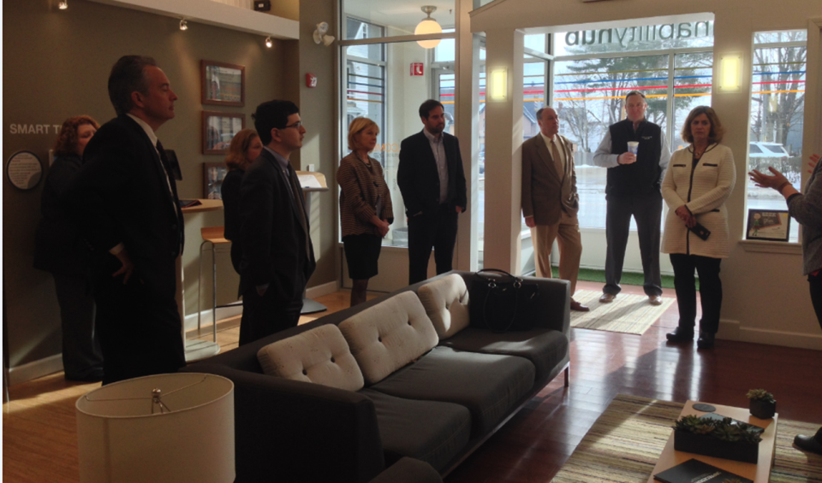
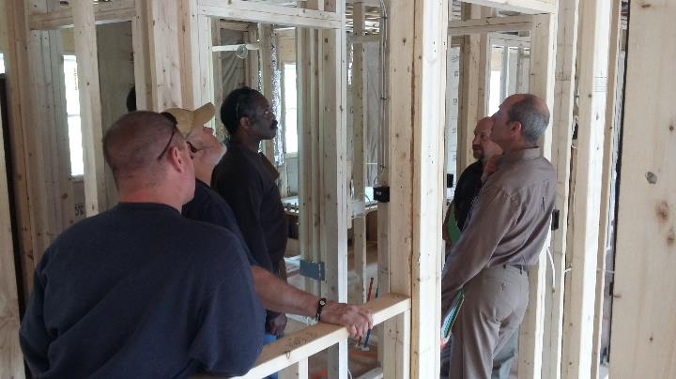
EERMC Field Trip Proposals
RI EERMC
November 16, 2017

Slide 2
Residential Focused Proposals
Title | Location | Potential Days of Week | Duration (# of hours) | Summary of Field Trip
Rhode Island Innovation Hub | Providence, RI | M-F preferred, Weekend possible | 1 | Visit to the Rhode Island Innovation Hub to see how the Company is working to engage the RI public in energy efficiency and how energy efficiency plays a greater role in transformation of the energy system to clean, sustainable energy
Energy Code Training | RI Innovation Hub and other locations | Lighting controls - 12/7/17 Stretch code intro - 1/25/18 | 1-3 hours depending on subject | Attend training sessions for code officials, builders, design professionals, and other industry players aiming to foster increased compliance with the state energy code.
Multifamily Market Rate or Income Eligible Site | TBD | M-F | TBD | Visit a Multifamily (market rate or income eligible) site to observe installation work in progress. Possible work might include lighting, thermostats, showerheads, insulation, air sealing, heating system replacement, etc.
Residential New Construction | TBD | M-F | TBD | Visit a residential new construction single or multifamily site . The site could be a completed Zero Net Energy (ZNE) project with Photo Votaltic (PV) or a ZNE project under construction where insulation and air sealing can be observed before the drywall are up.
Income Eligible | TBD | M-F | 2-3 hours | Visit an income eligible home energy assessment or weatherization.
EnergyWise | TBD | M-F | 2-3 hours | Visit a market rate customer's home energy assessment or weatherization.
Notes:
C&I – (Target, Q2, pct of goal, pct forecast) kW- 17, 408; 6,561; 37.7%; 90.0% MWh - 104,017; 48,246; 46.4%; 97.3%; Participation - 3,133; 1,663; 53.1%; Expenses - $44,735.6 ; $14,022.8; 31.3%
Income Eligibile - kW – 797; 390; 49.0%; 102.4%; MWh - 7,076; 3,292; 46.5%; 108.9%; Participation - 5,519; 3,874; 70.2%; Expenses - $11,976.5; $4,522.8; 37.8%
Non-Income Eligible Residential – kW - 10,338; 5,917; 57.2%; 98.6%; MWh - 90,254; 50,368; 55.8%; 100.1% ; Participation - 517,648; 522,647; 101.0%; Expenses - $31,798.4 ; $13,116.2; 41.2%
Total – kW 28,543; 12,868; 45.1%; 93.4%; MWh - 201,347; 101,906; 50.6%; 98.9%; Participation - 526,299; 528,183; 100.4%; Expenses - $ 90,143.1; $ 32,338.7; 35.9%
Highlights – At the end of the second quarter the company achieved 50.6% of its over MWh goal. Here you can see that there is strong results across all of our programs which track closely with last year. One area to highlight is C&I. In Q2 we claimed savings for a large CHP project and also 6,800 MWh of savings from the LED streetlight program in Providence, Cranston, and Bristol.

Slide 3
C&I Focused Proposals
Title | Location | Potential Days of Week | Duration (# of hours) | Summary of Field Trip
Architectural Project | TBD | M-F | 1-2 hours | Meeting with an Architectural Firm who has helped a customer participate in our C&I Programs.
New Construction for C&I | RI Veteran's Home | M-F | 1.5 hours | A Rhode Island Veterans Home Tour to discuss energy efficiency measures for a successful project.
Dave's Fresh Marketplace | TBD | M-F | TBD | Visit a local Rhode Island grocery store to see the energy efficiency measures utilized for a medium/large commercial customer.
Franchisee | RI Dunkin Donuts | TBD | 1 hour | See how the Company's franchisee program works for small business owners
Tour of schools and municipal buildings | Coventry, RI | M-F - Tour schools during vacations or after dismissal (2:00PM+) | 2 – 4 hours | Coventry, RI passed a $5,000,000 energy bond in 2012 and utilized the Company's EE programs to implement comprehensive improvements (boilers, EMS, lighting, insulation and air sealing, VFD, etc.) in all school and municipal buildings (Six schools and about 8 muni buildings, all within 20 minutes of each other). National Grid is currently doing a press release for the Town and Schools there.
Notes:
C&I – (Target, Q2, pct of goal, pct forecast) kW- 17, 408; 6,561; 37.7%; 90.0% MWh - 104,017; 48,246; 46.4%; 97.3%; Participation - 3,133; 1,663; 53.1%; Expenses - $44,735.6 ; $14,022.8; 31.3%
Income Eligibile - kW – 797; 390; 49.0%; 102.4%; MWh - 7,076; 3,292; 46.5%; 108.9%; Participation - 5,519; 3,874; 70.2%; Expenses - $11,976.5; $4,522.8; 37.8%
Non-Income Eligible Residential – kW - 10,338; 5,917; 57.2%; 98.6%; MWh - 90,254; 50,368; 55.8%; 100.1% ; Participation - 517,648; 522,647; 101.0%; Expenses - $31,798.4 ; $13,116.2; 41.2%
Total – kW 28,543; 12,868; 45.1%; 93.4%; MWh - 201,347; 101,906; 50.6%; 98.9%; Participation - 526,299; 528,183; 100.4%; Expenses - $ 90,143.1; $ 32,338.7; 35.9%
Highlights – At the end of the second quarter the company achieved 50.6% of its over MWh goal. Here you can see that there is strong results across all of our programs which track closely with last year. One area to highlight is C&I. In Q2 we claimed savings for a large CHP project and also 6,800 MWh of savings from the LED streetlight program in Providence, Cranston, and Bristol.

