Slide 1


Third Quarter 2017 Results
RI EERMC November 16th 2017

Slide 2
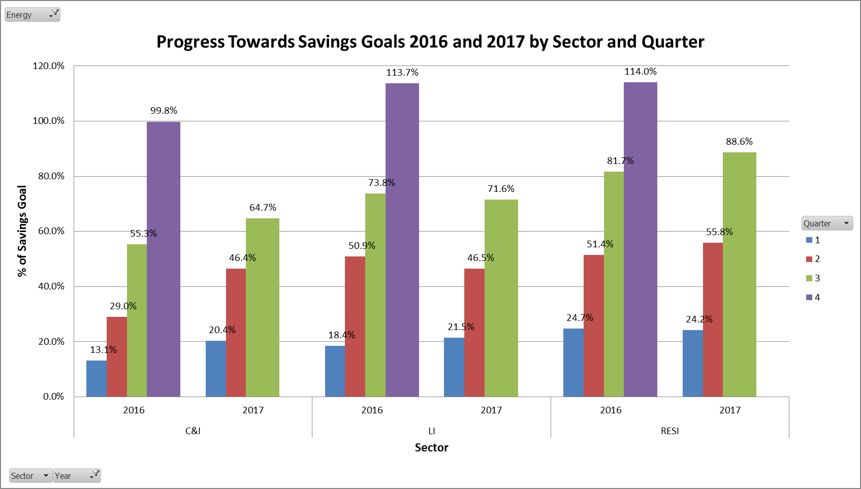
Q3 2017 Electric Sector Results

Slide 3
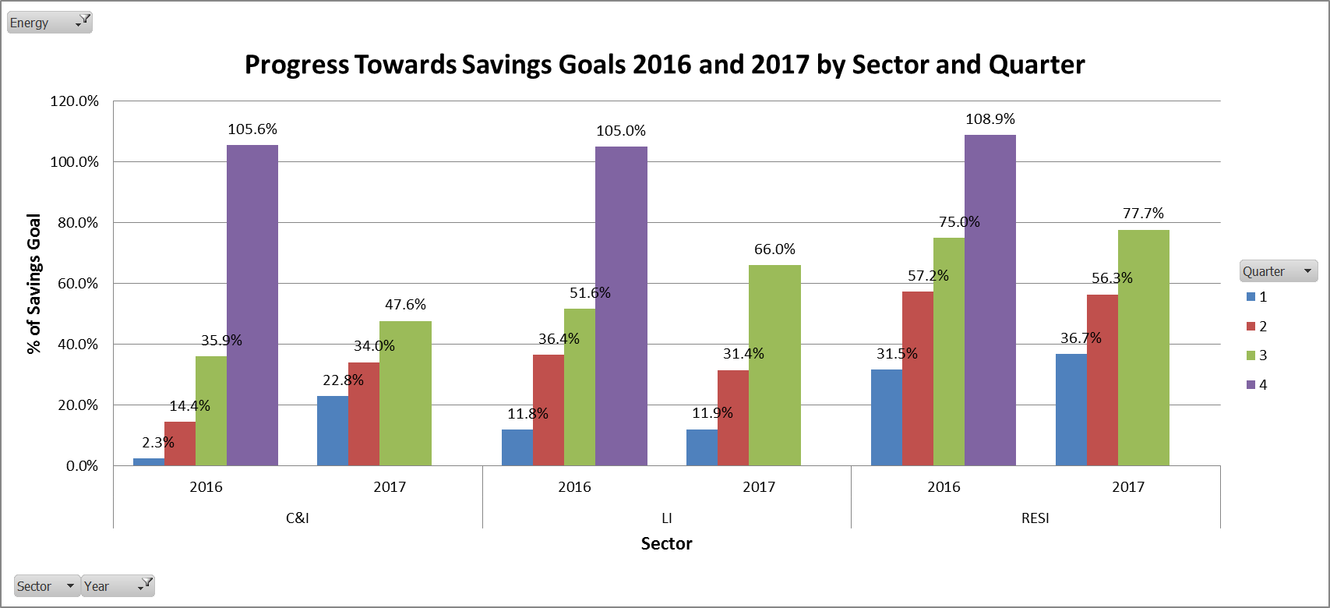
Q3 2017 Gas Sector Results

Slide 4
Residential Highlights
Building on today’s success
while preparing for tomorrow
in
Q3 2017
  Residential New Construction
  Income Eligible Multifamily Gas Benefits
  Lighting Sector Transformation
  HVAC Upstream Products

Slide 5
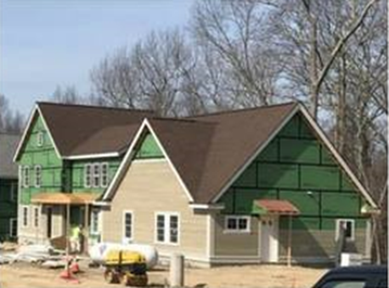
HIGHLIGHTS OF THE RESIDENTIAL SECTOR
GREENRIDGE HOUSING DEVELOPMENTS
This project includes 75 townhouse apartments in Greenridge Commons and 21 apartments in mixed use buildings in Greenridge’s downtown.
The development project is expected to generate about 125 construction jobs over the three-year building process, and will help Burrillville reach its goal of ensuring that 10% of its housing stock is affordable.
Notes:
This home is extremely airtight, with high-performance windows and doors, a high R value, continuous insulation throughout the envelope, and an energy recovery ventilator.

Slide 6
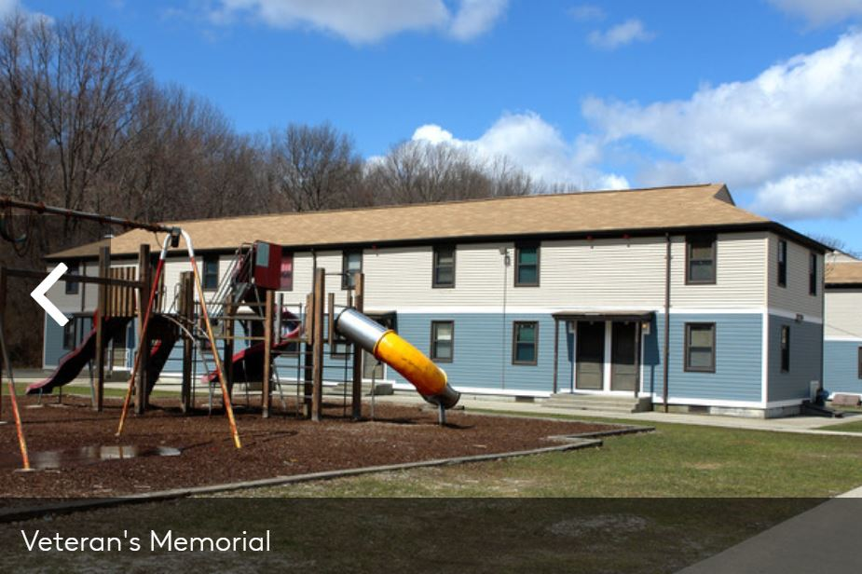
HIGHLIGHTS OF THE RESIDENTIAL SECTOR
INCOME ELIGIBLE BENEFITS
Through the 3rd quarter the Income Eligible Multifamily gas program had installed over 50 boilers in multifamily buildings across Rhode Island helping hundreds of low income customers reduce their heating bills into the future.
Notes:
This home is extremely airtight, with high-performance windows and doors, a high R value, continuous insulation throughout the envelope, and an energy recovery ventilator.

Slide 7

HIGHLIGHTS OF THE RESIDENTIAL SECTOR
LIGHTING SECTOR TRANSFORMATION
ENERGYSTAR® Lighting customers saw the price of bulbs reach the $1/bulb benchmark.
Has led to increased sales and the program is expected to exceed its energy savings target.
Notes:
This home is extremely airtight, with high-performance windows and doors, a high R value, continuous insulation throughout the envelope, and an energy recovery ventilator.

Slide 8

HIGHLIGHTS OF THE RESIDENTIAL SECTOR
HVAC UPSTREAM PRODUCT ADDITIONS
Heat Pump Water Heater Instant Rebate Program - 2018
Initial discussions started with distributors.
Program will require distributors to collect consumer information in exchange for the instant rebate.
Notes:
This home is extremely airtight, with high-performance windows and doors, a high R value, continuous insulation throughout the envelope, and an energy recovery ventilator.

Slide 9




RI Energy Efficiency
Q3 2017
COMMERCIAL HIGHLIGHTS
UPSTREAM
For the upstream lighting program a $1.00 minimum customer contribution was extended through the end of 2017.
For the upstream HVAC program two new products were launched in September: VRF and ECM Circulator Pumps. The program continues to sign up additional distributors for gas water heating.
The launch of a market assessment study for potential inclusion of gas space heating equipment was approved for 2018
NEW CONSTRUCTION
RETROFIT
SMALL BUSINESS DIRECT INSTALL
UPSTREAM
9.1

Slide 10


Large Commercial Retrofit
Cranston, Barrington and Bristol replaced existing street lights with LEDs for incentives totaling $724,000 and MWh savings of 4,700 MWh.
A hotel was post-inspected and commissioning was scheduled for the final quarter in 2017.
An apartment building is under construction with a post-inspection expected in the final quarter of 2017.
70.2% of the annual electric goal
(54,462 MWh)
53.6% of the annual gas goal
(100,788 MMBtu)
LED Street Lighting:
Barrington, Cranston, Bristol

Slide 11
Small Business Direct Install
The Small Business Direct Install program also continues to have strong performance through the third quarter with achieved savings of 8,502 MWh (70% the annual goal) and 2,536 MMBtu (70% of the annual goal) and is projected to deliver 95-100% of the savings goal by the end of the year.
70%
of the annual electric goal
(8,502 MWh)
70%
of the annual
gas goal
(2,536 MMBtu)

Slide 12
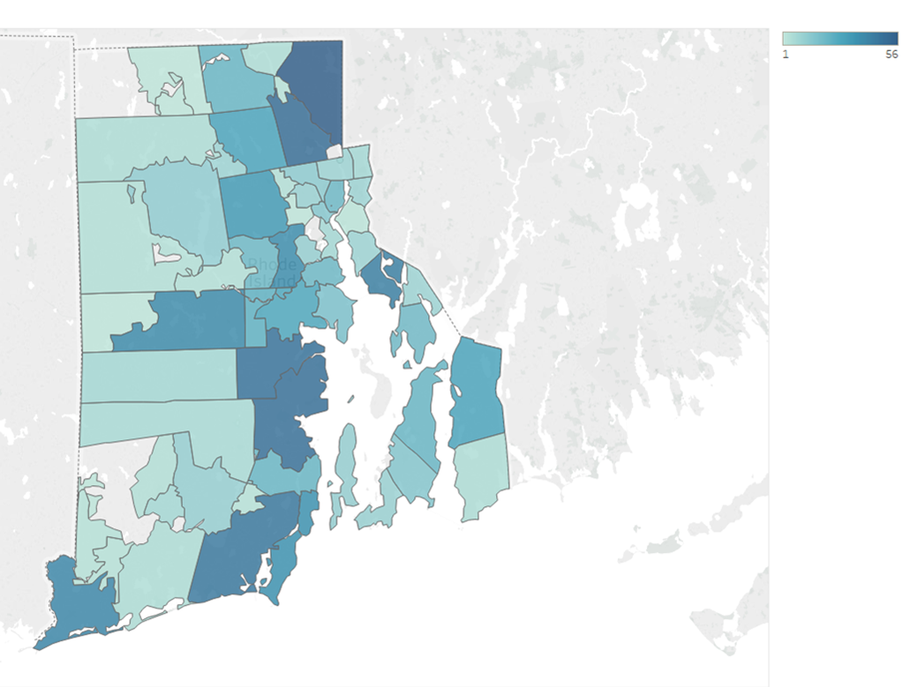
Pilots 2017
Demand Response C&I : The Connected Solutions Program for C&I Customers has exceed its goal of 5MW and signed up 6.7MW of demand response from 27 participating customers with two demand response events being called this summer.
Demand Response Residential: Over 1,200 residential customers now have new thermostats and are participating in the Connected Solutions program with nine demand response events being called this summer..
Connected Solutions Residential customers in RI

