Slide 1
Energy Efficiency Program Planning & Cost-effectiveness Analytical Components: Recap of 2017 and 2018 Retreats

Slide 2
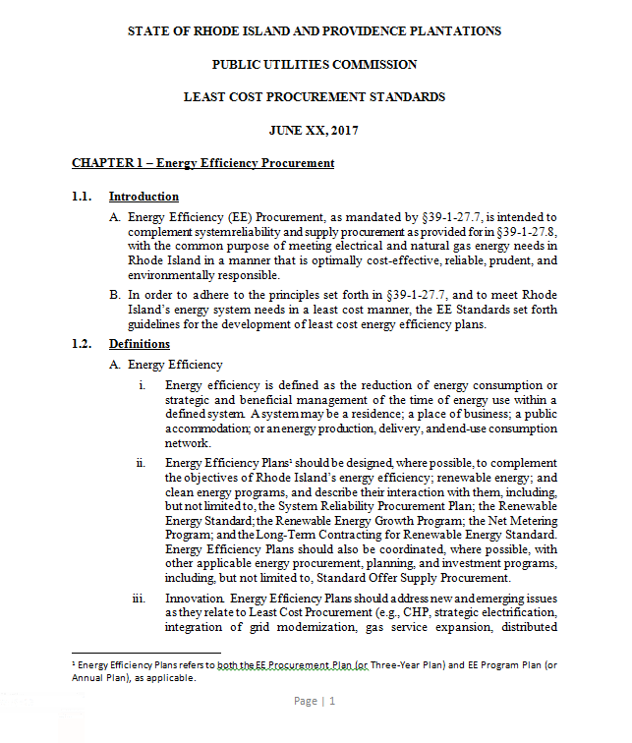
Least Cost Procurement Standards
About: The Standards are guidelines for least cost energy efficiency plans.
Last updated: June, 2017
Prescribed guidelines for:
Three-Year Plans
Annual Plans
System Reliability Plans
Notes:
Content Master: Danny, Courtney, and Kate

Slide 3
The Three-Year Planning Process At a Glance
‘17
‘18
‘19
‘20
Targets
Three-Year Plan
Plan
EM&V
EM&V
Plan
EM&V
Plan
EM&V
2020
2018
2019
Plan
Drafts
Implement
Plan
Drafts
Implement
Plan
Drafts
Implement
Annual Plans

Slide 4
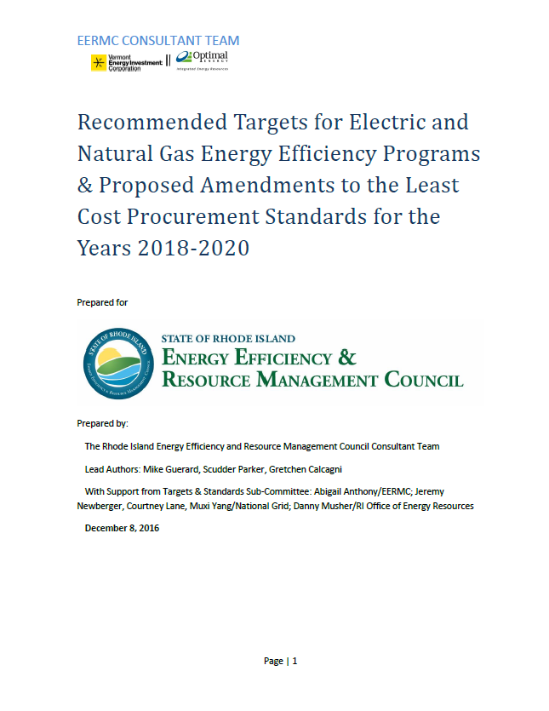
Setting Energy Savings Targets
Targets
EM&V
Three-Year Plan

Slide 5
Setting Energy Savings Targets
First step of the 3-year planning process.
EERMC responsible for drafting and filing with the PUC
Works closely with N-Grid, OER, and Collaborative.
Targets are set on a triennial basis and are completed a year in advance of a completed 3-year plan.
Targets cost-effective potential and proposes energy savings targets for PUC consideration.
Targets are developed to serve as guideposts as the utility develops its 3-Year Plan and more detailed Annual Plans.

Slide 6
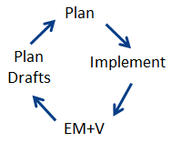
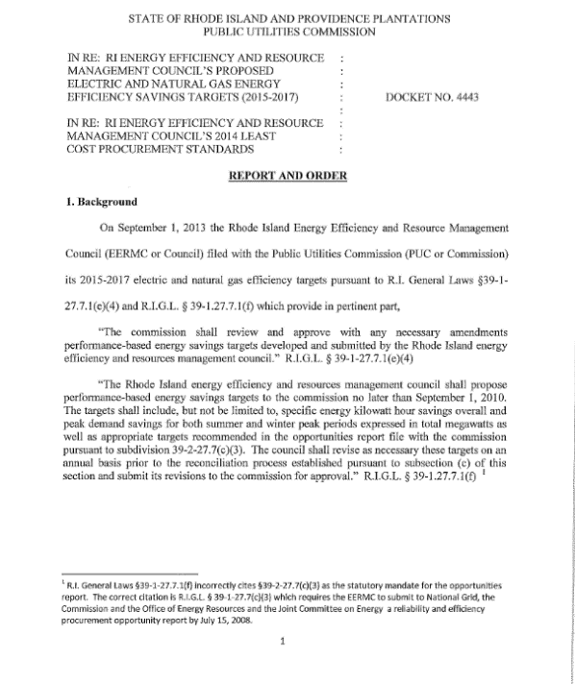
The Three-Year Plan
Three-Year Plans
Annual Plans
System Reliability Plans
Targets
Three-Year Plan

Slide 7
The Three-Year Plan
Due Triennially on September 1st.
N-Grid is responsible for drafting and filing.
N-Grid Works closely with EERMC, C-Team, OER, and the Collaborative to draft the Plan.
Primary Sections of the Plan:
Strategies & Approaches to Planning
Cost-Effectiveness
Prudence & Reliability
Funding Plan and Savings Targets
Performance Incentive Plan

Slide 8
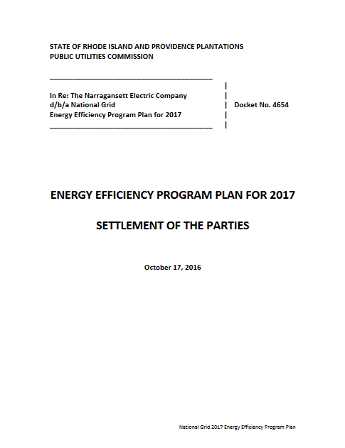
The Annual Planning Process At a Glance
Oct. 15th
Three-Year Plans
Annual Plans
System Reliability Plans
Annual Plan
Program Implementation Starts
Measurement & Verification
Program Drafts
August
January
Year-long
Notes:
Emily, Rachel/ Courtney, Becca-Carrie

Slide 9
The Annual Plan
Due on October 15^{th*}
National Grid responsible for drafting and filing.
Works closely with EERMC, C-Team, OER, and Collaborative.
Primary Sections of the plan:
Final Funding Plan and Budget Amounts, Cost-Effectiveness, and Goals
Program Descriptions
Monitoring & Evaluation Plan
Reporting Requirements
Performance Incentive Plan
* Due Nov. 1st when falling on a Three-year planning year.

Slide 10
Highlights of the Annual Plan
Portfolios are required to be cost-effective. Programs should be cost-effective.
“Rough parity” should be maintained between Residential and C&I.
Budget to show:
Projected costs,
Benefits and energy savings goals of each program,
Total Resource Cost of efficiency resources.
Identify energy cost savings and bill impacts that Rhode Islanders will realize.
The EERMC shall take a leadership role in ensuring that Rhode Island ratepayers receive excellent value from the Three-Year Plan being implemented on their behalf.
Source: Least Cost Procurement Standards

Slide 11
The Role of the EERMC
The Role of the EERMC for the three year and annual planning process:
Review/ provide Input on Plan drafts
Work with C-team to understand key topics/ issues
Develop and submit cost-effectiveness memo to the PUC
Sign on to the “Settlement of the Parties” (i.e. The Plan)
Notes:
Mike, Courtney, Becca

Slide 12
RI 2020 Annual Energy Efficiency Plan Timeline
I.D. Program Changes
Review/Complete Plan
Monitor Programs
Set Priorities
Draft Plan
PUC Technical Review (60 days)
Draft Plan
Review/Edit Plan

Slide 13
Key Factors that Inform the Annual Plan
Targets
The Rhode Island Benefit-Cost Test
(aka: The “Rhode Island Test”)
Program evaluations and pilots
Evolving markets
New and/ or improved technologies
State policy objectives

Slide 14
Variable Factors
“Innovation” - Evolving markets & new and/or improved technologies
Regulatory: Public Utilities Commission; Division of Public Utilities and Carriers
State & local policy objectives
Governor’s Office; OER
Municipalities
Other state agencies and quasi-agencies
Rhode Island Building Code Commission
Rhode Island Infrastructure Bank (RIIB)
Rhode Island Housing
Legislative
Notes:
There’s no links, because they are different and variable over time.

Slide 15
Who? National Grid’s Role
Responsible for developing and filing plan with Public Utility Commission (PUC)
A full team effort: many you see, many you don’t
Planning, strategy, implementation
Marketing, finance, legal
Notes:
Mike, Courtney, Becca

Slide 16
Who? The Technical Working Group (Formerly Known as “The Collaborative”) Role
The Technical Working Group (TWG) has been meeting regularly since 1991 to analyze and inform the National Grid’s electric and gas energy efficiency program planning processes including the Annual and Three-year Plans.
Members presently include National Grid, the Division, Green Energy Consumers Alliance, TEC-RI, Acadia Center, City of Providence and other stakeholders.
In addition, the OER and several EERMC members and representatives from the EERMC’s Consulting Team participate in the TWG group.

Slide 17
Who? OER’s Role
Participates throughout
Technical Working Group Meetings
Council Meetings
Monthly Program & Evaluation Meetings
Participates in PUC hearings
Actively Coordinates with C-Team, the DPUC, National Grid and other stakeholders to review
Evaluations & Studies
Program Quarterly and Annual Reports
Draft Annual Plans

Slide 18
Who? EERMC Consultants’ Role
Advise the Council through review, analysis, research, and reporting on relevant topics
Support the Council as it fulfills its responsibilities and reaches for its objectives
Represent the Council in public fora (e.g., Technical Working Group and PUC meetings); ensure that statements and representations are grounded in the Council’s legislated roles and responsibilities as detailed in the Least Cost Procurement Law and Standards
Notes:
Mike, Courtney, Becca
Representation of EERMC -- In the fulfillment of this EERMC-approved annual Scope of Works, the C-Team:
Engages in public forums, such as the Collaborative and PUC meetings, that are related to discussions and activities that support Least Cost Procurement and other EERMC objectives
Provides review, analysis, reports and communications in these forum on behalf of the EERMC based on the direction and expectations
Take the primary operating position that our statements and representations must be grounded in our knowledge of the EERMC’s legislated roles and responsibilities as detailed in the clear documentation and expectations set in the Least Cost Procurement Law”
Fully support any process with EERMC counsel, Executive Committee and/or full EERMC on additional mechanisms to assure we act fully in support of EERMC roles, responsibilities and objectives.

Slide 19
The Role of the EERMC
“Evaluate and make recommendations, including, but not limited to, plans and programs, with regard to the optimization of energy efficiency, energy conservation, energy resource development; and the development of a plan for least-cost procurement for Rhode Island;”
“Promote public understanding of energy issues and of ways in which energy efficiency, energy conservation, and energy resource diversification and management can be effectuated.”
http://webserver.rilin.state.ri.us/Statutes/TITLE42/42-140.1/42-140.1-3.HTM
Notes:
Leave this blank, or with a big ? – let them answer

Slide 20
Program Implementation
Program implementation runs on a calendar year (Jan. – Dec.).
National Grid, EERMC C-team, and OER meet monthly to:
Review program progress,
identify any types of program issues,
assure programs are moving along in a timely fashion, and
discuss strategies to continually improve programs.
Annual Plan
Program Implementation Starts
Measurement & Verification
Program Drafts
Notes:
Emily, Strategy teams, Becca/ Carrie

Slide 21
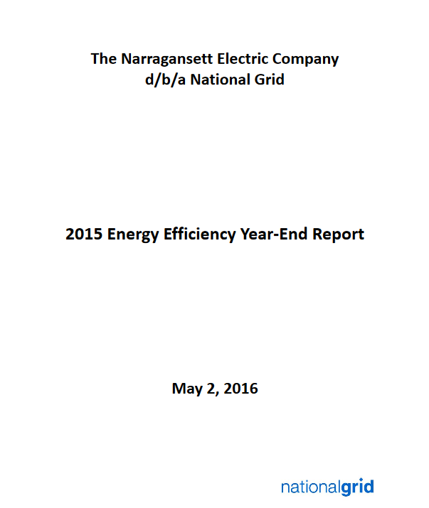
Program Reporting
“The distribution company, in consultation with the Council, will propose the content to be reported and a reporting format that is designed to communicate clearly and effectively the benefits of the efforts planned and implemented, with particular focus on energy cost savings and program participation levels across all sectors, to secure all EE resources that are lower cost than supply.”
Quarterly, and Annual Reporting
Source: Least Cost Procurement Standards
Notes:
Rachel and team

Slide 22
Evaluation, Measurement, & Verification (EM&V)
Targets
EM&V

Slide 23
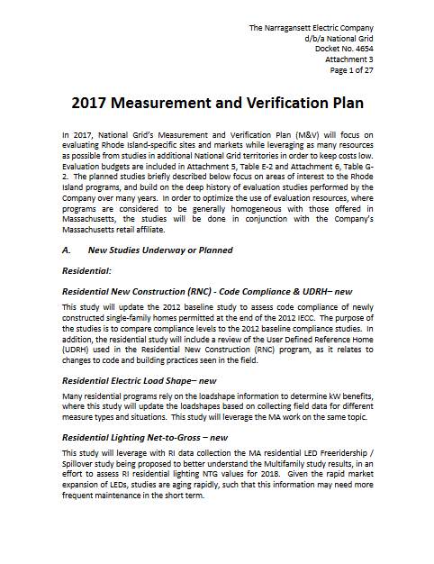
Rhode Island Measurement and Verification Plan
This Measurement and Verification (M&V) Plan shall address:
Savings verification, including where appropriate analysis of customer usage.
Verification should also facilitate participation in ISO-NE’s forward capacity market;
Issues of ongoing program design and effectiveness;
Efforts related to market assessment and methodologies to claim savings from market effects, among others;
Regional and other cooperative M&E efforts the distribution company is participating in, or plans to participate in; and
Longer-term studies, as appropriate, to assess programs over time.
Source: Least Cost Procurement Standards

Slide 24
Why do we do evaluations?
To understand how much energy savings is due to programs – Impact Evaluations
Methods include:
Billing analysis
Pre- and post-metering
Simulations and algorithms using nationally-vetted software and practices
To improve program delivery – Process Evaluations
Methods include:
Interviews
To understand market conditions & inform program planning – Market Evaluations
Methods include:
Interviews
Primary data collection
Simulations and algorithms based on economic/business theory
Notes:
We do evaluations for three reasons:
Tie back to annual EE plan

Slide 25
The Evaluation Team
Rhode Island Evaluation Team
Independent Evaluation Companies
Oversight Team
Mark Kravatz
C-team Evaluation Lead
Optimal Energy
Carrie Gill
OER Evaluation Lead
OER
Beth Hawkins
VP of Research Development
Ralph Prahl
Nationally-recognized evaluation expert
Prahl Consulting
Romilee Emerick
National Grid
Erin Crafts
National Grid
Glenn Reed
Energy Futures Group
Dave Jacobson
Consultant for National Grid
Jacobson Energy Research
George Lawrence
Optimal Energy
Adam Wirtshafter
Courtney Lane
Kevin Rose
Plus other subject matter experts as needed

Slide 26
RI Evaluation Team Involved Throughout
RI Evaluation Team identifies evaluation needs
RI Evaluation Team and Independent Evaluator refine scope of work and workplan
RI Evaluation Team reviews interim deliverables and provides feedback
RI Evaluation Team develops research question and scope for RFP
Findings incorporated into Energy Efficiency Annual Plan and Benefit-Cost Model
RI Evaluation Team provides input on all instruments
RI Evaluation Team reviews final deliverables
Final reports filed with PUC and posted on EERMC’s website
National Grid issues RFP and selects evaluator
Independent Evaluator incorporates feedback, collects data, conducts analysis, provides interim deliverables
Independent Evaluator incorporates feedback
Notes:
STEP 1: Try to evaluate all programs once every three years; needs informed by changing market conditions, technologies, and other factors.
STEP 3: Talk about data security
Allude to piggybacking – evaluation framework study ☺
Who does evaluation?
Independent evaluation companies conduct evaluation with oversight from EERMC and OER and input from EERMC, OER, and National Grid.
What oversight is there?
Oversight is provided through the EERMC’s consultant team and OER throughout the evaluation process, from idea conception through developing a scope of work and workplan and collecting data, to final reports that inform the planning process and are on file with the PUC.

Slide 27
System Reliability Plan
Three-Year Plans
Annual Plans
System Reliability Plans

Slide 28
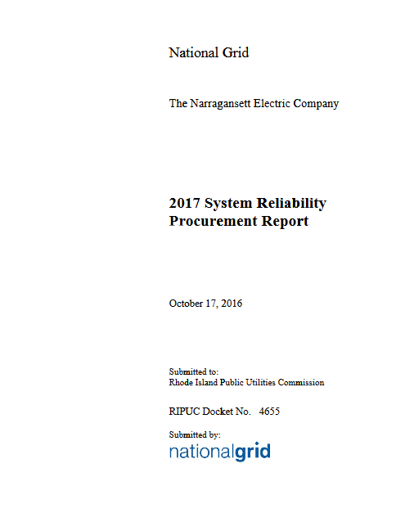
System Reliability Procurement (SRP) Plan
Due Annually and Triennially.
National Grid responsible for drafting and filing
Works closely with EERMC, C-Team, OER, and Collaborative
Described in Chapter 2 of the Least-Cost Procurement Standards.
The SRP Standards set forth guidelines for the incorporation of energy efficiency, distributed generation, demand response, and other energy technologies (collectively referred to as “non-wires alternatives” or NWA) into N-Grid planning.

