Slide 1
Residential Programs: An Introduction
05/17/2018
11:00 a.m. – 5:00 p.m.

Slide 2
Residential Programs

Slide 3


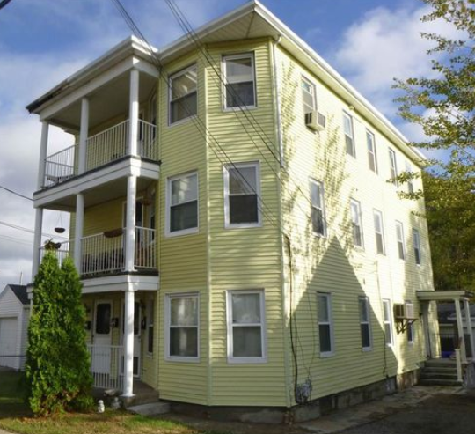
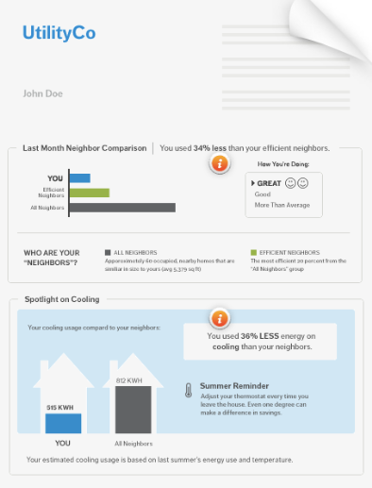
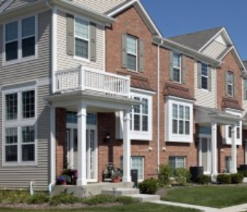

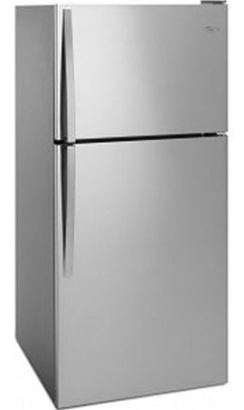
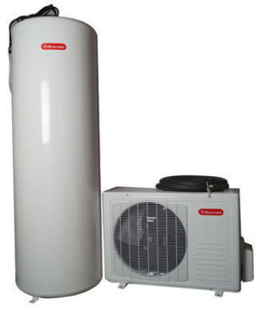
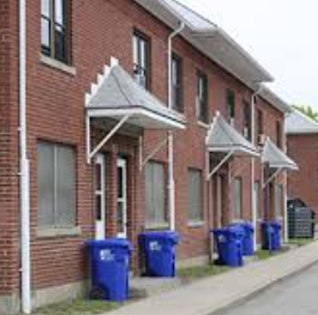
At a Glance
Single Family Market Rate
New Construction
Single Family Income Eligible
Home Energy Reports
Multi-family Market Rate
Energy Star® Lighting
Consumer Products
High-Efficiency Heating, Cooling and Hot Water
Multi-family Income Eligible

Slide 4
Single Family Market Rate

Slide 5
Single Family Market Rate –EnergyWise

Slide 6
Single Family Income Eligible Services

Slide 7
Single Family Income Eligible Services

Slide 8
Multi-Family Market Rate

Slide 9
Multi-Family Income Eligible Services

Slide 10
Multi-Family Market Rate and IES

Slide 11
New Construction

Slide 12
New Construction

Slide 13
Home Energy Reports

Slide 14
Home Energy Reports

Slide 15
Energy Star Lighting

Slide 16
Energy Star Lighting

Slide 17
Consumer Products

Slide 18
Consumer Products

Slide 19
Heating, Cooling, and Hot Water

Slide 20
Heating, Cooling, and Hot Water

