Slide 1
Commercial & Industrial Programs:
An Introduction
05/17/2018
11:00 a.m. – 5:00 p.m.

Slide 2
Commercial & Industrial Programs

Slide 3

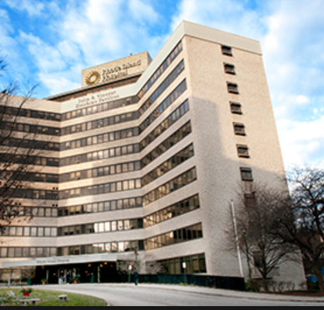
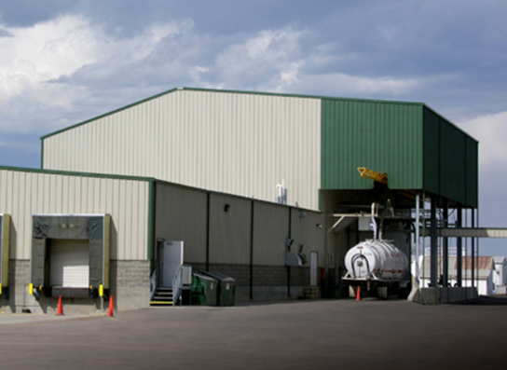

At a Glance
Small Business Direct Install
Large Commercial & Industrial Retrofit
Large Commercial & Industrial New Construction
Demand Response

Slide 4
Small Business Direct Install

Slide 5
Small Business Direct Install

Slide 6
Large C&I New Construction

Slide 7
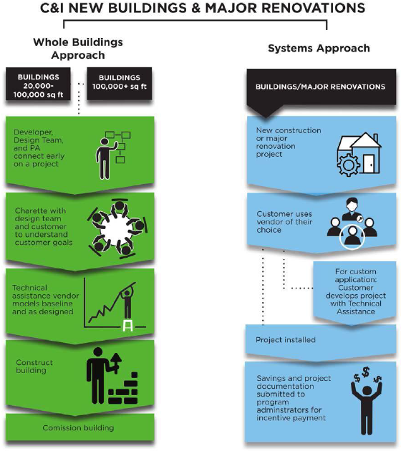
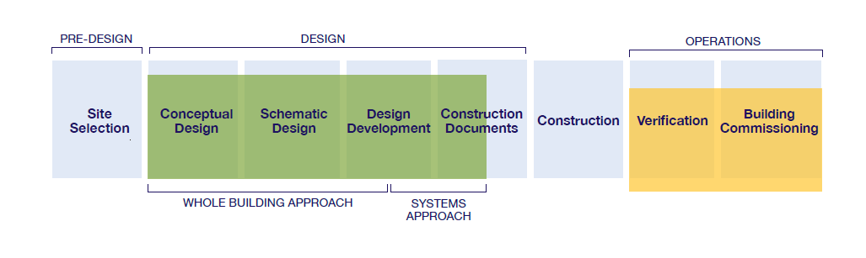
Large C&I New Construction
Large C&I New Construction Process

Slide 8
Large C&I Retrofit

Slide 9
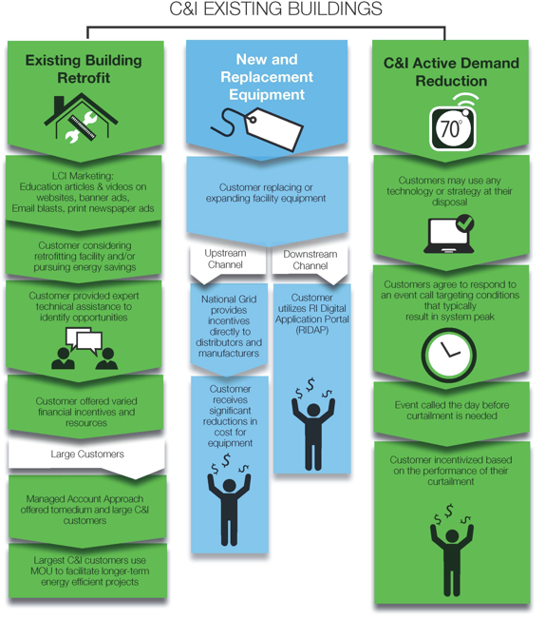
Large C&I Retrofit

Slide 10
Demand Response

Slide 11
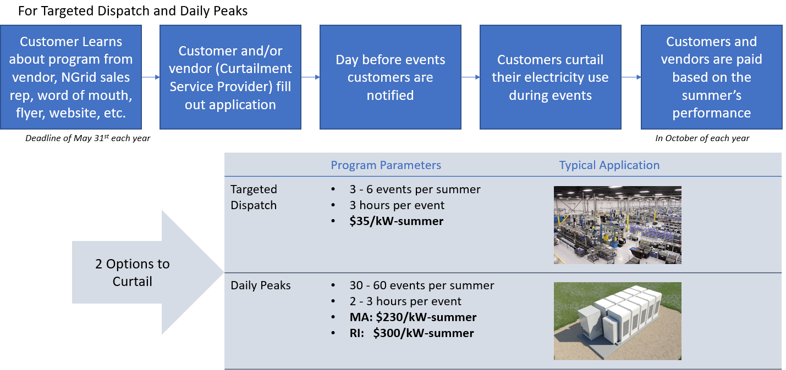
Demand Response

