Slide 1
Energy Efficiency Program Planning & Cost-effectiveness Analytical Components

Slide 2
Least-Cost Procurement: Timeline & Key Milestones
1996 RI enacted electric restructuring legislation AKA: Rhode island’s Public Utilities Restructuring Act of 1996.
Created the nation’s first public benefit fund
Funded through the SBC
Flat Fee set between 1996 and 2006
Only electric programs
2002: separated DSM (90%) and Renewable (10%) charges
2006: Rhode Island Comprehensive Energy Conservation, Efficiency, & Affordability Act (i.e. Least-cost Procurement)
Startup phase: 2006-2008
2008, Programs started
2010: Revenue Decoupling
2006: RI Comprehensive Energy Conservation, Efficiency and Affordability Act (i.e. Least Cost Procurement)
2012: First Triennial Plan Filed
1996 RI Public Utilities Restructuring Act
2010: Revenue Decoupling and LCP extended to gas
2006: Creation of first Natural Gas legislation
1996 – 2006 Flat fee set for electric programs only
2011: Targets set for 2012-2014 Triennial Plan

Slide 3
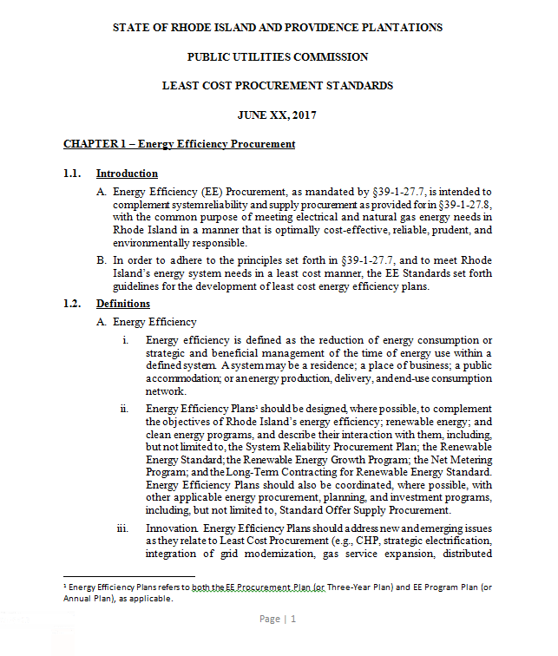
Least Cost Procurement Standards
About: The Standards are guidelines for least cost energy efficiency plans.
Last updated: June, 2017
Prescribed guidelines for:
Three-Year Plans
Annual Plans
System Reliability Plans
Notes:
Content Master: Danny, Courtney, and Kate

Slide 4
The Three-Year Planning Process At a Glance
‘17
‘18
‘19
‘20
Targets
Three-Year Plan
Plan
EM&V
EM&V
Plan
EM&V
Plan
EM&V
2020
2018
2019
Plan
Drafts
Implement
Plan
Drafts
Implement
Plan
Drafts
Implement
Annual Plans

Slide 5
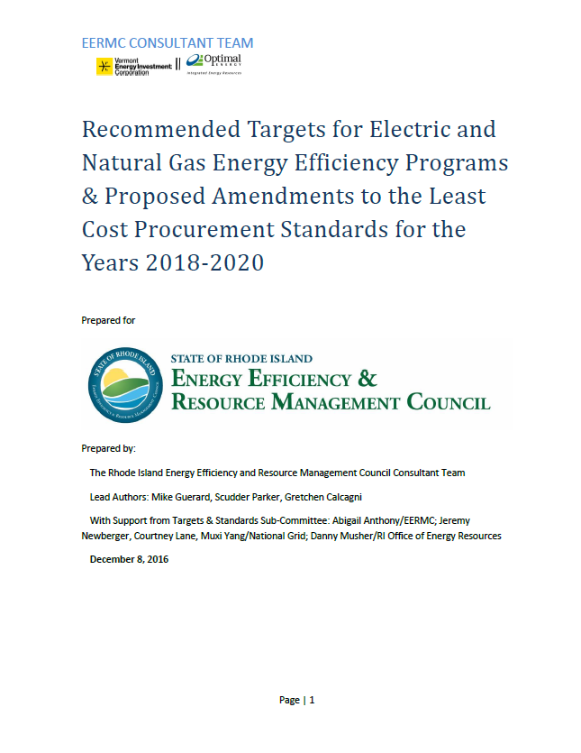
Setting Energy Savings Targets
Targets
EM&V
Three-Year Plan

Slide 6
Setting Energy Savings Targets
First step of the 3-year planning process.
EERMC responsible for drafting and filing with the PUC
Works closely with N-Grid, OER, and Collaborative.
Targets are set on a triennial basis and are completed a year in advance of a completed 3-year plan.
Targets cost-effective potential and proposes energy savings targets for PUC consideration.
Targets are developed to serve as guideposts as the utility develops its 3-Year Plan and more detailed Annual Plans.

Slide 7
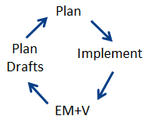
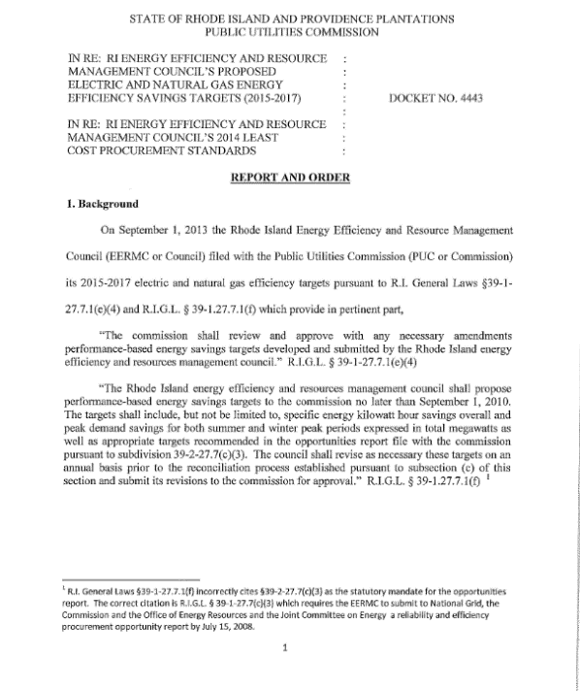
The Three-Year Plan
Three-Year Plans
Annual Plans
System Reliability Plans
Targets
Three-Year Plan

Slide 8
The Role of the EERMC
The Role of the EERMC for the three year and annual planning process:
Set Targets
Review/ provide Input on Plan drafts
Work with C-team to understand key topics/ issues
Develop and submit cost-effectiveness memo to the PUC
Sign on to the “Settlement of the Parties” (i.e. The Plan)
Notes:
Mike, Courtney, Becca

