Slide 1
Potential Studies
An Overview
Presented By: Sam Ross, Optimal Energy, Inc.
Date: July 17, 2019

Slide 2

Why a Potential Study?
  Quantify potential future energy efficiency savings
  Consider cost-effectiveness
  Account for realistic energy efficiency program and policy imple­mentation
  Evaluate efficiency relative to supply side resourc­es
  Formulate high-level program design, including savings targets and timelines

Slide 3

How are Potential Studies Used?
Set attainable savings targets
Quantify efficiency resources for system planning
Determine funding levels for energy efficiency programs
Design programs to achieve long-term potential
Reassess opportunities as economic condi­tions change
Account for changes in efficiency technologies

Slide 4
Potential Study Scenarios
    What’s possible with current and emerging technology?
Technical Potential
Economic Potential
    Of that, what is cost-effective?
Maximum Achievable
Of that, what would customers install with very aggressive efficiency programs?
Program Achievable
Of that, what would customers install with more realistic efficiency programs?

Slide 5
Rhode Island Potential Study
Next EE three-year plan developed in 2020
  EE targets need PUC approval in early 2020
How are targets set?
  Energy efficiency potential studies
  Other sources & analysis
Update RI potential
  Last potential study completed in 2010
3-Year Plan
Annual
3-Year Plan
Annual
Annual
Annual
Notes:
Prior study intended to cover 10 years, but was primarily useful for first three year cycle, marginally for second, and not really used in final three year cycle b/c so much had changed in the meantime

Slide 6
RI – Potential Study Scope
Scope | Details
Time Period | 2021 through 2026
Geography | All of Rhode Island (3 Utility Territories)
Covered Fuels | Electricity, Natural Gas, & Delivered Fuels
Key Areas Covered | - Energy Efficiency - Demand Response & Energy Storage - Combined Heat and Power - Emerging Technologies - AMF - Heating Electrification - Renewables
Potential Study Scenarios | - Technical - Maximum Achievable - Economic - Program Achievable

Slide 7
RI – Potential Study Timeline
Data collection and Analysis
Throughout 2019
3 year planning cycle
Interim results by Dec 31, 2019
(sufficient to plan Targets)
Annual planning cycle
Final results by March 2020

Slide 8

RI – Potential Study Team
Potential Study Manager
  EERMC Consultant Team (Optimal Energy, Inc.)
Policy Support and RFP Issuance
  Office of Energy Resources
Potential Study Implementation
  EERMC-selected contractor
Data Collection and Support
  National Grid
Additional Stakeholders

Slide 9
QuestionS?

Slide 10
Appendix A – MPS workflow

Slide 11
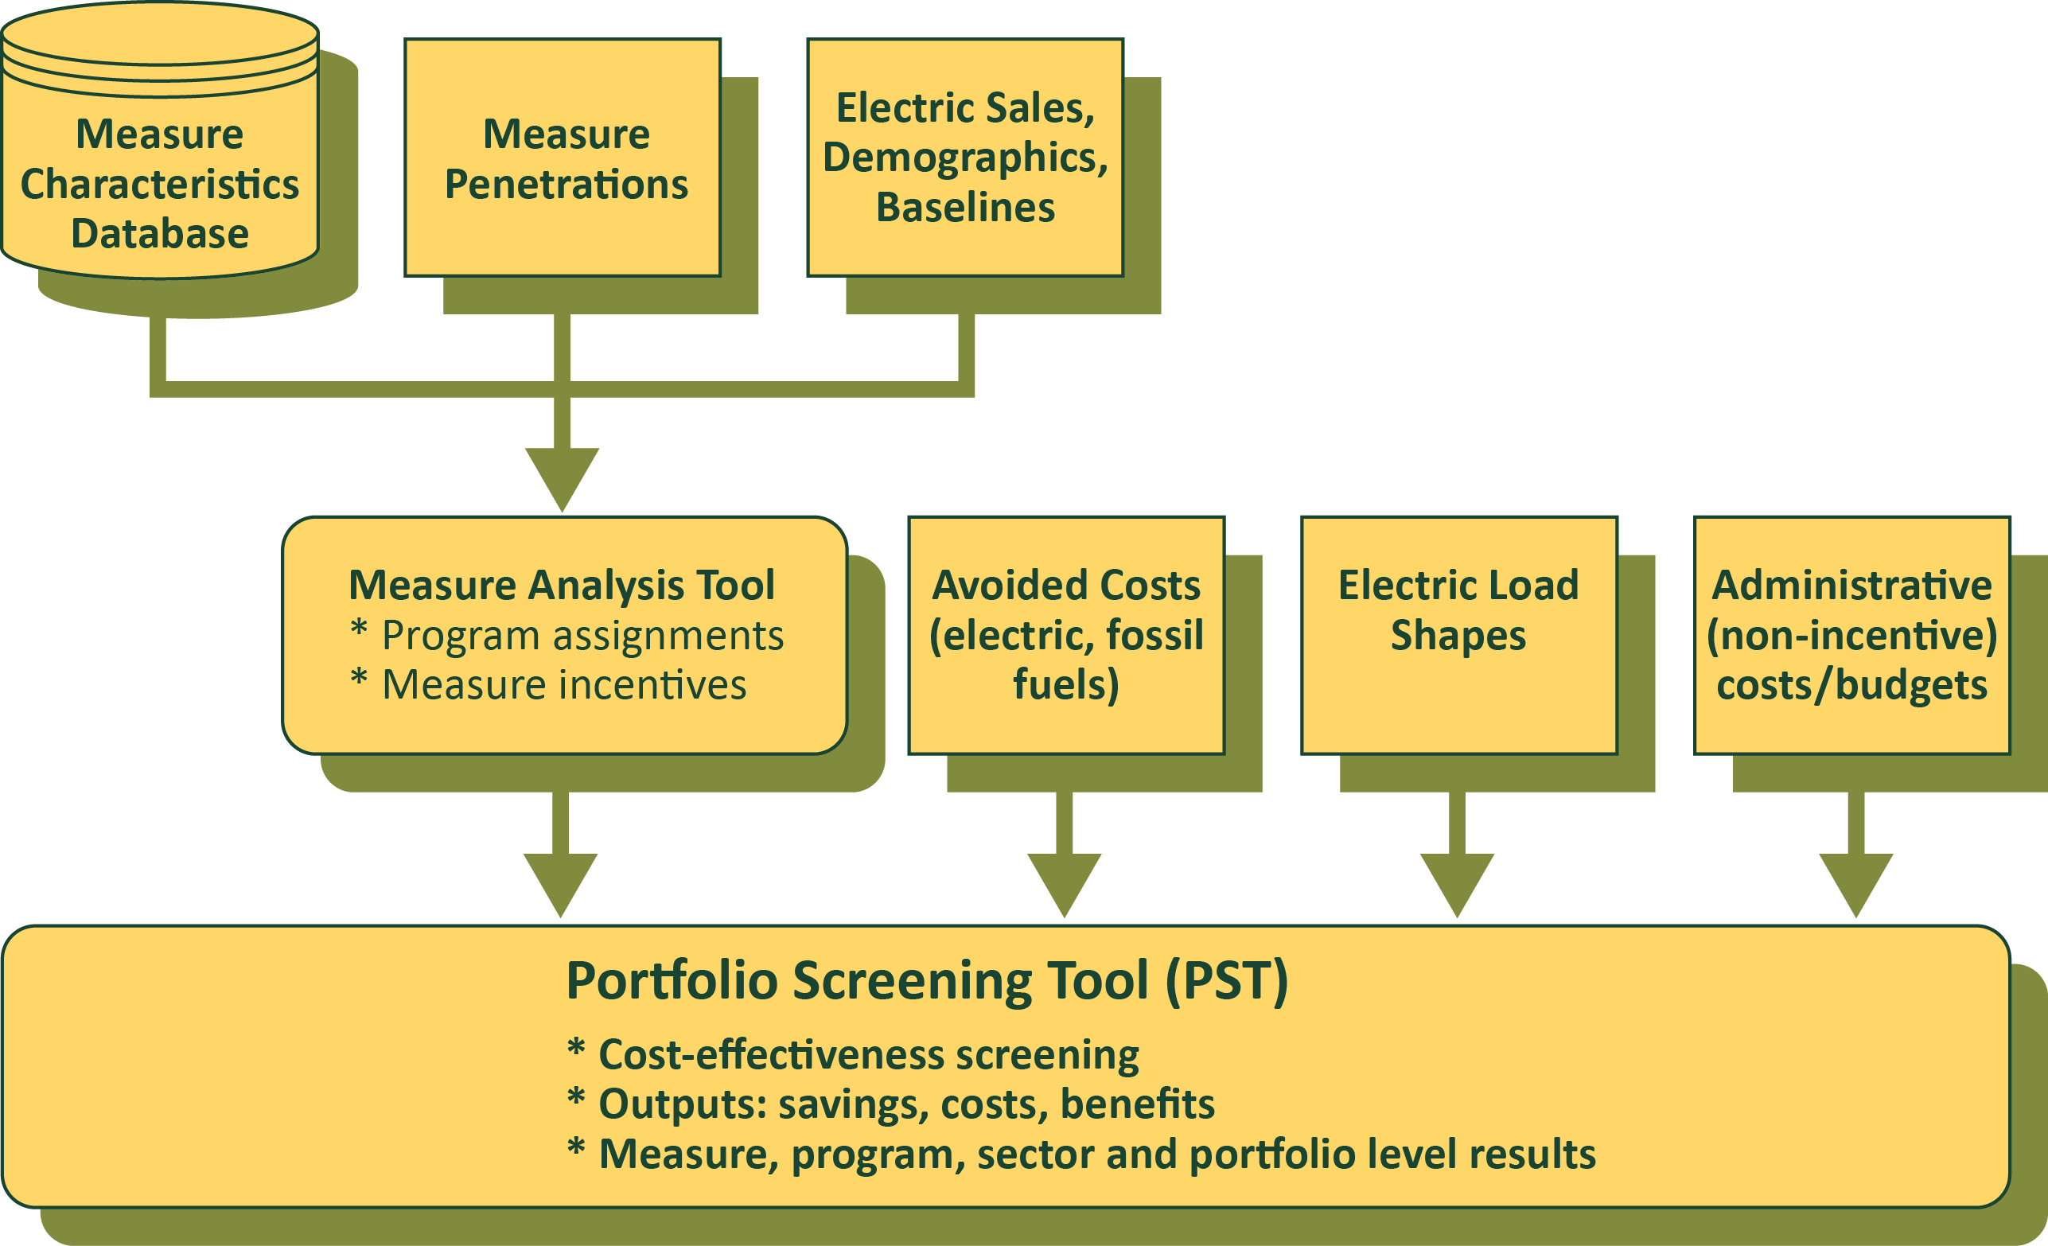
Analysis Workflow

Slide 12
Analysis Approach
Begins with energy sales forecast
    Broken down by sector, building type, and end-use
    Further disaggregated to individual measures
‘Top-down’ sales combined with ‘bottom-up’ measure level data
Measure savings = a percentage of total energy consumed by non-efficient equipment
Measure costs in terms of $/kWh
Penetrations as a percent of available savings in any given year
EE potential adds up net savings across measures and over time

Slide 13
Appendix b – measure example

Slide 14
Analysis Workflow

Slide 15
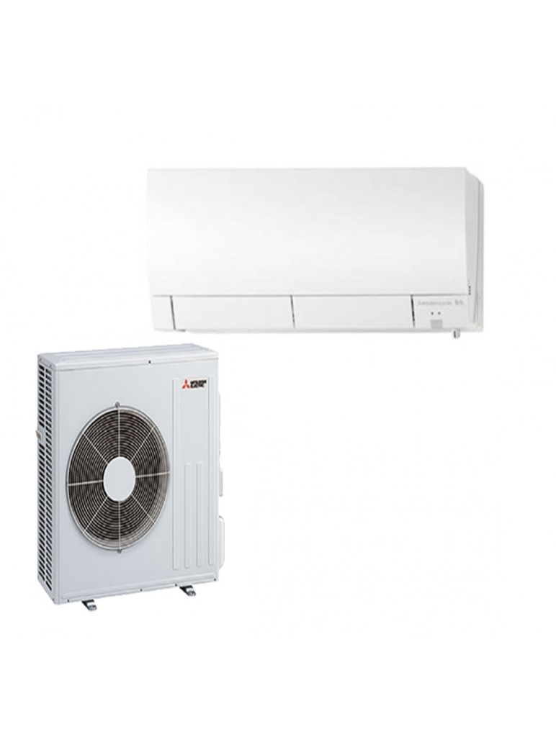
Key Measure Data Fields
Air Source Heat Pump
  Sectors | Commercial / Industrial / Residential
  Segment | Building Types / Demographics
  Market | Retrofit (RET) / Market Driven (MD)
  Primary Fuel | Electric (E)
  Primary End-Use | Space Heating
  Secondary Fuel | Electric, gas, and / or unregulated fuel
  Secondary End-Use | Cooling

Slide 16
Applicable End-Use Energy
Determined from the Sales Disaggregation & Equipment Saturations
By end-use and building type
  Applicability (to a particular technology)
  Feasibility (technically feasible)
  Turnover rate (replacement)
  Not-complete (retrofit)
Energy Savings | = | Sales (kWh or MMBtu) | x | Applicability Factor | x | Feasibility Factor | x | Turnover Factor (replace-ment only) | x | Not Complete Factor (retrofit only) | x | Savings Fraction | x | Net Penetration Rate
Applicable End-Use Energy

Slide 17
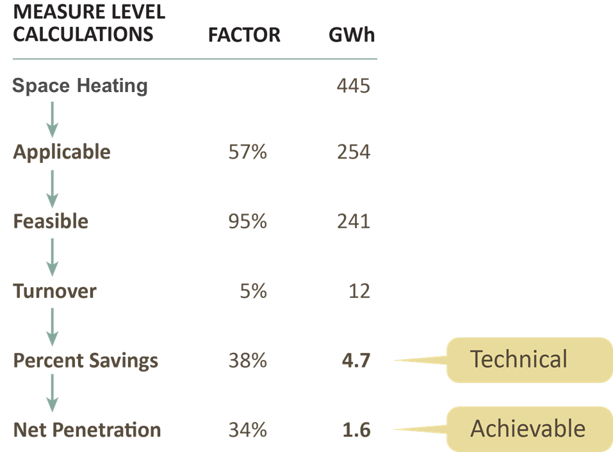
Measure Savings Calculation

Slide 18
Appendix C – Other Inputs

Slide 19
Analysis Workflow

Slide 20
Avoided Costs
Estimates of current and future costs for energy and capacity on the margin
Used to calculate $ benefits of saved energy and capacity
Avoided cost components typically include:
  Generation (electric) or commodity (gas) energy
  Peak capacity
  Transmission and Delivery capacity

Slide 21
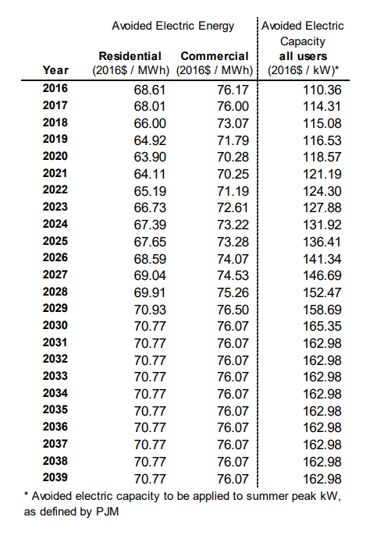
Avoided Costs Example
Costs change over time
Different cost streams
  E.g. Energy and Capacity
May have sector level values
Typically Energy, Capacity, T&D
Separate for gas

Slide 22

Avoided Emissions
CO2e, SOx, Nox
Electric (tonne/kWh) and Gas (tonne/MMBtu)
Factors for energy generation offset on the margin
Monetized benefits as externalities

Slide 23
Load Shapes
Distribute annual savings by energy period
Generally by end use and building type
Can derive from hourly 8760 usage data
    Specific to geographic region & climate

Slide 24
Peak Coincidence Factors
Portion of demand reduction occurring at peak demand
Can derive from 8760 usage data
  Based on max kWh/kW ratio

Slide 25
Appendix d - Results

Slide 26
Cost-Effectiveness Screening
Fully accounts for technology impacts, including capital, fuel, water, operation and maintenance, and other quantifiable non-energy impacts (NEIs)
Captures benefits, calculated using annual values of long-run avoided costs of electricity, gas, and other resources
Accounts for various timing effects, such as baseline shifts and capital expenditure deferrals
Conduct standard cost-effectiveness test – propose using Total Resource Cost (TRC) test for decision-making purposes

Slide 27
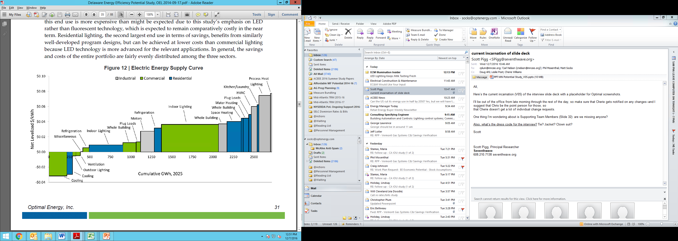
Example ‘Cost of Supply’

Slide 28
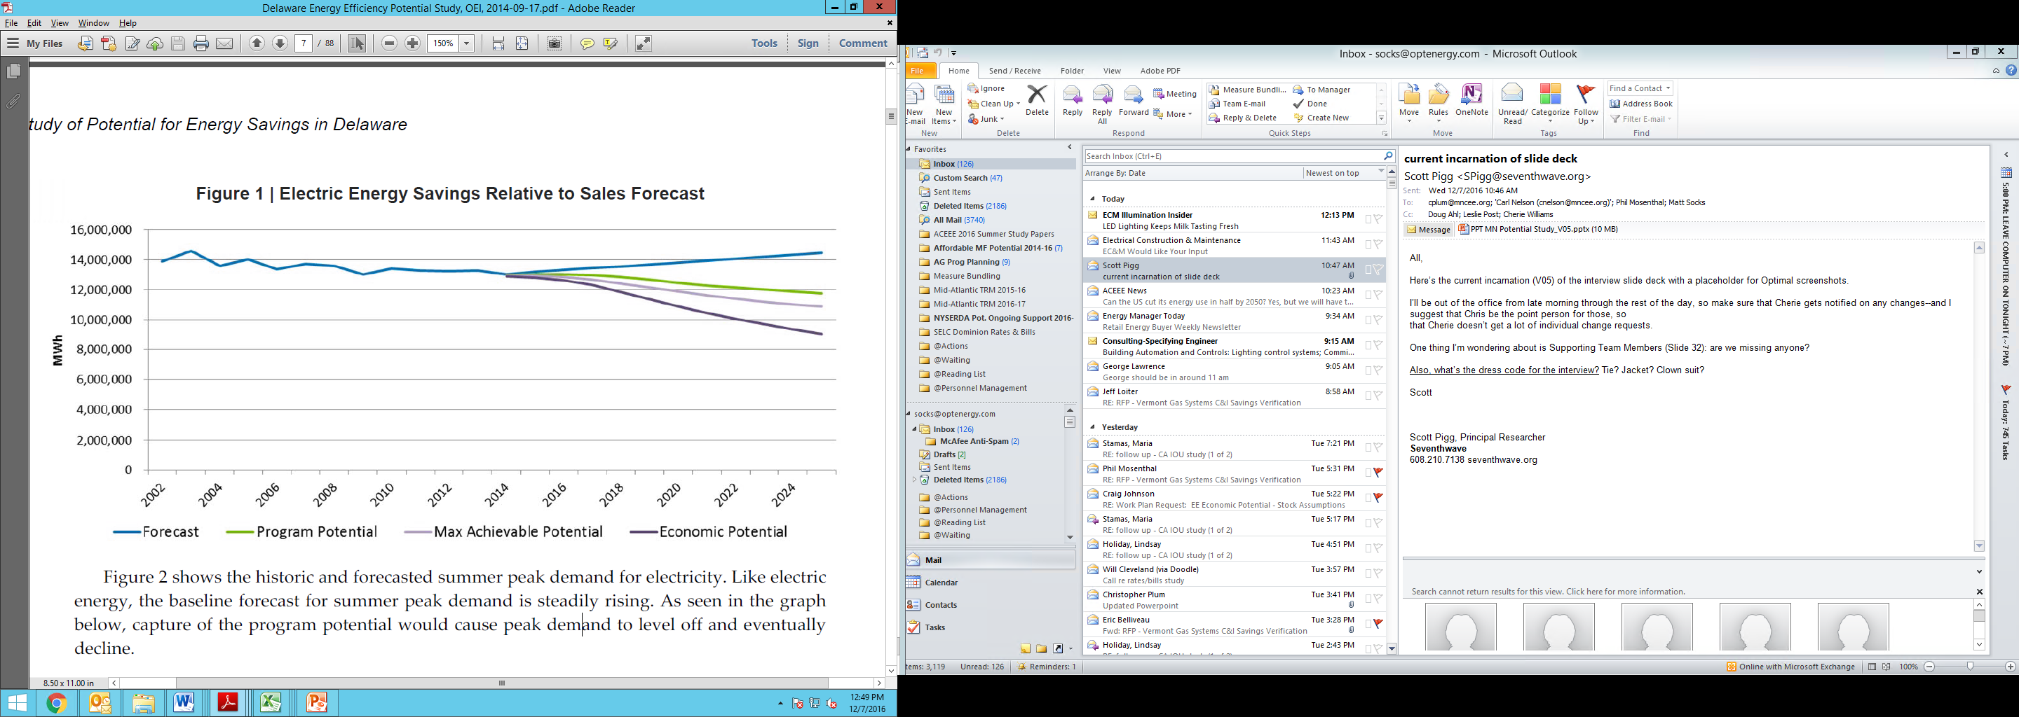
Scenario Savings

Slide 29
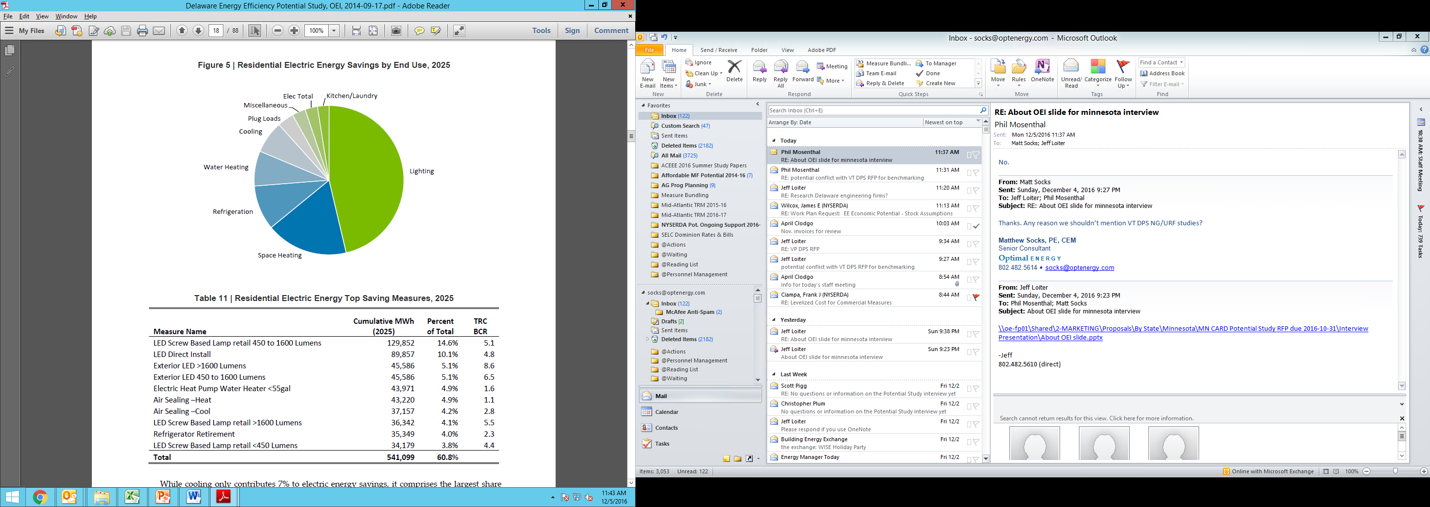
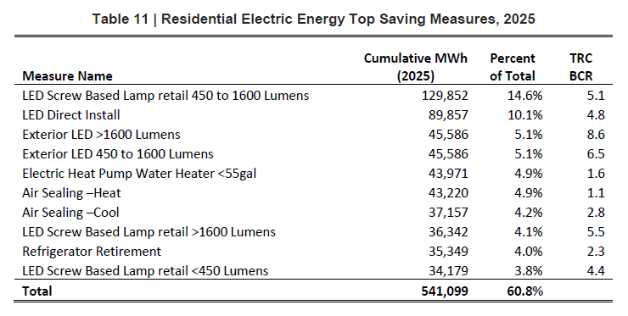
Savings by Measure; End Use

