Slide 1
2020 Energy Efficiency Program Plan & Systems Reliability Procurement Plan
Next Steps
EERMC Council Meeting September 19, 2019
Presentation by EERMC Consultant Team

Slide 2
Status of Key 2020 Plan Issues
Savings and Budget – still believe there is a gap here (e.g. acquisition costs)
Bill Impacts & Cross Program attachments – received for 1st time with third draft
Unanswered questions
  C-Team: A few outstanding BC Model questions; overarching data transparency
  Stakeholders: The Division and TEC-RI have outstanding questions as well
EBF - data and language supporting funding; determine funding source
Program Incentive Mechanisms (PIMs) – confirm in 3rd draft
Combined Heat and Power (CHP) – confirm in 3rd draft

Slide 3
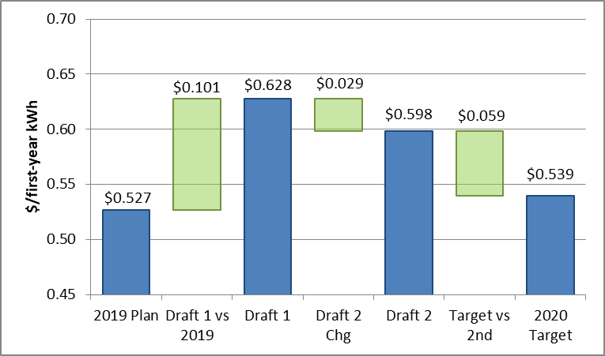
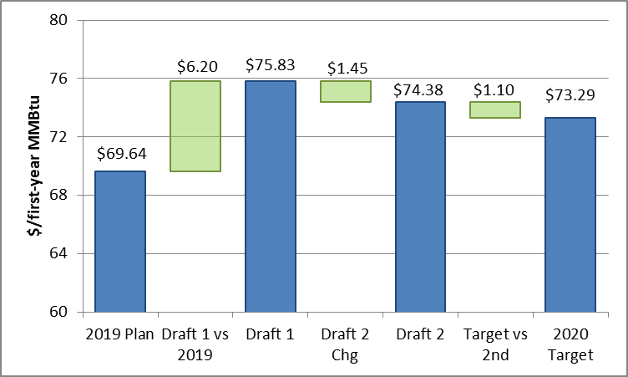
Annual Savings Acquisition Cost
Electric Portfolio Estimated Acquisition Cost
Gas Portfolio Estimated Acquisition Cost
The data in these charts was calculated as (implementation budget) / (total annual savings)

Slide 4
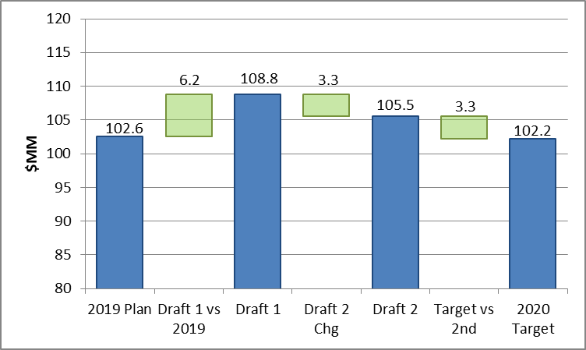
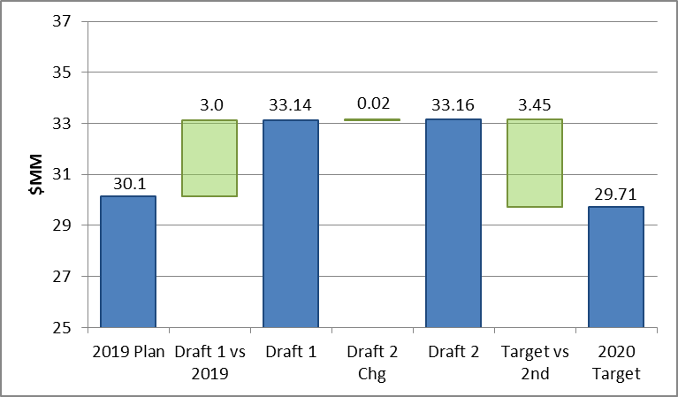
2020 Annual Plan Budget
Electric Implementation Budget ($MM)
Gas Implementation Budget ($MM)

Slide 5
Budget Shift Drivers
Commercial & Industrial Sector (C&I) Electric responsible for half of electric budget increase
  Even larger increase in Large Commercial Retrofit program offset by reductions elsewhere in C&I, especially Small Business Direct Install
Single Family Income Eligible Program is showing a large electric budget increase
C&I Gas responsible for 75% of gas budget increase
  Driven by Large Commercial Retrofit, Commercial Pilots, and Finance program budget increases
Other gas increases in Single Family Income Eligible and Energy Star HVAC

Slide 6
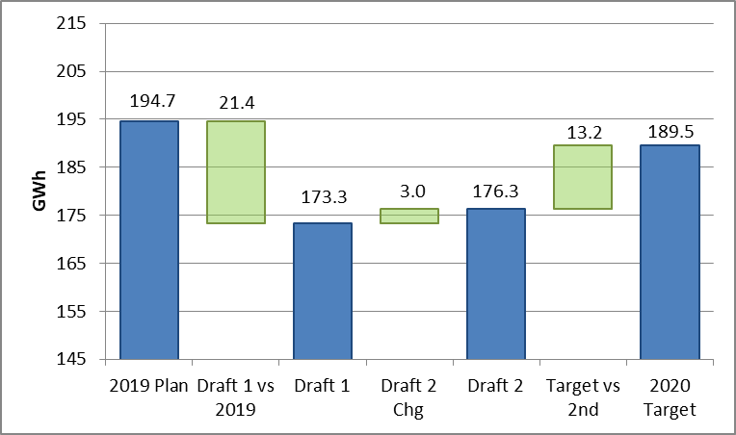
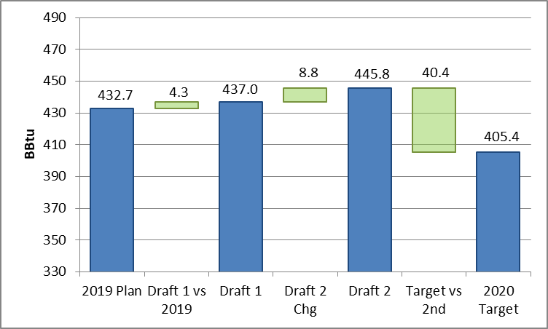
2020 Annual Plan Savings
Electric Portfolio Savings (Annual GWh)
Gas Portfolio Savings (Annual MMBtus)

Slide 7
Savings Shift Drivers
Electric decrease 50% due to Residential Energy Star Lighting
However, significant decreases elsewhere, including programs with sizable budget increases
Gas savings increases driven by Large Commercial Retrofit & New Construction, Energy Star HVAC, SF Income Eligible
Areas of increased savings more closely match areas of increased budget in gas

Slide 8
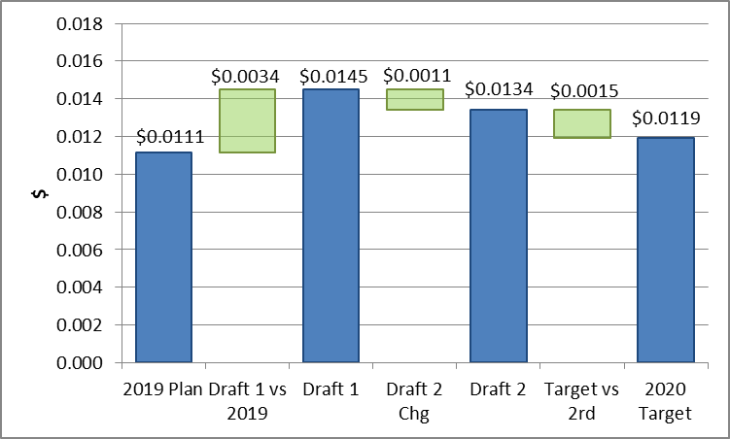
System Benefit Charge
Sizable increase compared to 2020 target from 3-year plan
  Driven by inter-year reconciliation
Came down significantly from 1st draft
2020 target still represents a >7% increase from 2019

Slide 9
Next Steps
2020 Plan
Resolution on key 2020 plan issues by October 3 meeting
E.g. budget, savings, outstanding questions, EBF, PIMs, CHP
Prompt delivery of 3rd draft BC Model
Need to review text & BC Model, ask questions, receive & assess answers
Vote on 2020 plan (3rd draft + final changes) at EERMC October 3 meeting
Future Planning Cycles
Prompt and comprehensive deliverables (drafts, BC Models, responses to questions)
More transparency into details of changes from prior year
Data granularity in BC models (especially C&I), clarity on forecasting methods
Explanation of changes – why there are changes, not just what they are
Year-End Report must have a BC Model version delivered

Slide 10
Timeline

Slide 11
APPENDIX

Slide 12
Program-Level Budget Shifts
Electric Programs
Gas Programs

Slide 13
Program-Level Savings Shifts
Electric Annual MWh Savings
Gas Annual MMBtu Savings

