Slide 1
Modernizing Energy Management:
Solutions for Data-Driven Energy Efficiency
Thursday, December 5, 2019
Robert J. Higgins Welcome Center

Slide 2
Sustainability in Manufacturing: Cutting-Edge Engineering Innovations Manufacturers Need to Know
DR. VALERIE MAIER-SPEREDELOZZI
Associate Professor, URI Department of Industrial & Systems Engineering
Global warming, a growing world population, and the development of global markets have shifted companies toward a new paradigm– sustainable manufacturing. Dr. Maier-Speredelozzi will share her research on how equipment decisions and production routings can be characterized in terms of their sustainability; she’ll propose an approach for use in identifying opportunities for sustainable manufacturing.
Dr. Valerie Maier-Speredelozzi earned her Ph.D. and dual Master’s degrees from the University of Michigan in Mechanical Engineering and Industrial and Operations Engineering, respectively. Her research interests include lean manufacturing, sustainability, healthcare, human factors and system design. For more information about Valerie’s research and teaching interests, please visit www.linkedin.com/in/valerie-maier-speredelozzi-1a12882/.

Slide 3
Sustainability in Manufacturing: Cutting-Edge Engineering Innovations Manufacturers Need to Know
Associate Professor Valerie Maier-Speredelozzi
Graduate Student Christoph Gerdes
Mechanical, Industrial and Systems Engineering

Slide 4
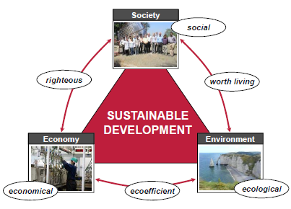
Sustainable development
“…meet the needs of the present without compromising the
ability of future generations to meet their own needs”
(Brundtland-Report, 1987)
Triple bottom line must also be considered in manufacturing
(Herrmann et al., 2014)
New paradigm of manufacturing: Sustainable Manufacturing
(Thiede, 2012)
(Herrmann, 2010)

Slide 5
Sustainability Definition
Sustainability
LEAN
GREEN
HUMAN
Notes:
LEAN: Delivering products and services with added value optimizing economic efficiency
GREEN: Reducing the environmental impact of production, usage and end-of-life phases of products
HUMAN: Determining impact and interaction of humans with engineered systems
Sustainable manufacturing or making sustainable products – or both!

Slide 6
Motivation
Rising energy prices
Actions of industrial companies for a more sustainable manufacturing are required
(Duflou et al., 2012)
Bring economic, ecological, and social goals to an agreement (Thiede, 2012) (Reich-Weiser et al., 2010)
Need to take sustainability into account for routing decisions
Global emissions
Growing world population
(Bunse et al., 2011)
(Herrmann, 2010)
(Duflou et al., 2012)
(Thiede, 2012)

Slide 7
Objective
Develop a method for manufacturing companies to make sustainable routing decisions
Ensure practicality (case study approach)
Define performance indicators to assess sustainability
Provide guidelines for decision making
Establish a general method that is scalable for various applications

Slide 8
Approaches for sustainable manufacturing
supply chain level
Energy Flows
Electrical energy
system level
Compressed air
(Thiede, 2012)
(Saidur et al., 2010)
machine level
(Drake et al., 2006)
(Gauchel, 2006)
Material Flows
Lubrication oils
Material waste
product level
(Sarhan et al., 2012)
(Saidur et al., 2010)
(Miller et al., 2007)
(Gauchel, 2006)

Slide 9
Evaluation Techniques
Sustainable Value Stream Mapping (Sus-VSM)
Life Cycle Assessment (LCA)
Visualize the manufacture of a product
Show material and information flows
Add metrics to display the sustainability of processes to traditional VSM
Different approaches in literature
Evaluate the environmental impact of processes and products
Considers the total life cycle of a product
Approach can be streamlined for specific purposes
(Kuriger & Chen, 2010)
(Faulkner & Badurdeen, 2014)
(Hochschorner & Finnveden, 2003)
(Erlach & Westkämper, 2009)
(Todd & Curran, 1999)

Slide 10
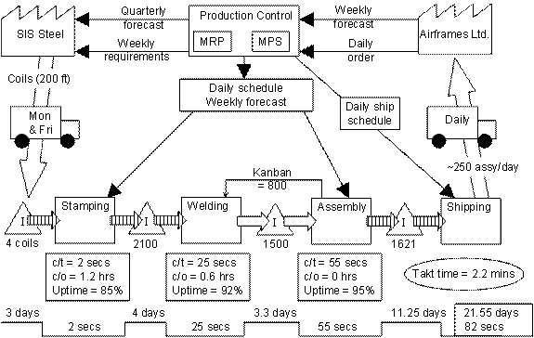
VSM: Value Stream Mapping
http://www.leansimulations.org/2011/09/value-stream-map-examples.html
Notes:
Raw material phase is responsible for 95% of environmental impact

Slide 11
SUS-VSM: Sustainable Value Stream Mapping
Faulkner, Badurdeen (2014)
Notes:
Raw material phase is responsible for 95% of environmental impact

Slide 12
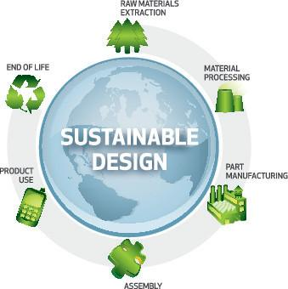
LCA: Life Cycle Analysis
Notes:
Raw material phase is responsible for 95% of environmental impact

Slide 13
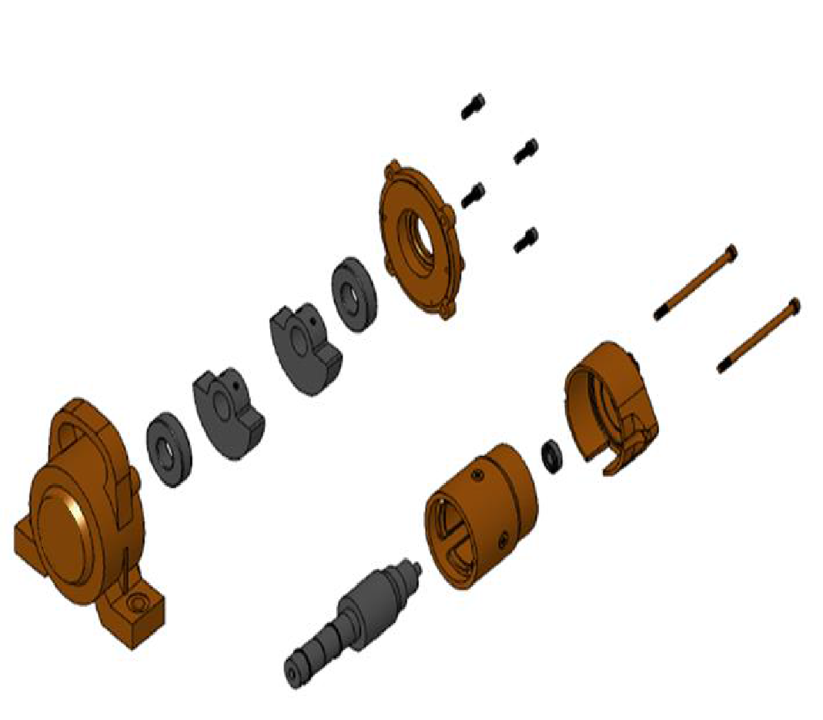
Cost and Environmental Impacts

Slide 14
Obstacles for Manufacturing Companies
Categories:
Market failure
Organizational
Institutional
Behavioral
Lack of metering capabilities
Lack of financial resources
Lack of expertise and training
Tradeoffs between performance factors
Gap between literature and practice
New method must consume less resources and must be
easily applicable in companies
(Chai & Yeo, 2012)
(Chai & Yeo, 2012)
(Thiede et al., 2012)

Slide 15
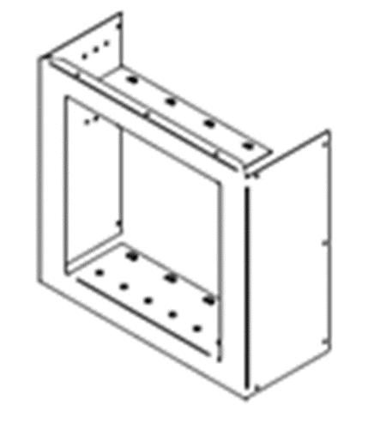
Methodology
Process Mapping
Case Study Approach:
Company in the thermal management industry
Medium-sized plant
Certain size of product family
Front case is investigated
Functional unit: One part
Data Acquisition
Selection of Metrics
Measuring Procedure
Data Visualization
Data Analysis

Slide 16
Flexible Routing
Routing = Sequence of workstations to produce a part or product
(Hopp and Spearman, 2001)
Flexible Routing to:
Face unpredictable events (Browne et al., 1984)
Avoid deadlocks
(Lawley, 1999) (Ezpeleta et al., 2002)
Optimize a production system in terms of costs and times
(Yao & Pei, 1990)

Slide 17
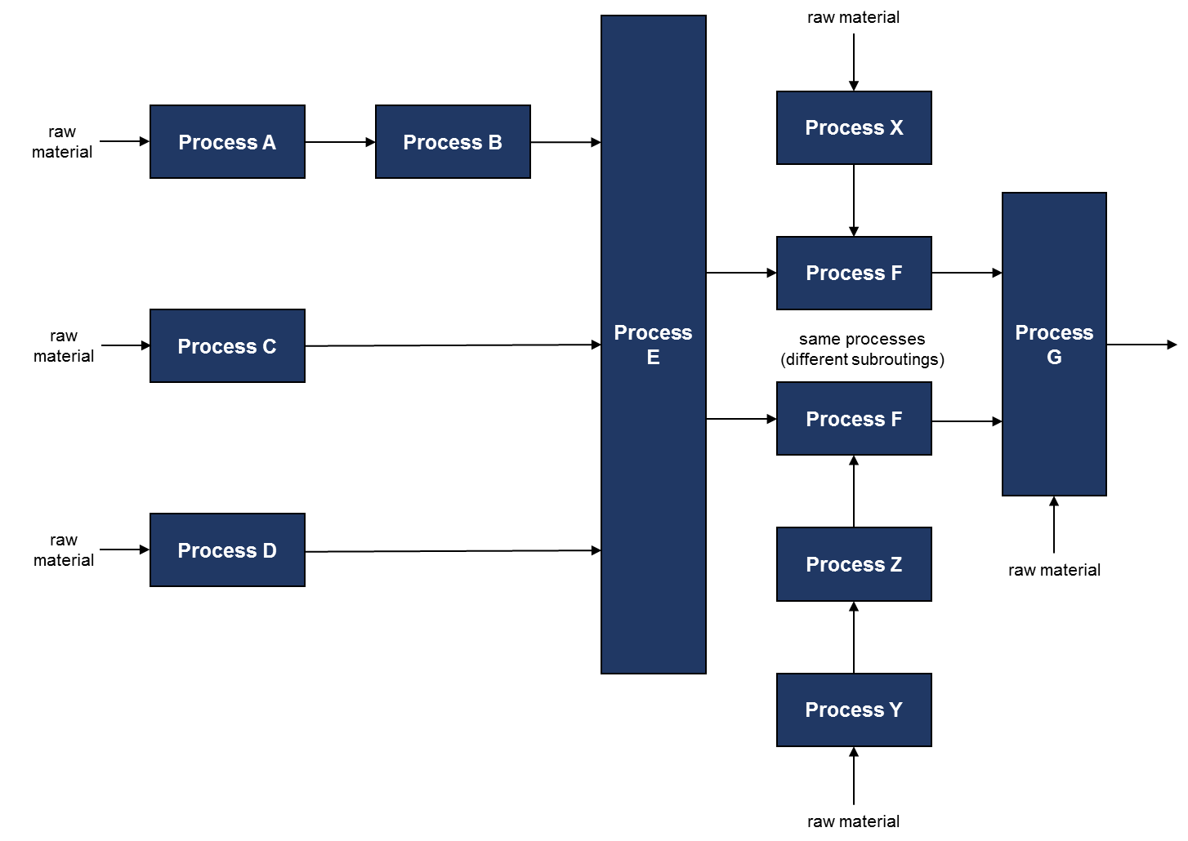
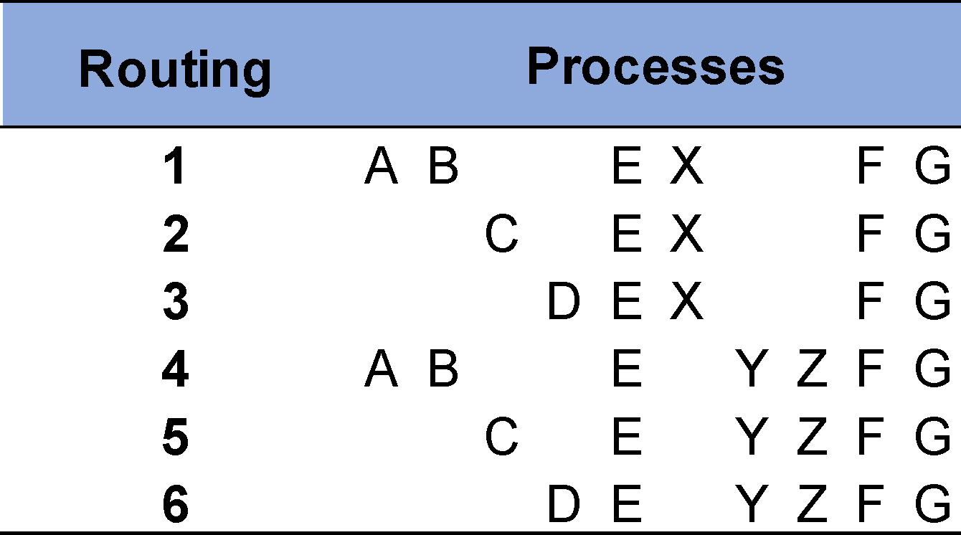
Process Mapping
6 possible routings

Slide 18
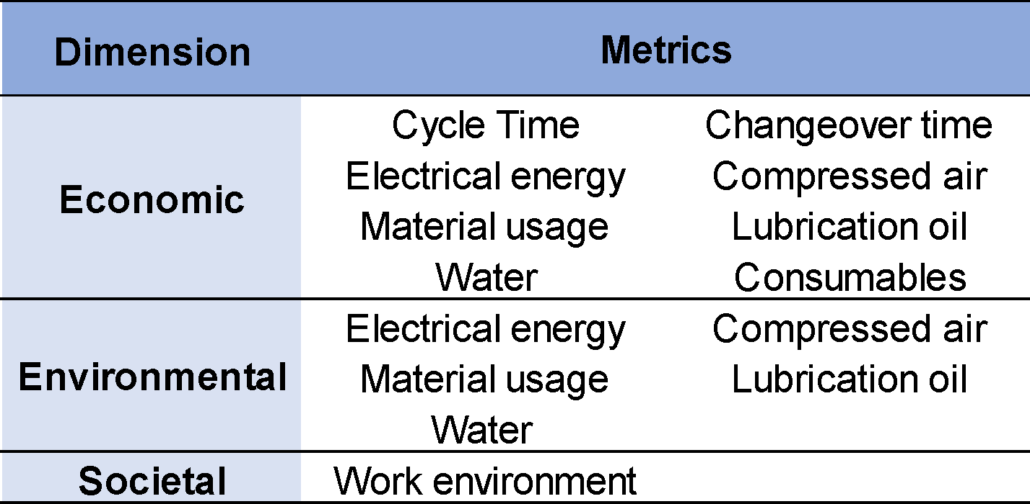
Data Acquisition
Selected Process Metrics:
Data is collected from available information or measured on the shop floor
Gathered data is processed for functional unit
Procedure and calculations are explained

Slide 19
Example: Compressed Air
Measuring Procedure:
𝐸𝑛𝑒𝑟𝑔𝑦 𝑐𝑜𝑛𝑠𝑢𝑚𝑝𝑡𝑖𝑜𝑛 (𝐶𝐴) = 𝐶𝑜𝑛𝑠𝑢𝑚𝑝𝑡𝑖𝑜𝑛 𝑟𝑎𝑡𝑒
×𝑇𝑖𝑚𝑒
×𝐿𝑒𝑎𝑘𝑎𝑔𝑒 𝑓𝑎𝑐𝑡𝑜𝑟
×𝐺𝑒𝑛𝑒𝑟𝑎𝑡𝑖𝑜𝑛 𝑒𝑓𝑓𝑖𝑐𝑖𝑒𝑛𝑐𝑦
Amount of compressed air per time is measured
Consumed volume per part is identified by multiplication with processing time
Leakage factor accounts for losses in pipe lines
Generation efficiency of compressor is identified to assess energy consumption

Slide 20
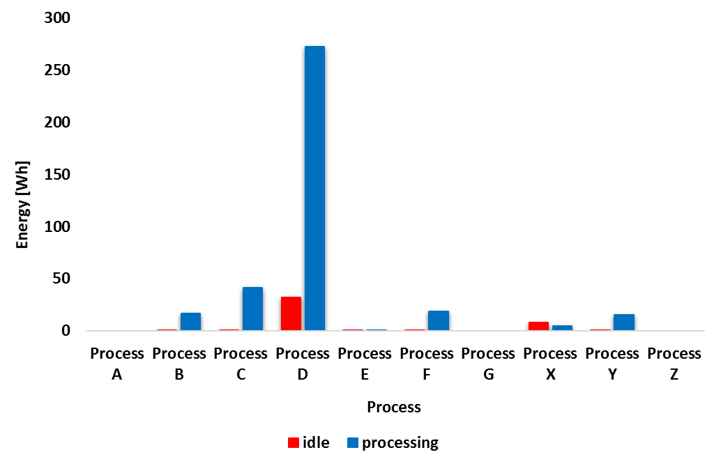
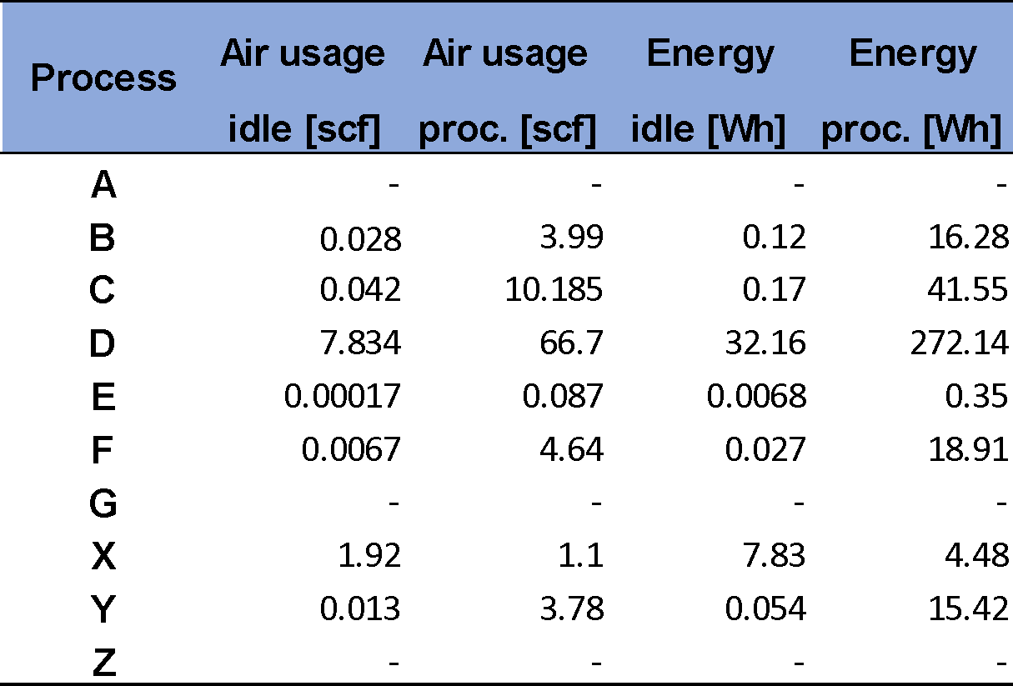
Example: Compressed Air
Measurement Results:

Slide 21
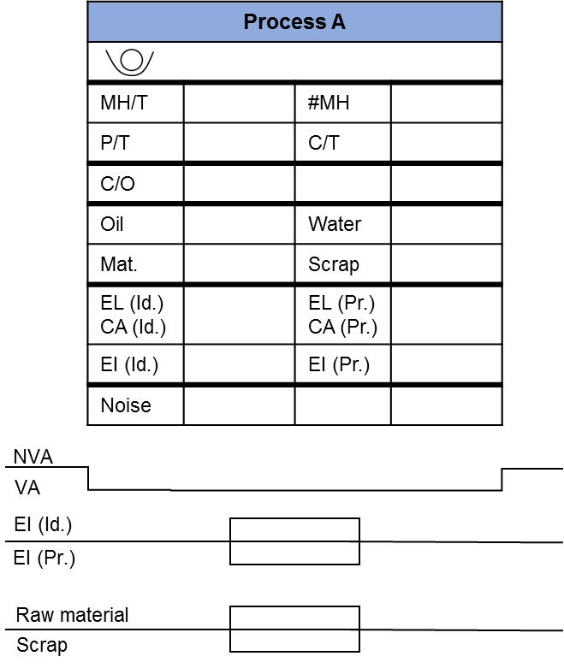
Data Visualization
Material handling time
Number of material handlings
Sustainable value stream mapping:
Processing time
Cycle time
Data box to display sustainability of processes
Inventory data for routings
Information flow to control the production
Changeover time
Water usage
Oil usage
Scrap
Raw material
Electrical energy and Compressed air
Noise level
Energy Intensity (Idle + Processing)

Slide 22
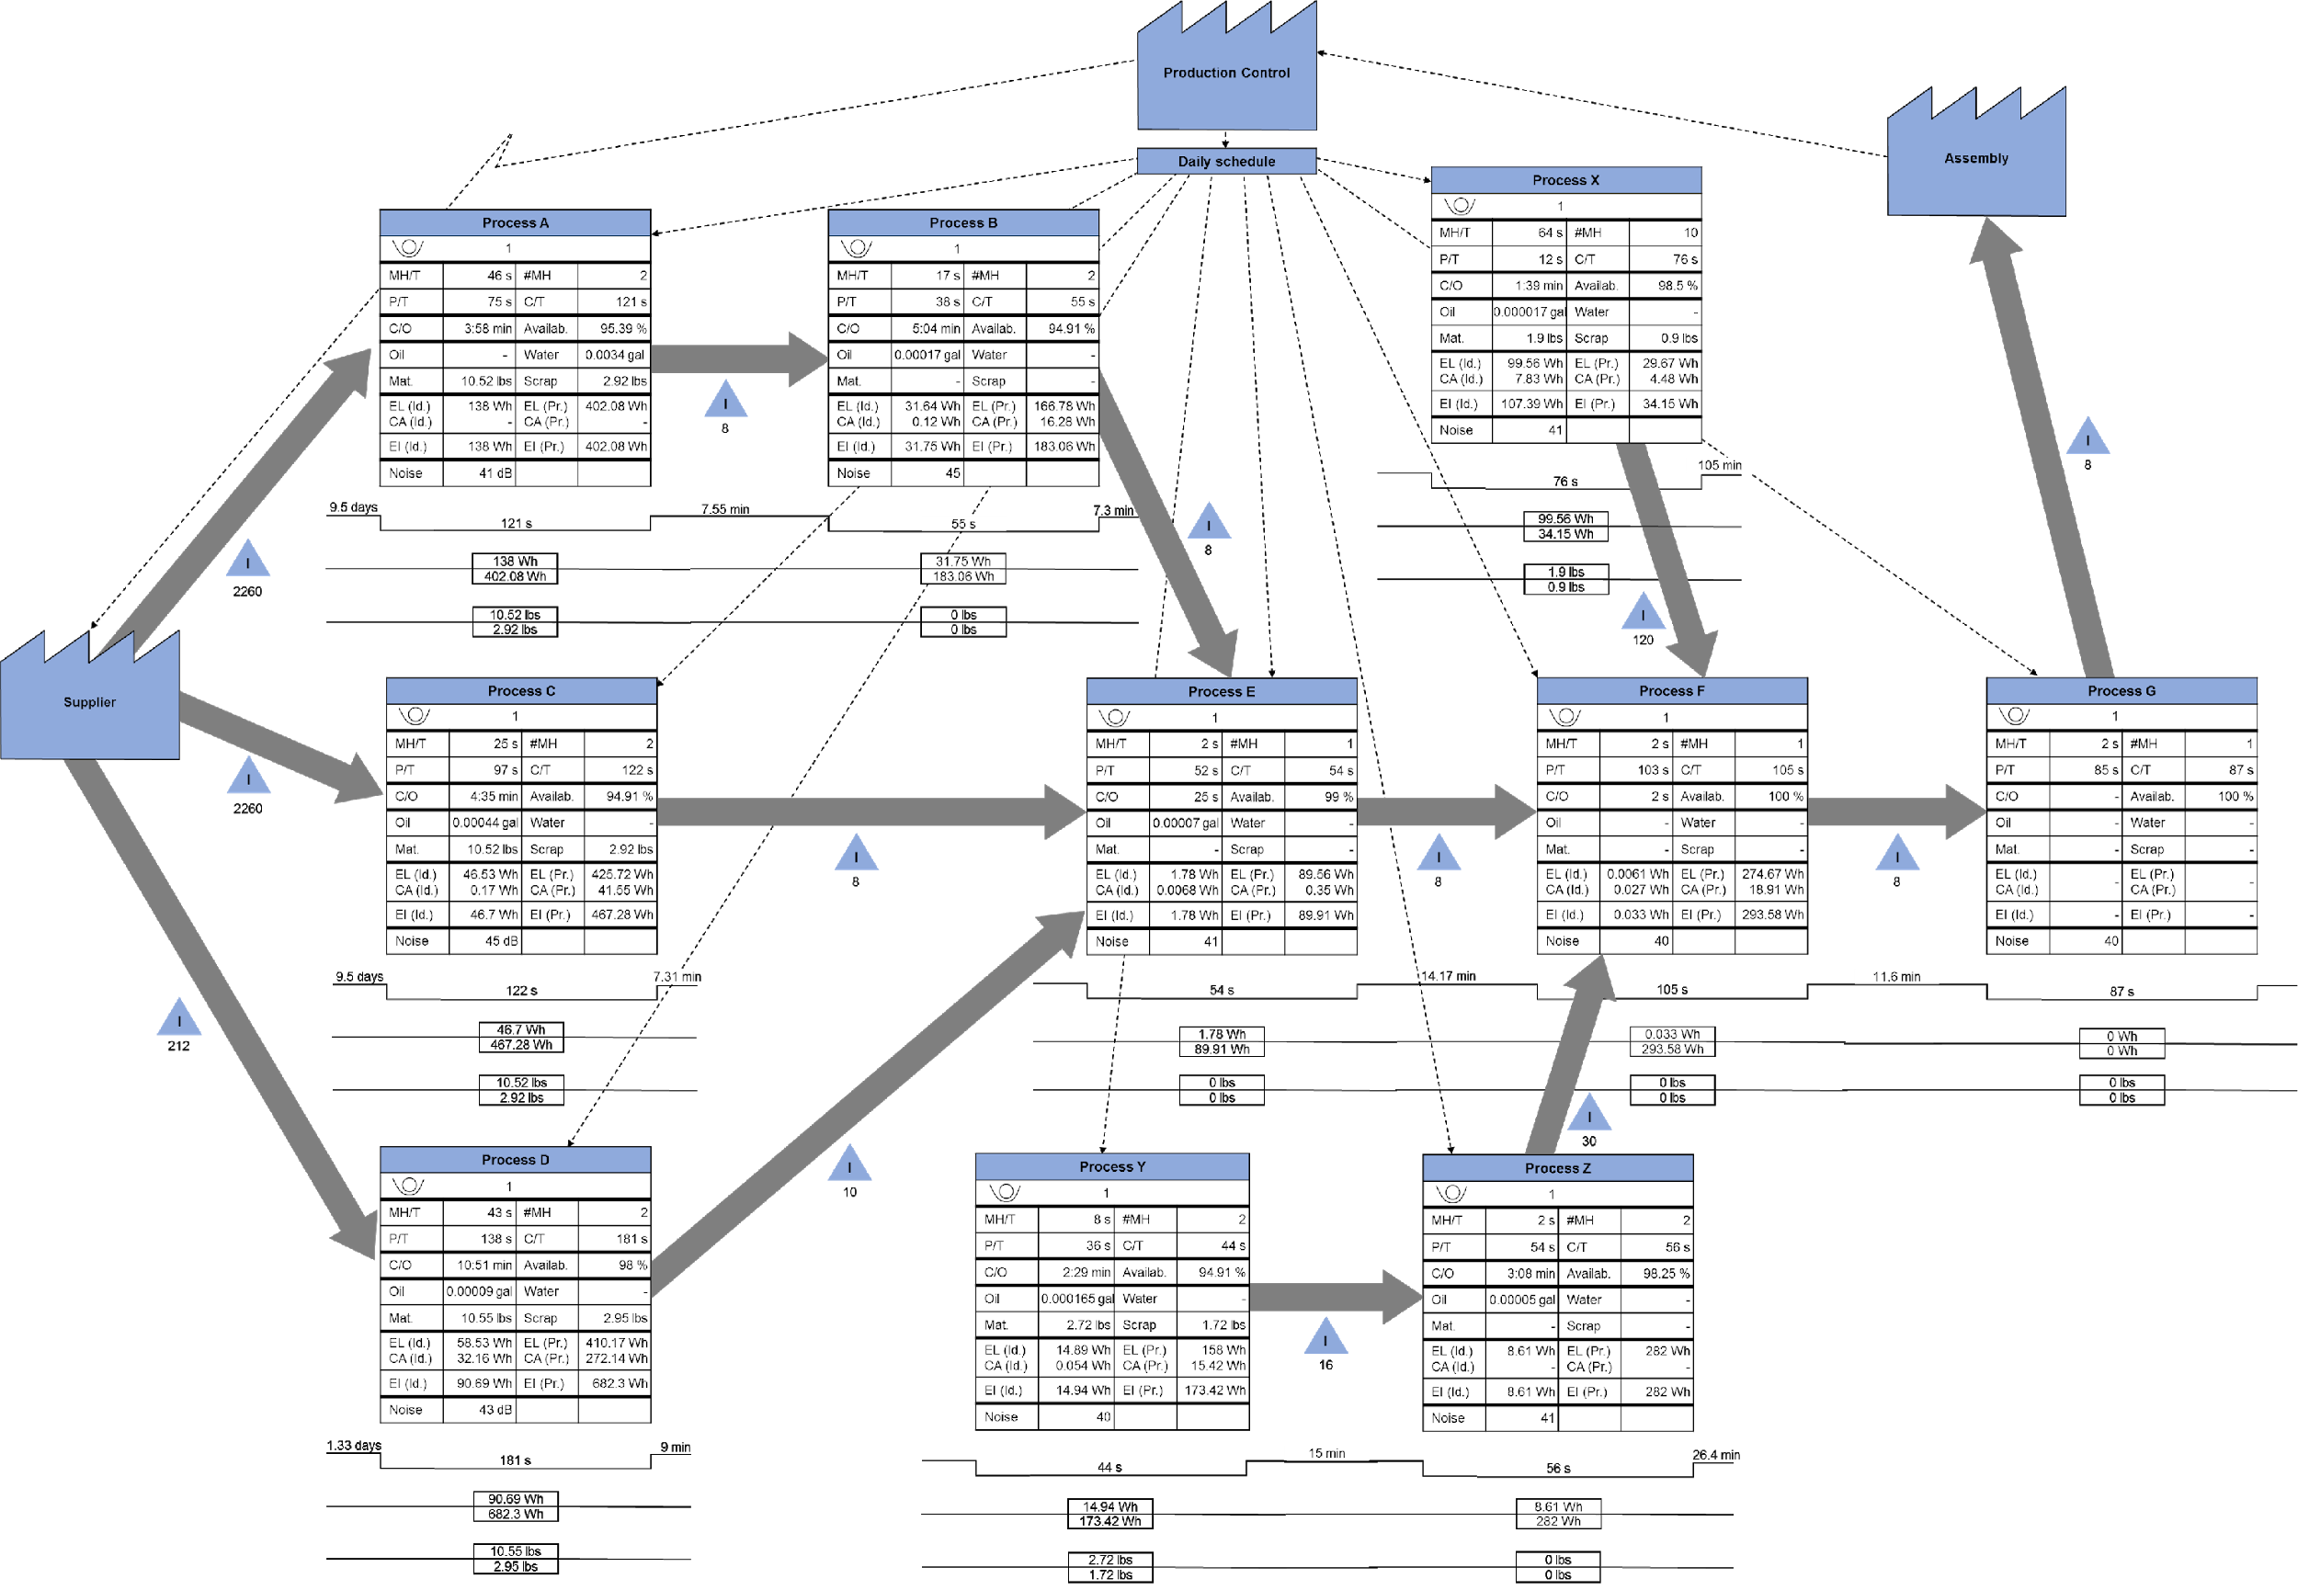

Slide 23
Data Analysis – Economic Perspective
Cost evaluation:
Assessment of total costs of each process
Definition of cost categories
Identification of adequate cost factors
Calculation of costs per part
Cost categories
Labor costs
Energy costs
Material costs
Lubrication oil costs
Water costs
Consumables costs

Slide 24
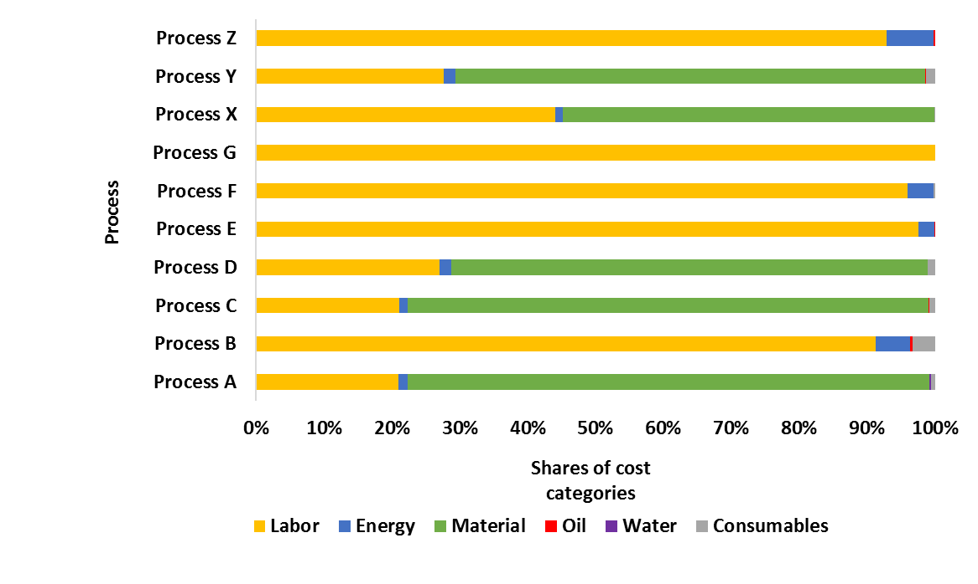
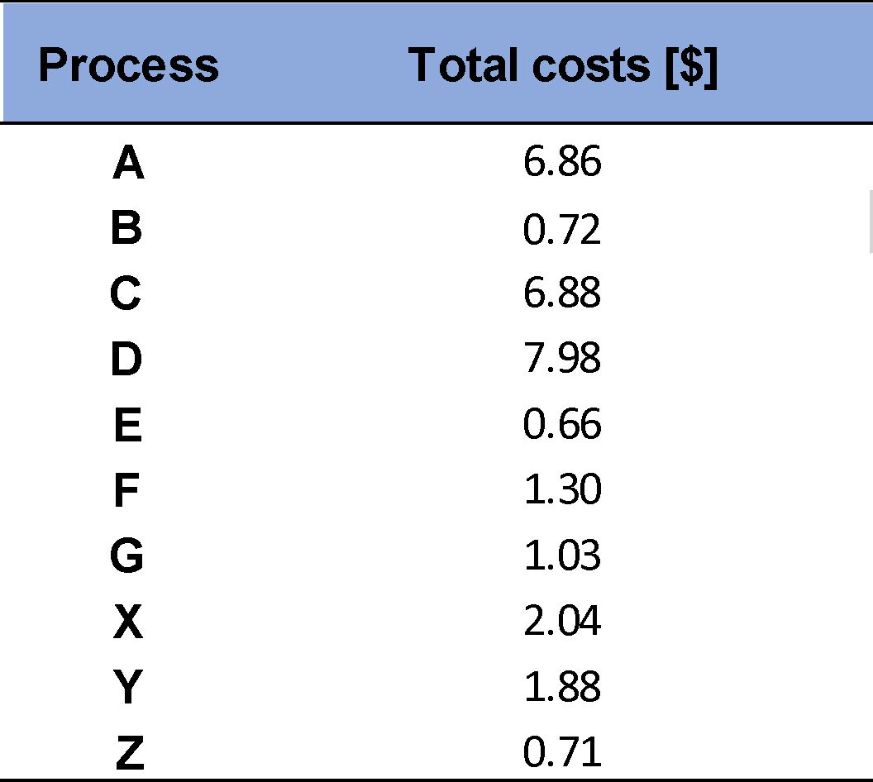
Data Analysis – Economic Perspective
Analysis Results:

Slide 25
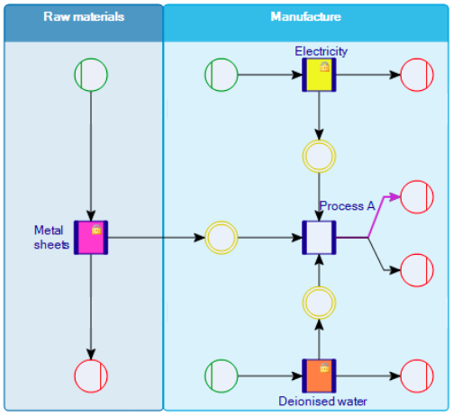
Data Analysis – Environmental Perspective
Life Cycle Assessment (LCA):
Usage of software Umberto NXT LCA
Consideration of raw materials phase + manufacturing phase
Generic data from database ecoinvent
Two impact categories:
Global warming potential (GWP)
Acidification potential (AP)

Slide 26
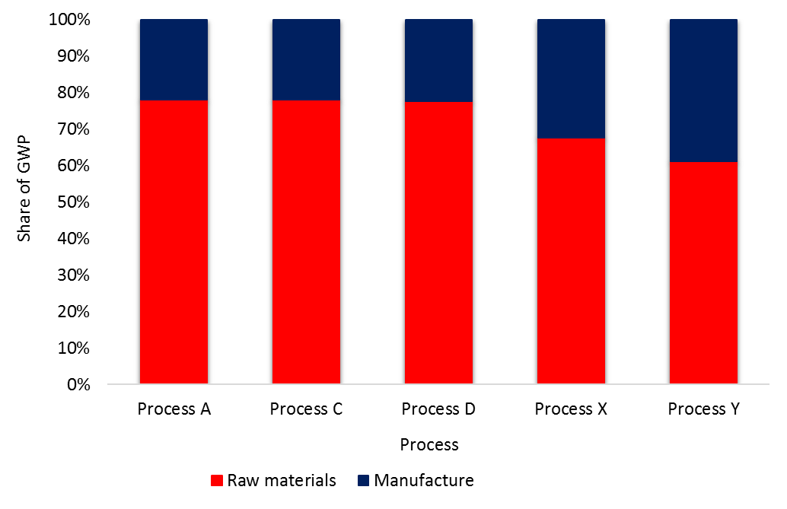
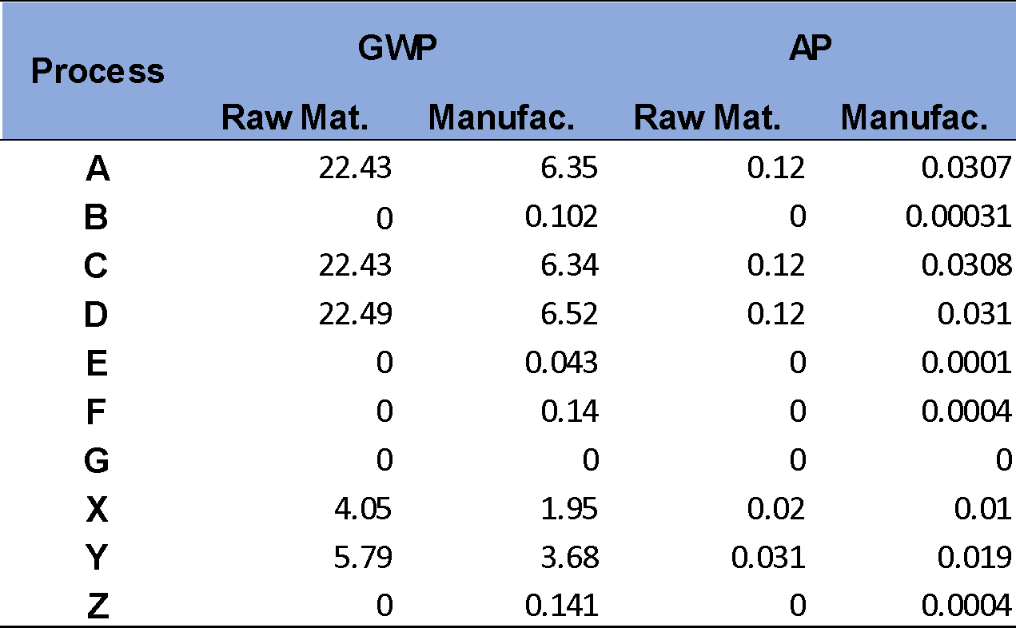
Data Analysis – Environmental Perspective
Analysis Results:
Raw materials + manufacturing phase

Slide 27
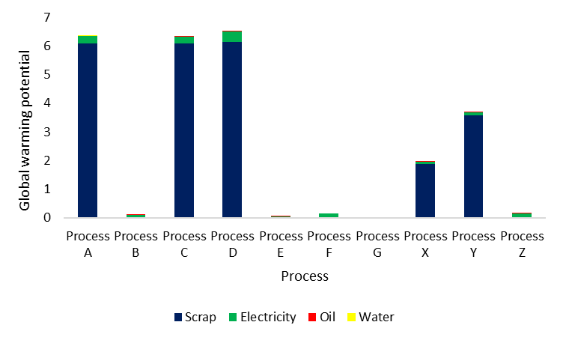
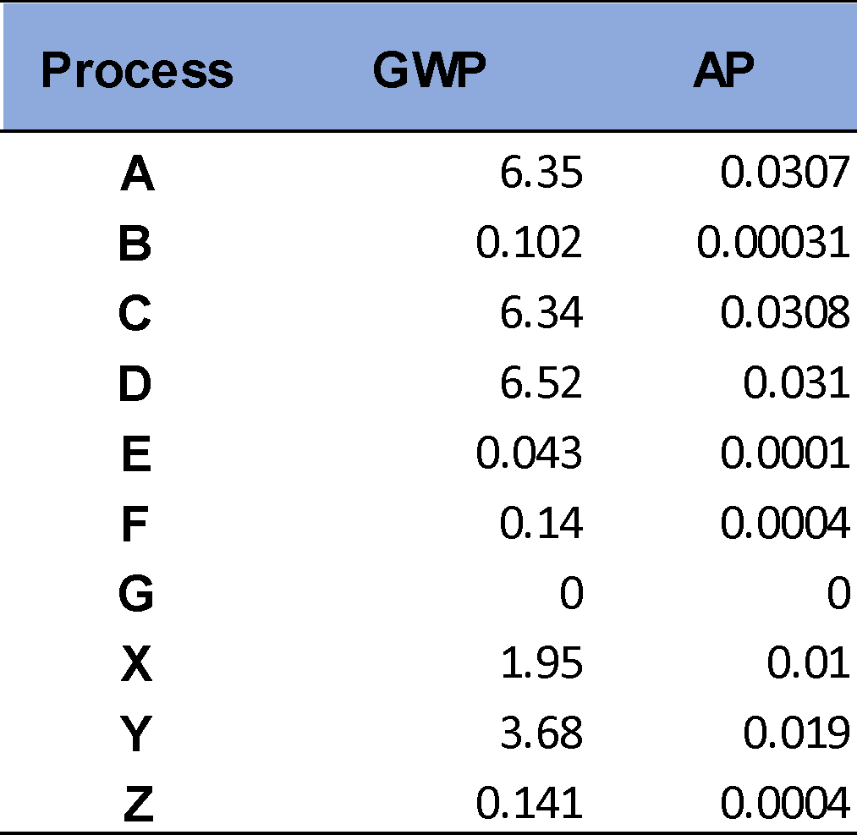
Data Analysis – Environmental Perspective
Only manufacturing phase

Slide 28
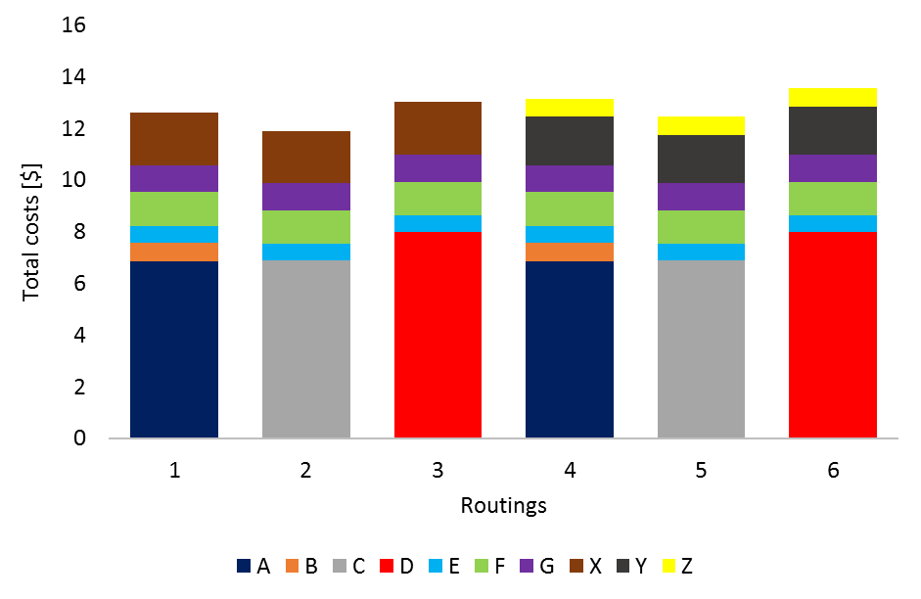
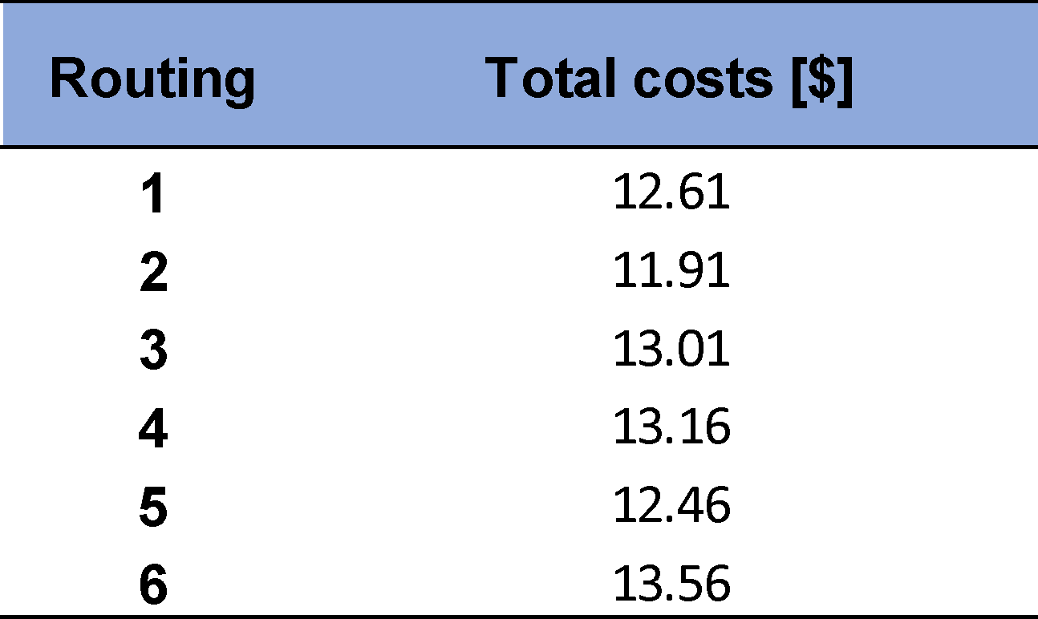
Comparison of Routings - Economic

Slide 29
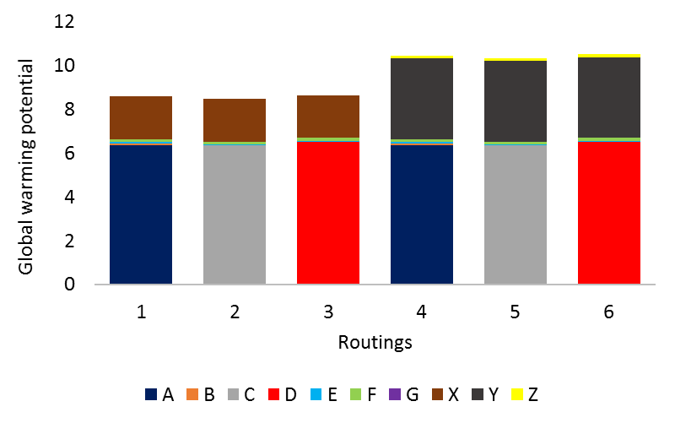
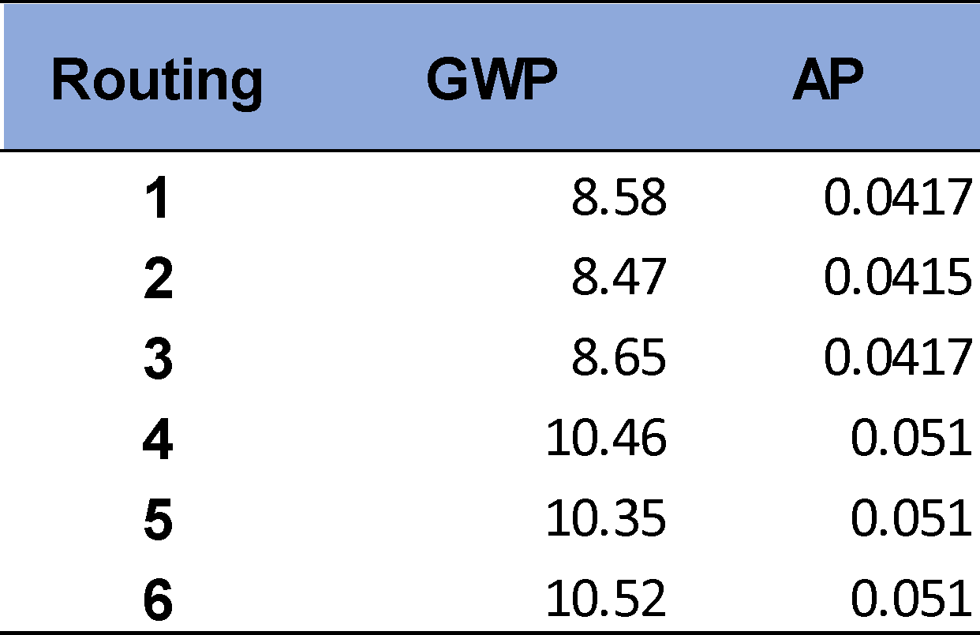
Comparison of Routings - Environmental

Slide 30
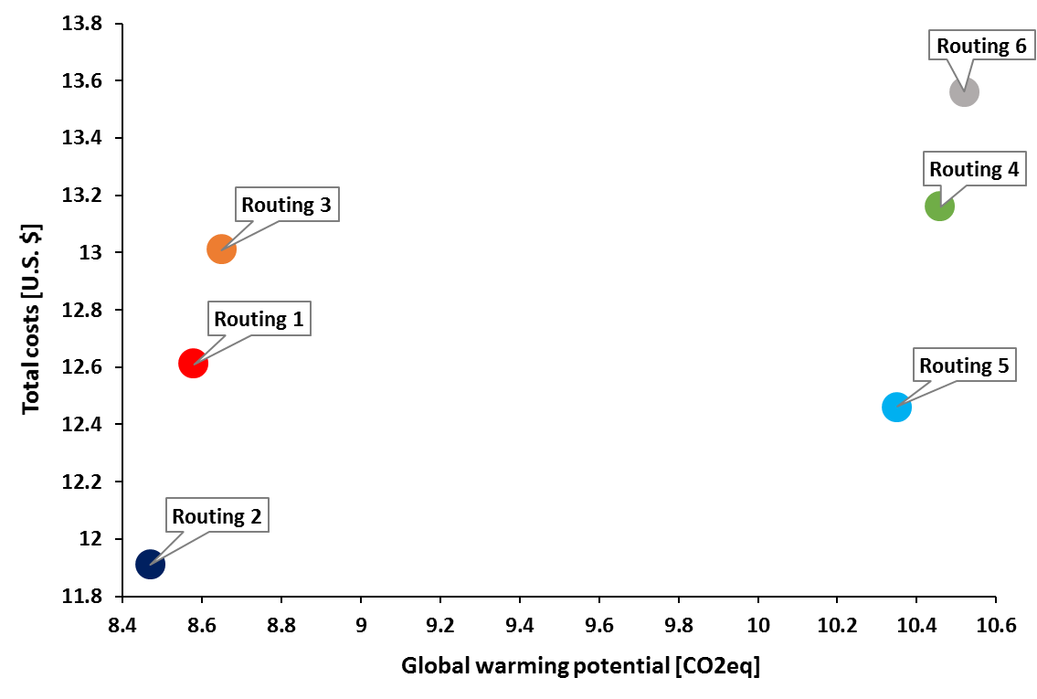
Comparison of Routings - Overall
Routing 2 best overall option
least costs
least environmental impact
Routing 5 is cheaper than routings 1 + 3
Routing 5 has a higher GWP than routings 1 + 3
Preferences on performance indicators need to be set for decision making

Slide 31
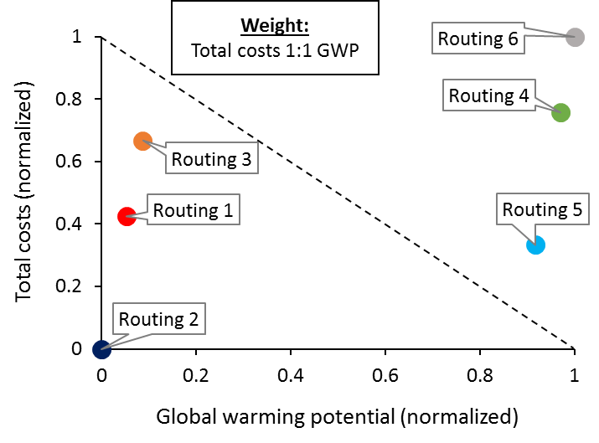
Finding trade offs
Setting preferences:
Two examples:
Total costs 1:1 Global warming potential
Total costs 3:1 Global warming potential
Normalization of data to compare values with one another

Slide 32
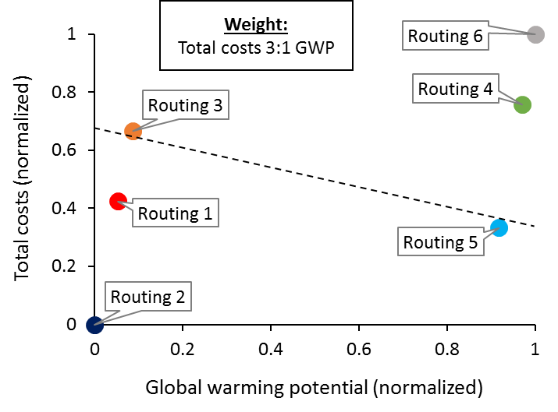
Finding trade offs
Setting preferences:
Two examples:
Total costs 1:1 Global warming potential
Total costs 3:1 Global warming potential
Normalization of data to compare values with one another

Slide 33
Benefits of sustainable routing decisions
Best case scenario: Routing 2
Most frequently used: Routing 3
Savings per part from switching routings:

Slide 34
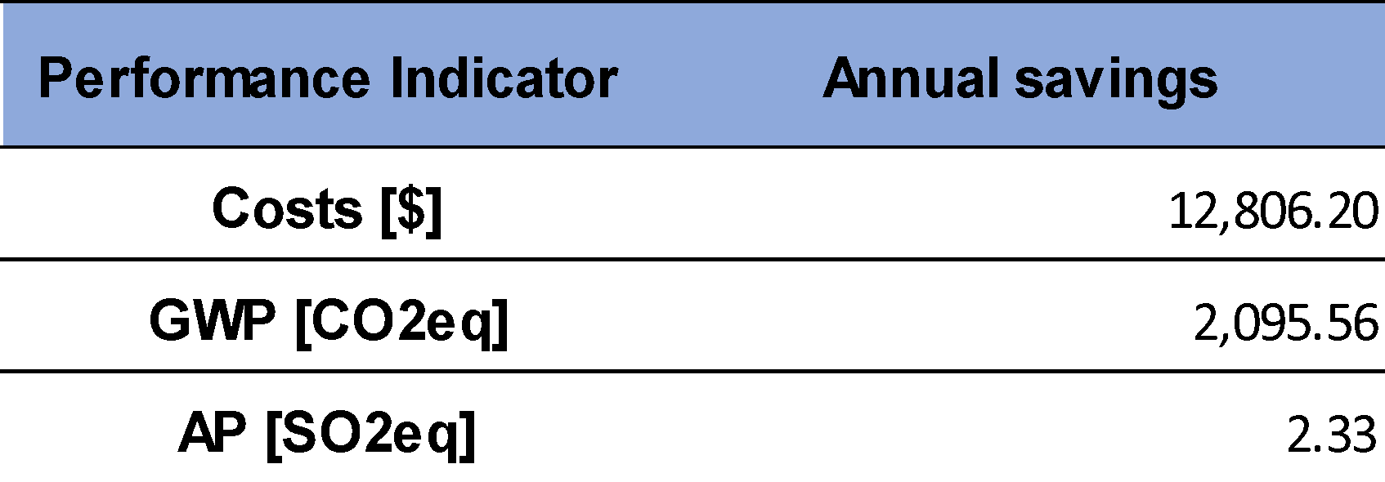
Benefits of sustainable routing decisions
Annual savings from switching routings:
Considering the whole product family
Annual volume of 11,642 units
Requirements for switching routings must be examined (machine capacities)
Potential savings are additional incentive for investigated company to think about new investments

Slide 35
Achievements
New method for sustainable routing has been developed
Practicality proven by case study
Benefits of the method have been presented
Step-by-step approach that can be used as guidance for the improvement process
Designed conceptually to be scalable for individual applications

Slide 36
Discussion
Limitations of the approach
(Dis-)advantages of method could be different for other cases
Requirements for routing decisions must be considered
Limited number of metrics; social dimension briefly addressed
Preferences in example are not based on specific targets

Slide 37
Further Research
Case studies
Prove general applicability of method
Performance indicator to represent all
three dimensions
Trade-offs
Revision of Method
Requirements
Machine capacities
Productivity issues
Identification and evaluation
of adequate metrics
Societal impact
Synergies
Similarities to other methods

Slide 38
Questions
Dr. Valerie Maier-Speredelozzi
valerie@uri.edu 401-874-5187
Mechanical, Industrial and Systems Engineering

