Slide 1
Modernizing Energy Management:
Solutions for Data-Driven Energy Efficiency
Thursday, December 5, 2019
Robert J. Higgins Welcome Center

Slide 2
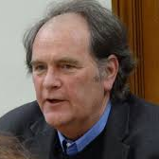
8:20 p.m. Modern Municipal Streetlights: How Intelligent
Technologies are Saving RI Taxpayer Dollars
JEFF BROADHEAD
Executive Director, Partnership for Rhode Island Streetlight Management
Streetlights are usually the single largest energy use by a municipality, surpassed occasionally by a large wastewater plant. Since the passage of the Municipal Streetlights Investment Act (RIGL 39-30) in 2013, municipalities are able to purchase existing lights from National Grid for their original cost, less depreciation, and upgrade them with real-time, remote-controlled management systems that can spot problems, aid in troubleshooting, and manage overall and individual light energy use.
Jeff Broadhead is the founder and Executive Director of the Partnership for Rhode Island Streetlight Management, the author of RI’s streetlight reform legislation, and Executive Director of the Washington County Regional Planning Council. He has had a long career in government, nonprofit, and consulting on both coasts. Jeff holds a BA in Economic Geography / Environmental Studies from the University of Washington, and an Executive MBA from URI. For more information about PRISM, please visit http://www.prismstreetlights.org/.

Slide 12
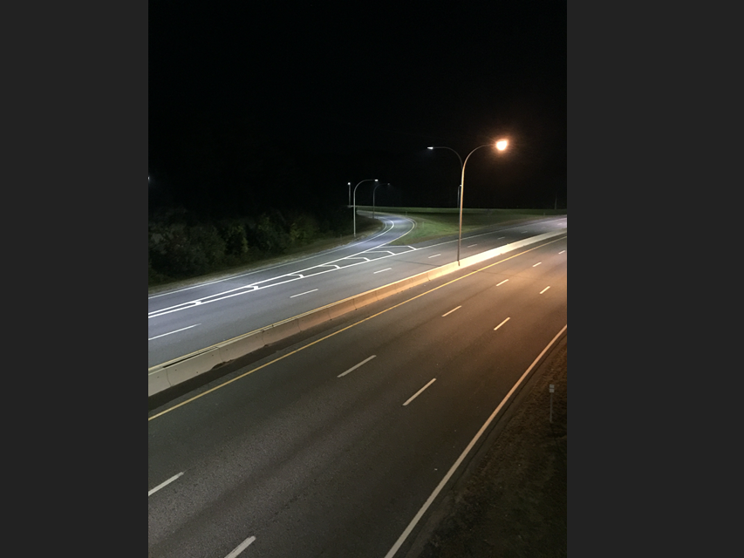

Slide 14
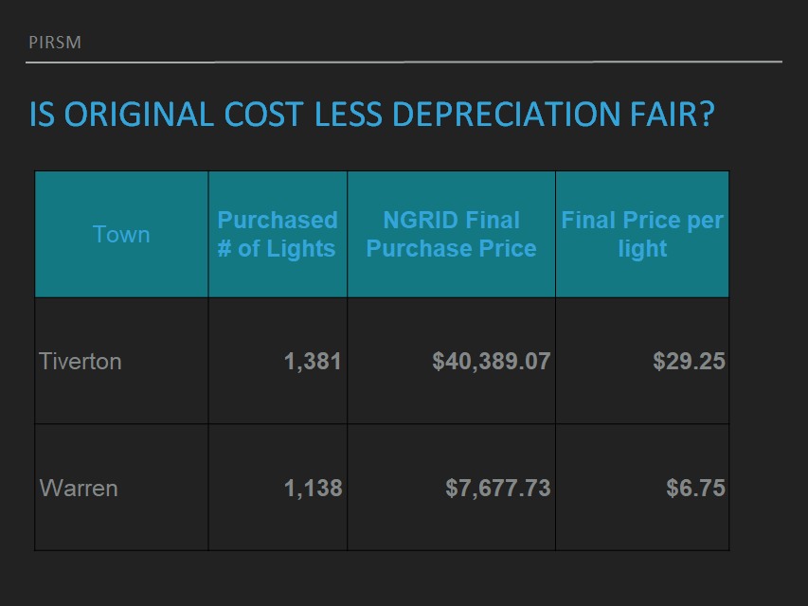

Slide 20
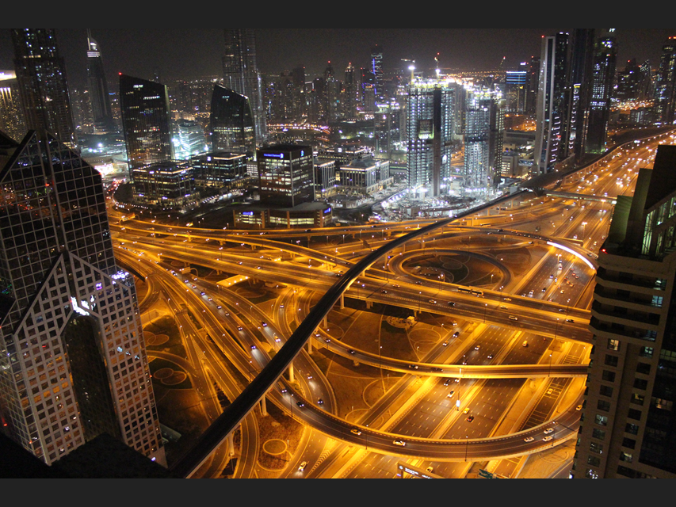

Slide 30
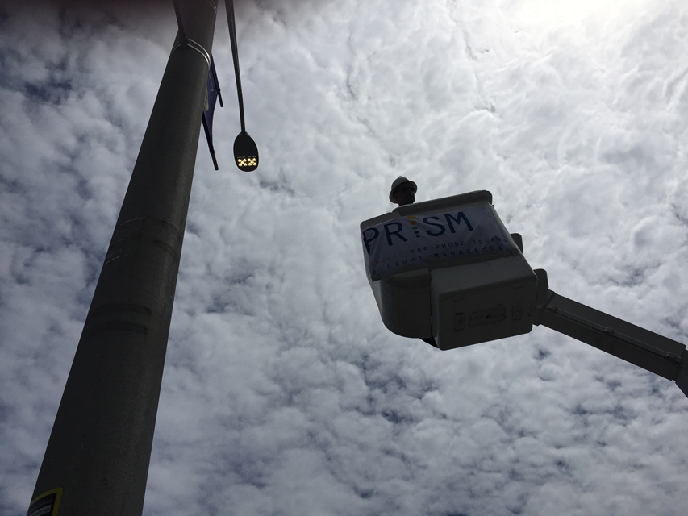

Slide 33
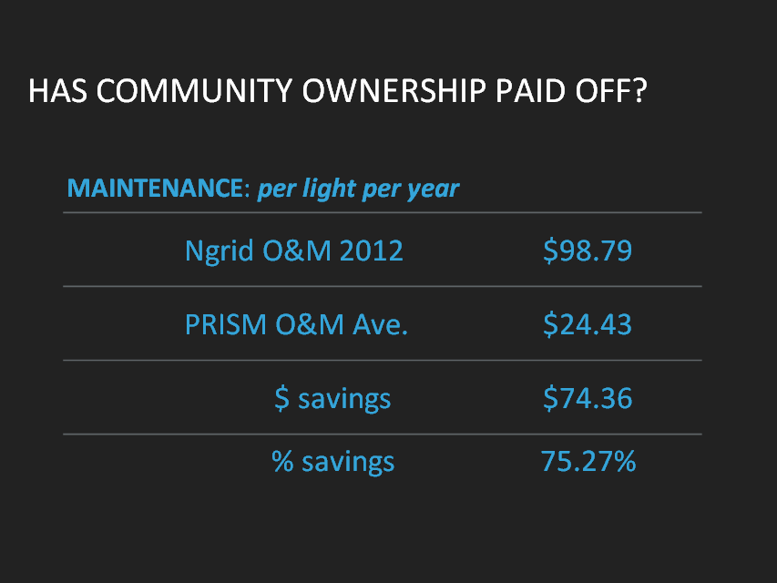

Slide 36
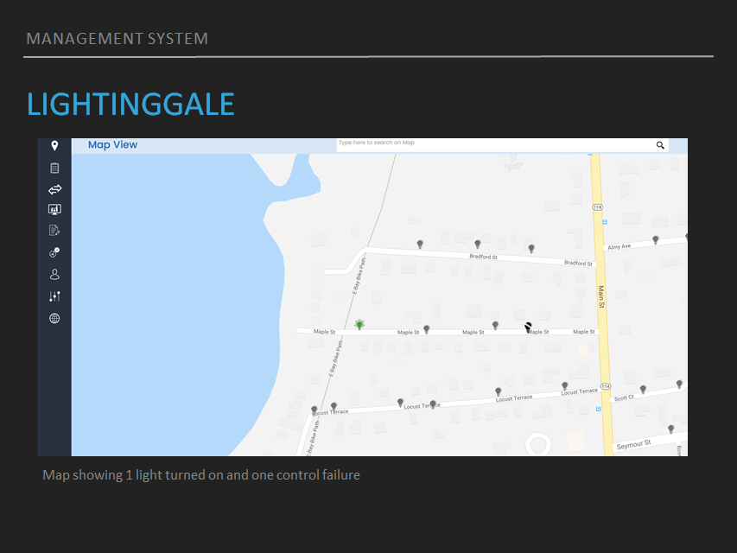

Slide 37
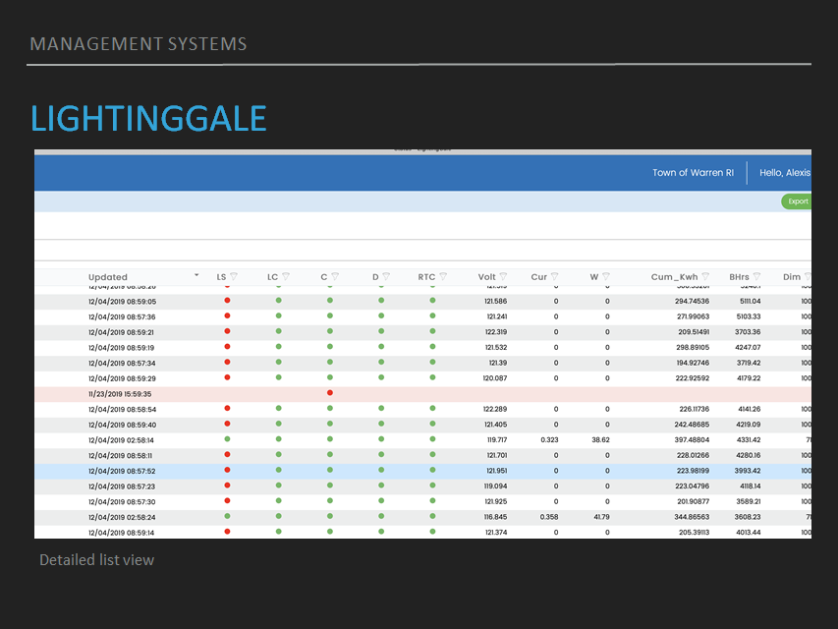

Slide 38
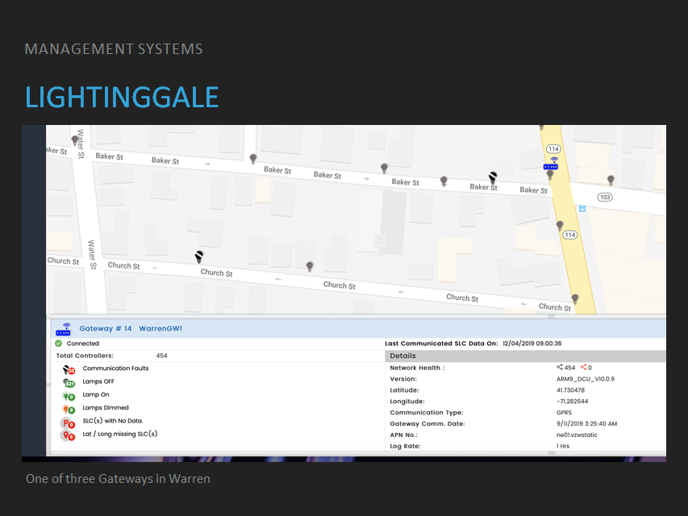

Slide 39
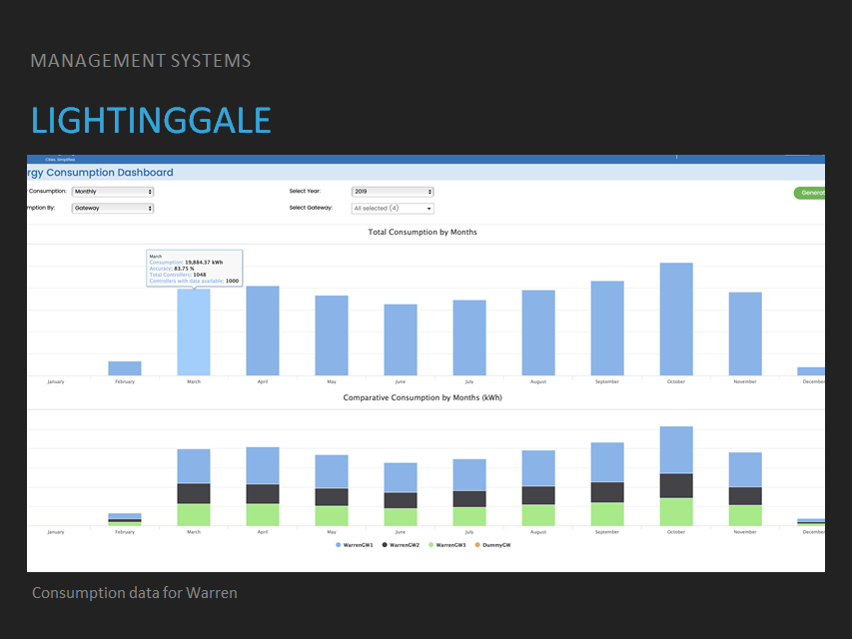

Slide 40
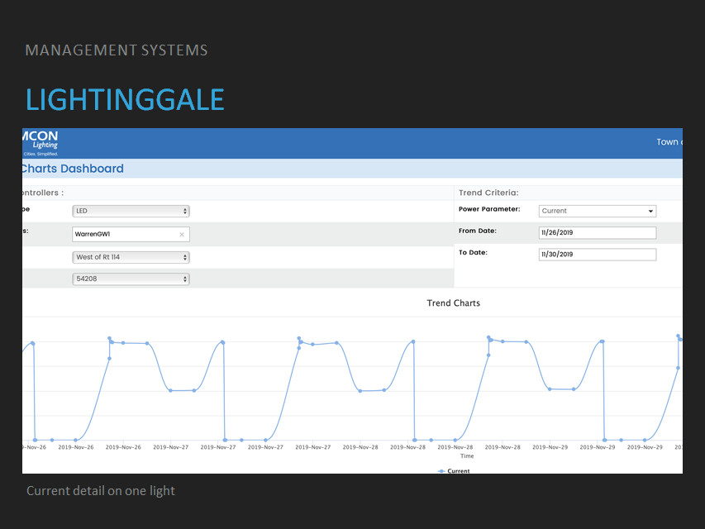

Slide 41
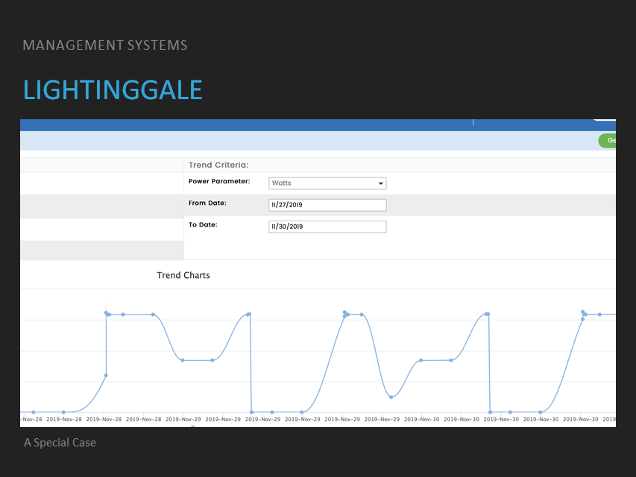

Slide 42
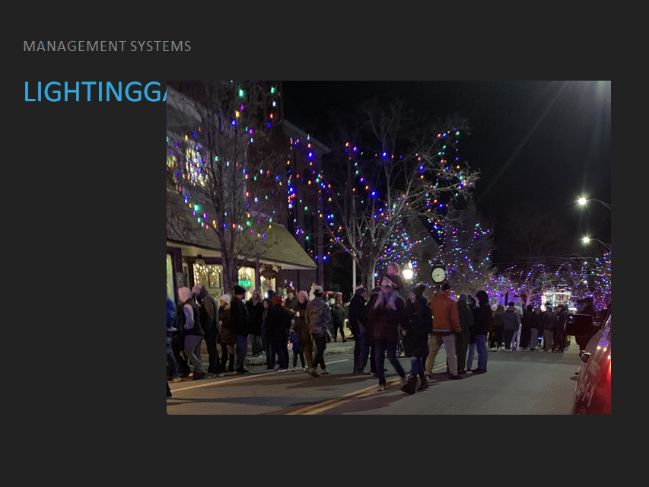

Slide 43
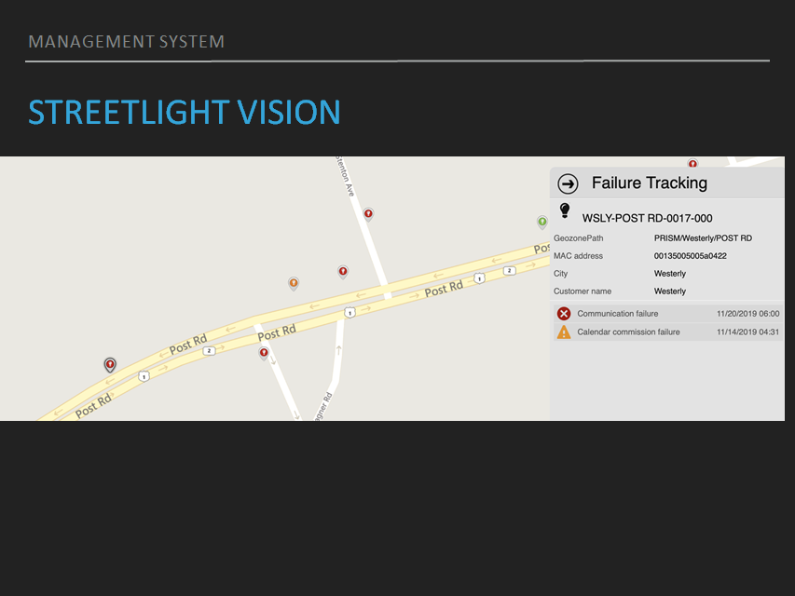

Slide 44
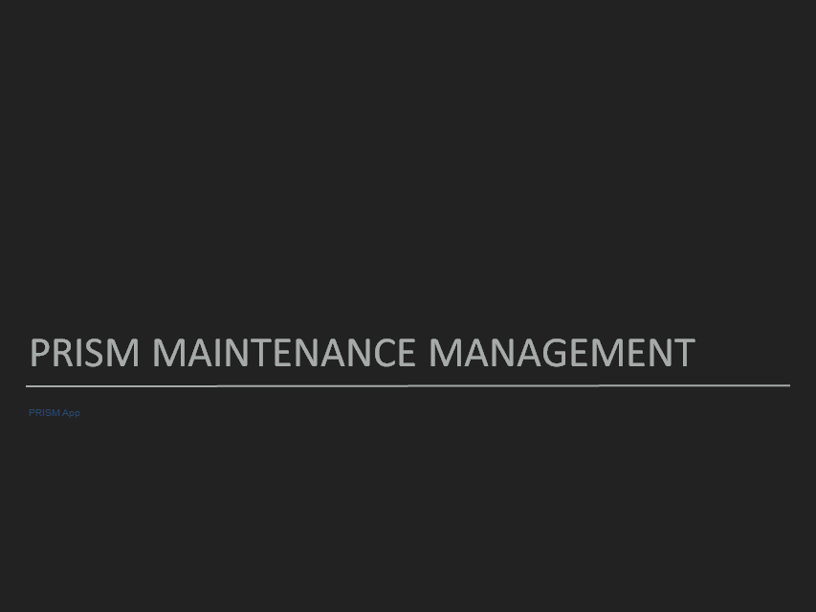

Slide 45
