Slide 1
Lower Bills for Everyone: The Role of Equity in Energy Efficiency
Monday, December 9, 2019
Robert J. Higgins Welcome Center

Slide 2
From Theory to Practice: Applying Theoretical Frameworks to Implement Real Solutions to RI’s Energy Equity Challenges
YASMIN YACOBY
Energy Justice Program Manager, RI Office of Energy Resources
In order to address energy inequity, we must begin to address inequity issues at large. Yasmin’s presentation will focus on contextualizing theoretical frameworks and academic concepts in practical settings. She will discuss the importance of equity in the Office of Energy Resources (OER), Rhode Island’s lead state agency on energy policy and programs, and the various environmental justice tools OER will attempt to utilize in the coming years.
Yasmin is a Govern for America Fellow and graduated from Harvard University with Honors in May 2019 with a Bachelor of Arts in Environmental Science and Public Policy. For more information about Yasmin’s background, please visit https://www.linkedin.com/in/yasmin-yacoby-4229a3179/.

Slide 3
FROM THEORY TO PRACTICE
APPLYING THEORETICAL FRAMEWORKS TO RHODE ISLAND’S ENERGY EQUITY CHALLENGES
Yasmin Yacoby
Energy Justice Program Manager,
RI Office of Energy Resources
She, Her, Hers
Yasmin.Yacoby.CTR@energy.ri.gov
(401) 574-9103

Slide 4
TABLE OF CONTENTS
The WHO: About me
Environmental Justice Definitions
The WHAT: My Goals at OER
The WHY and the Theory Behind It
The HOW: Applying Theory to Practice
The WHEN and WHERE

Slide 5
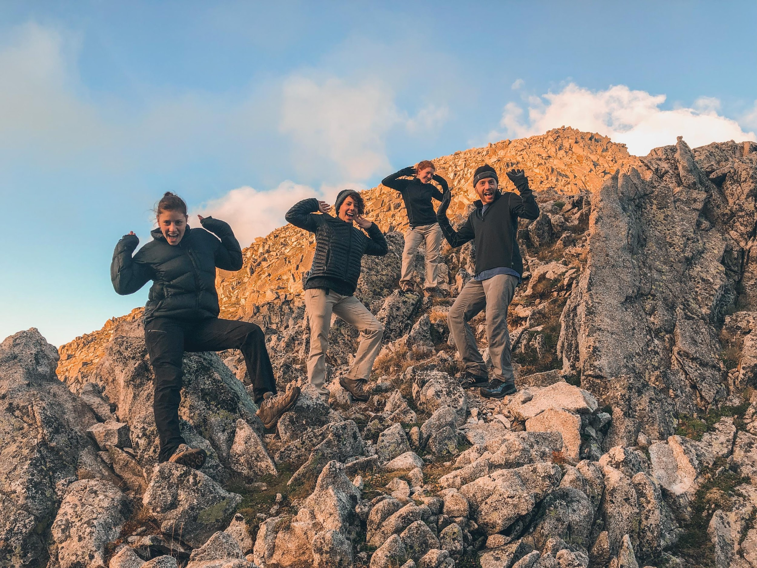
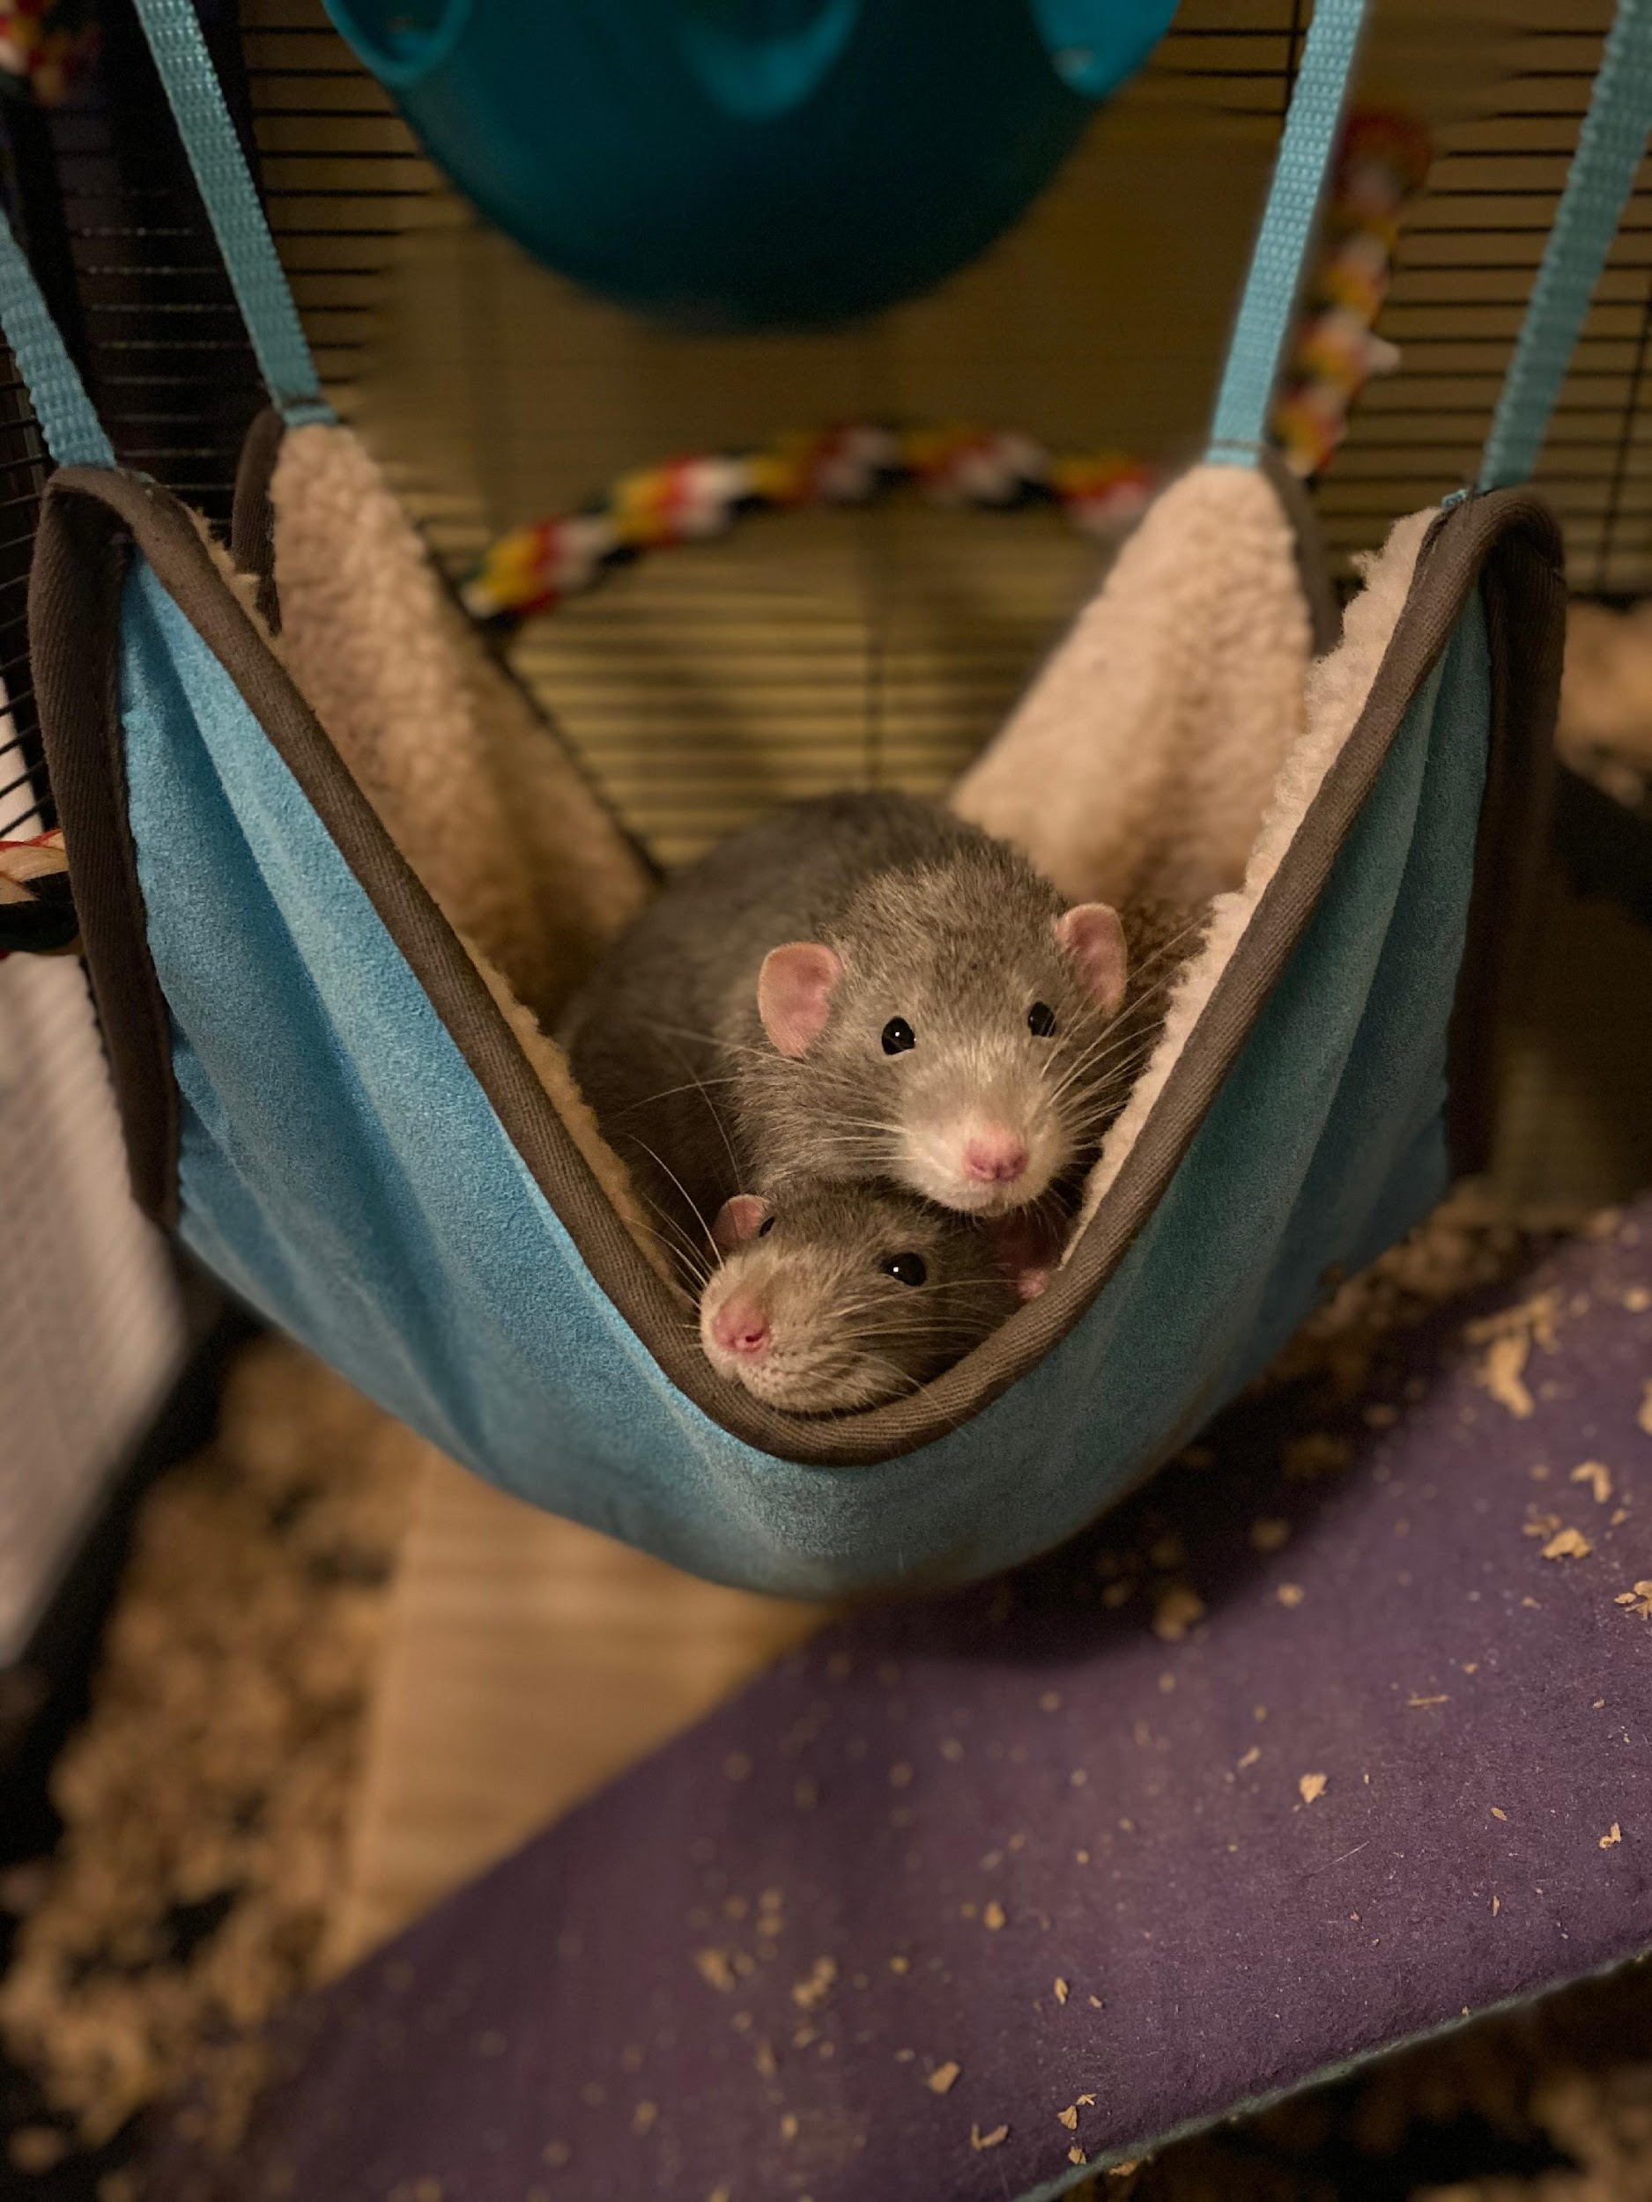
THE WHO: ABOUT ME
Notes:
I am a recent graduate, and I studied ESPP with a focus in Environmental Justice. I wrote my Honors thesis on the topic of EJ issues in federal policy.
I am a Govern for America Fellow, which is a non-profit that pairs recent graduates and state agencies to encourage innovation in government
I work for the RI Office of Energy Resources as the program manager for Energy Justice, which will be the focus of the talk today
I have 3 siblings, and two adorable pet rats

Slide 6
WE ARE ALL LEARNING
Please ask questions
Notes:
Real quick: I am learning, you are learning, we are all learning! Its important that we keep it that way. So please ask questions. Clarifying questions are best during the presentation, but larger conceptual questions are welcome after!

Slide 7
ENVIRONMENTAL INJUSTICE
The unequal and disproportionate distribution of environmental harm – from climate change, from pollution, from mitigation measures, etc. – in marginalized communities.
Notes:
Generally, the way this looks is that people of color who have contributed the least to the climate crisis are disproportionately burdened by pollution and degradation.

Slide 8
ENVIRONMENTAL INJUSTICE

Slide 9
ENERGY JUSTICE Everyone should have access to Clean, Affordable, and Reliable Energy.
Clean
Affordable
Reliable
Energy
C.A.R.E
Notes:
Just like environmental justice says that everyone has the right to be protected from environmental pollution and the right to live in a healthy and clean environment, energy justice says that people should all have access to clean, affordable, and reliable energy. And that is OER’s mission statements

Slide 10
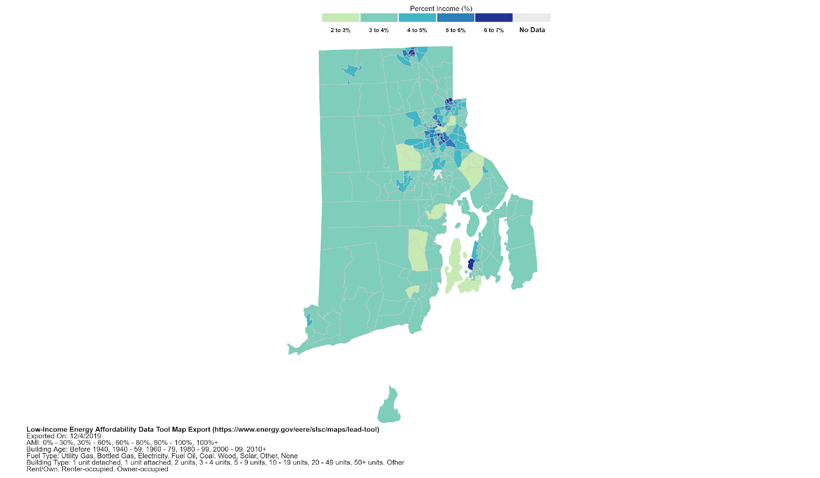
WHAT DOES ENERGY JUSTICE LOOK LIKE IN RI
Notes:
What does Energy Burden is the percent of your household’s income that goes towards your energy bill. The majority of the state of Rhode Island is approximately at 3%, so for example, if my annual income is $50,000, you’d be paying $1,500 on your energy bills annually. But not everyone is paying 3% of their income

Slide 11
Factors:
Income level
Building type
Rent/Own
Energy Efficiency
Etc.
Notes:
This is a map of the census tracts in Providence
How is it that there are two census tracts that are right next to each other, and one is paying 3% of its income for energy and one is paying 6% of its income to energy?
Turns out that there are a lot of factors that feed into this, like your income level, the type of building you live in, If you own or rent your space, the efficiency of your home, etc.

Slide 12
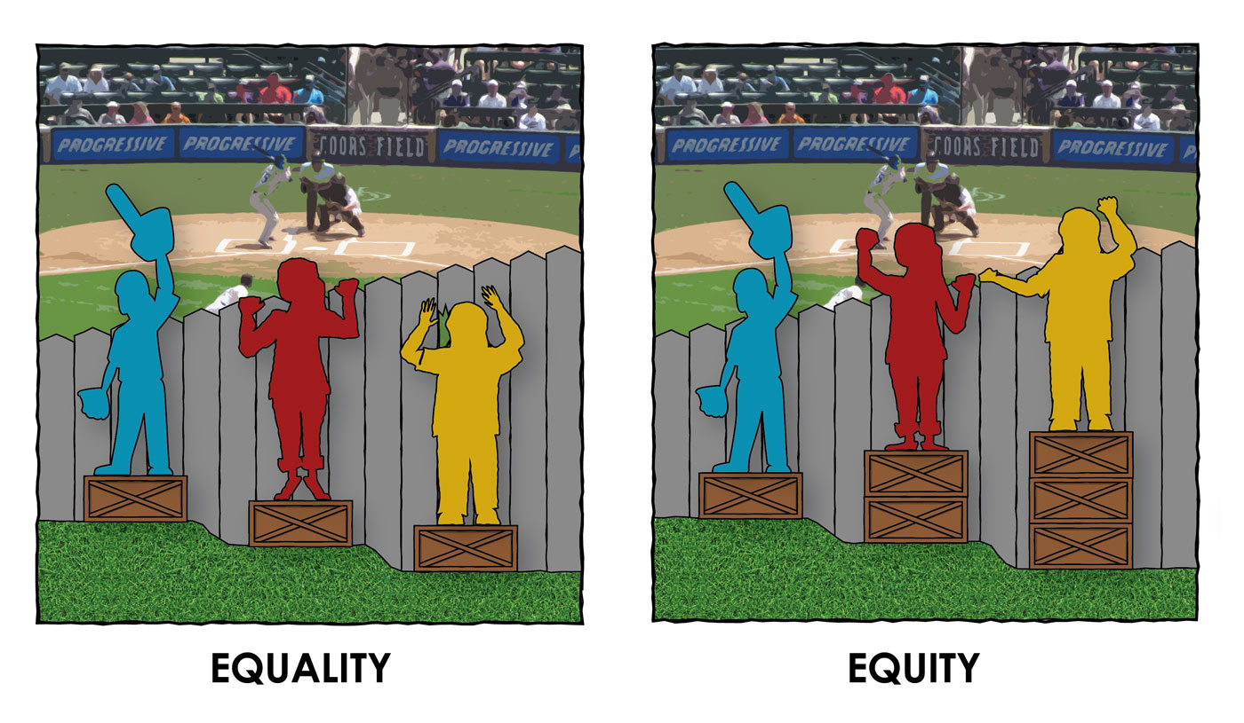
EQUALITY VS. EQUITY
Notes:
Which is why its so important we define the different between Equality versus Equity. Has anyone seen this graphic before? Does someone want to give defining this difference a shot?
’Equality’ is often used to mean giving people the same resources, regardless of the situation. Equity, meanwhile, is about ensuring everyone has what they need. That will mean expending more effort on some communities than others to ensure they too end up with fair opportunities for a healthy life.
I don’t like this image though, because it assumes the problem is with the person as opposed to the system (height of the person is the limiting factor), so this graphic is one I like better. Here, the fence is institutional discrimination, the ground is situational differences. Its important to keep in mind that we do not all have equal footing and equal access, but that that is what we are striving to achieve – Equity.
Any Questions about EJ? About these definitions?

Slide 13
TABLE OF CONTENTS
The WHO: About me
Environmental Justice Definitions
The WHAT: My Goals at OER
The WHY and the Theory Behind It
The HOW: Applying Theory to Practice
The WHEN and WHERE

Slide 14
THE WHAT: MY GOALS AT OER
Ensure the position is community oriented
Integrate Environmental Justice tools into OER’s framework
Notes:
The WHAT: What are my goals at OER? What is important to change?
Ensure that the position is as community oriented as possible.
Integrate Environmental Justice tools into OER’s framework
That’s great, but having goals doesn’t really matter if there isn’t a reasoning behind them. Which brings me to… the why

Slide 15
THE WHY AND THE THEORY BEHIND IT
Ensure the position is community oriented
Important to include everyone in the conversation!
Politics of Knowledge
Integrate Environmental Justice Tools
Will help with looking at problems with an Equity lens
Targeted Universalism
Notes:
The WHY and the THEORY behind it – Why is this important, why is important that it change from the status quo
(As I’m going through this theory, do bear in mind that it took me long years to learn it fully, and I am trying to explain it in 10 minutes, so bear with me and ask clarifying questions as needed)
The first goal I mentioned was making the position Community oriented. This is important to change because it is crucial to engage stakeholders in our process, and the public (specifically the LMI public) has not been as actively involved in the past. If the folks impacted by our work are not aware of the work and are not contributing their opinions, we might create programs that are not actually beneficial for them. We want to make sure we are including everyone in the conversation and affecting everyone.
The underlying theory behind having a community oriented focus is the politics of knowledge.
Politics of Knowledge: addresses questions such as what knowledge, produced by whom, is considered legitimate, and why; it also looks at the factors that contribute to whose claims are considered credible.

Slide 16
POLITICS OF KNOWLEDGE
Notes:
Looking at a general example: Are we more inclined to believe someone in an institution or someone in the general public? 🡪 Institution.

Slide 17
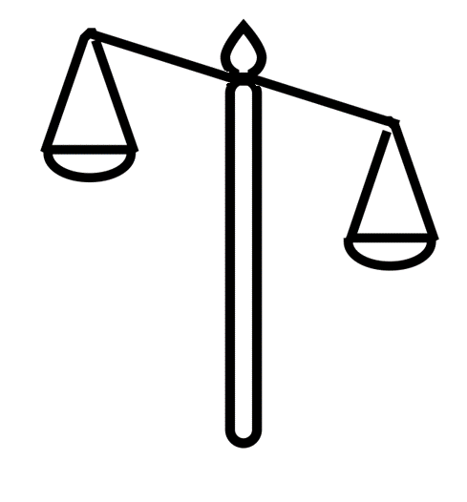
POLITICS OF KNOWLEDGE

Slide 18
POLITICS OF KNOWLEDGE
Notes:
Are we more inclined to believe scientific knowledge or local/experiential knowledge? Well, science, right? Because science is based in facts. We know certain things to be true. But there is a flip side to this…

Slide 19
POLITICS OF KNOWLEDGE
Notes:
Example: an oil refinery that emits pollutants. They emit pollutants below the National ambient air quality standards. They are abiding by the law. But folks living within a mile of that refinery have significantly higher asthma rates. The scientific consensus around the NAAQS say that emitting those levels of pollutants is safe, but the people living by the refinery are experiencing something different.

Slide 20
THE WHY AND THE THEORY BEHIND IT
Ensure the position is community oriented
Important to include everyone in the conversation!
Politics of Knowledge
Integrate Environmental Justice Tools
Will help with looking at problems with an Equity lens
Targeted Universalism

Slide 21
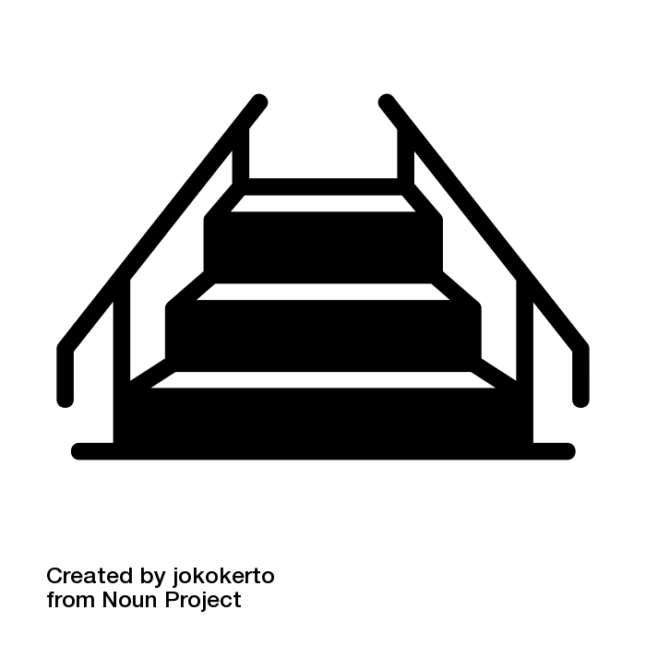
TARGETED UNIVERSALISM

Slide 22
TARGETED UNIVERSALISM

Slide 23
TARGETED UNIVERSALISM

Slide 24
TARGETED UNIVERSALISM

Slide 25
TABLE OF CONTENTS
The WHO: About me
Environmental Justice Definitions
The WHAT: My Goals at OER
The WHY and the Theory Behind It
The HOW: Applying Theory to Practice
The WHEN and WHERE

Slide 26
THE HOW: APPLYING THEORY TO PRACTICE
Undoing Racism Trainings
Theory of Change

Slide 27
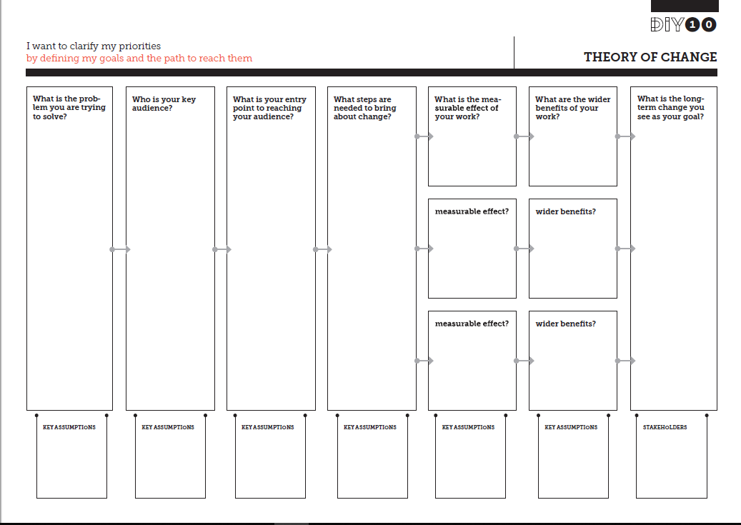

Slide 28
THE HOW: APPLYING THEORY TO PRACTICE
Undoing Racism Trainings
Theory of Change
Notes:
Why is it important to tackle both of these goals in this fashion?

Slide 29
THE LAYERS OF CHANGE
Ideological: Certain ideas about a group; creation of a dominant narrative about a group
Institutional: How institutions and systems reinforce and manifest ideology
Interpersonal: Mistreatment of individuals in oppressed groups, whether conscious or subconscious; Microaggressions
Individual: How we internalize ideologies of oppression, in both the dominant and oppressed group

Slide 30
THE LAYERS OF CHANGE

Slide 31
TABLE OF CONTENTS
The WHO: About me
Environmental Justice Definitions
The WHAT: My Goals at OER
The WHY and the Theory Behind It
The HOW: Applying Theory to Practice
The WHEN and WHERE

Slide 32
THE WHEN AND WHERE
ALWAYS AND EVERYWHERE
Notes:
My goal is to be present at the onset of new policies and projects, which will allow OER to develop our initiatives with EJ at the core. This is an important step in gaining the trust and support of the community and of EJ organizations, since they will begin to see that we are really striving for equity in every way we can.

Slide 33
ENERGY JUSTICE Everyone should have access to Clean, Affordable, and Reliable energy.
Clean
Affordable
Reliable
Energy
C.A.R.E
Notes:
Just like environmental justice says that everyone has the right to be protected from environmental pollution and the right to live in a healthy and clean environment, energy justice says that people should all have access to clean, affordable, and reliable energy.

Slide 34
ENERGY JUSTICE Everyone should have access to Clean, Affordable, and Reliable, and Equitable energy.
Clean
Affordable
Reliable
Equitable
C.A.R.E
Notes:
Just like environmental justice says that everyone has the right to be protected from environmental pollution and the right to live in a healthy and clean environment, energy justice says that people should all have access to clean, affordable, and reliable energy.

Slide 35
QUESTIONS?
Thank you!
Yasmin Yacoby
Yasmin.Yacoby.CTR@energy.ri.gov
(401) 574-9103

