Slide 1
Lower Bills for Everyone: The Role of Equity in Energy Efficiency
Monday, December 9, 2019
Robert J. Higgins Welcome Center

Slide 2
Cutting Carbon While We Work to Electrify Heat
MARTY DAVEY, C.E.M.
Director of Product & Service Development, New Ecology, Inc.
Rhode Island, like many other states, sees electrification of buildings as a key component to achieving carbon reduction goals. Even with aggressive policies and rich incentives, electrification is an undertaking that will take time. Meanwhile, we can (and should) be pushing hard to extract more gas savings, and ensure that savings are sustained in our existing buildings to bring very near-term climate benefits.
Marty has extensive experience developing and delivering building operational services, having worked to design and development WegoWise, an on-line building energy and water benchmarking tool and was Project Manager for numerous green building retrofit projects. Marty is an Association for Energy Engineers Certified Energy Manager. For more information about Marty’s work with New Ecology, please visit www.newecology.org.

Slide 3
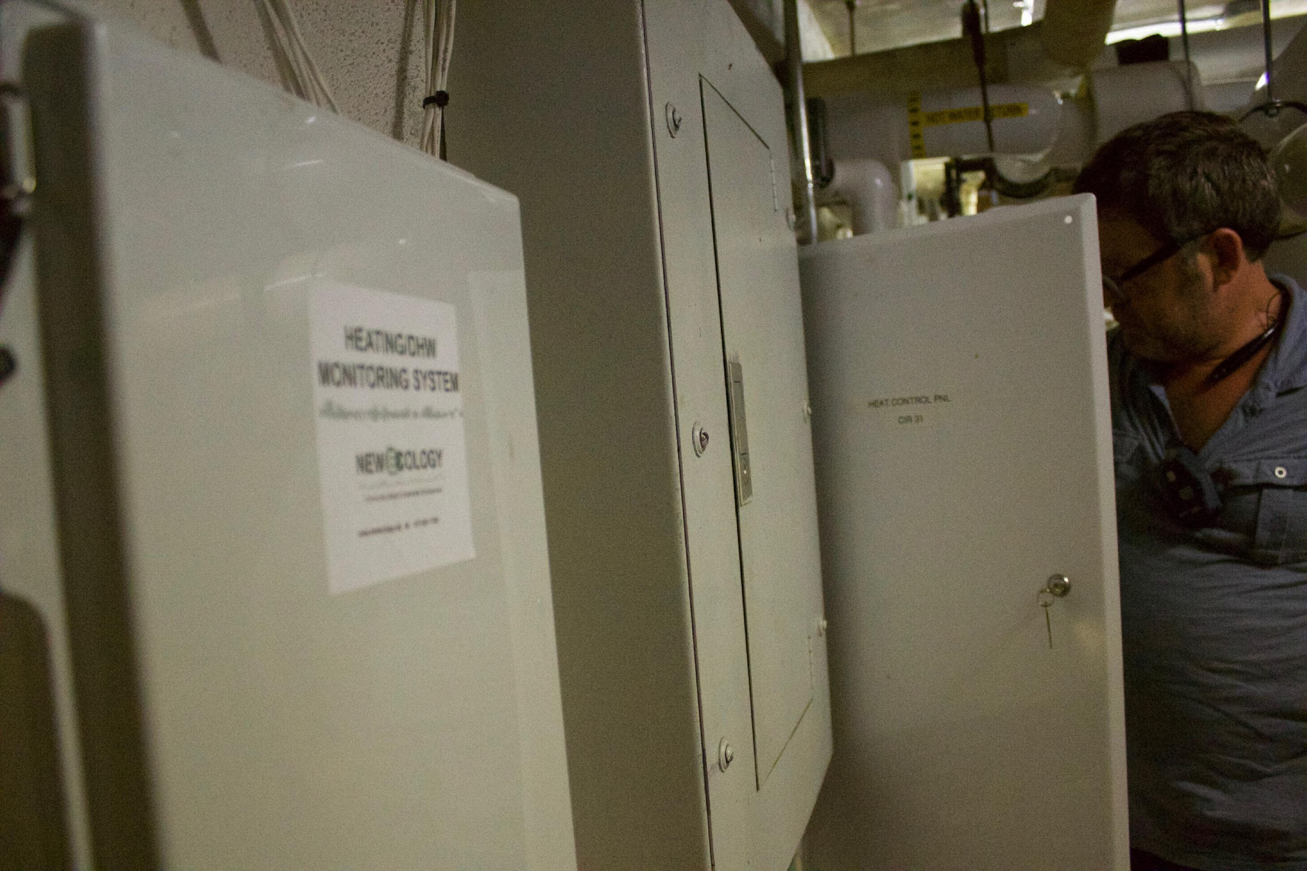
Presented at the URI Pier Lecture Series
December 9, 2019
Cutting Carbon While We Work To Electrify Heat

Slide 4
New Ecology works nationally to bring the benefits of sustainable development to the community level, with a concerted emphasis on underserved populations.
A mission-driven non profit, we seek to make the built environment more efficient, healthy, durable and resilient.
CORE WORK in Buildings:
Research & Test
Monitor & Diagnose
Implement & Solve
Certify & Verify
Train & Share

Slide 5
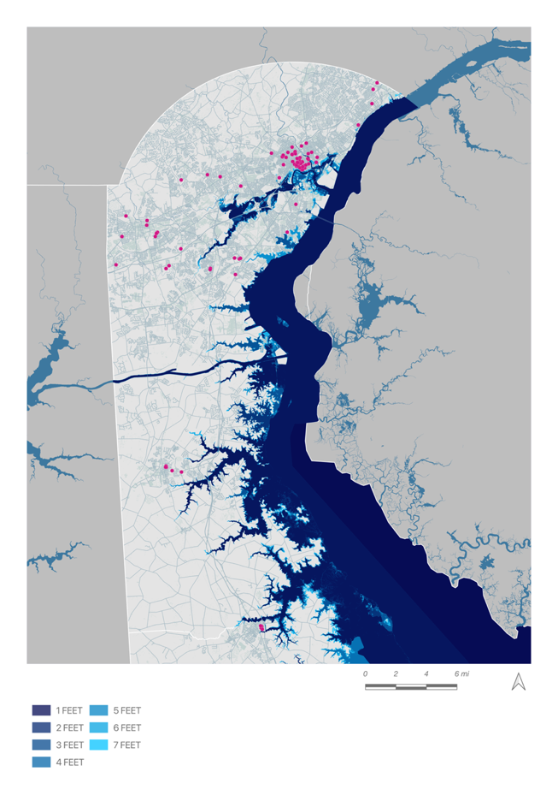
Cambridge, MA
and Statewide
(1,400+Developments)
Resiliency
Binghamton, NY
(1 Development)
Stamford, CT and Statewide
(5 Buildings)
New York, NY
(60 Developments)
Long Island, NY
(4 Developments)
Washington, DC
(20 Developments)
Delaware
(200 Developments)
Notes:
Existing building Resiliency Assessments and portfolio/city or statewide threat assessment/mapping exercises to ID priorities
DE – hired by the DE State Housing Authority - 3 phases:
GIS analysis of climate hazards for each development
Resiliency Audits of top 20 buildings most at risk
Review of program/policies given all that was learned – QAP, building code

Slide 6
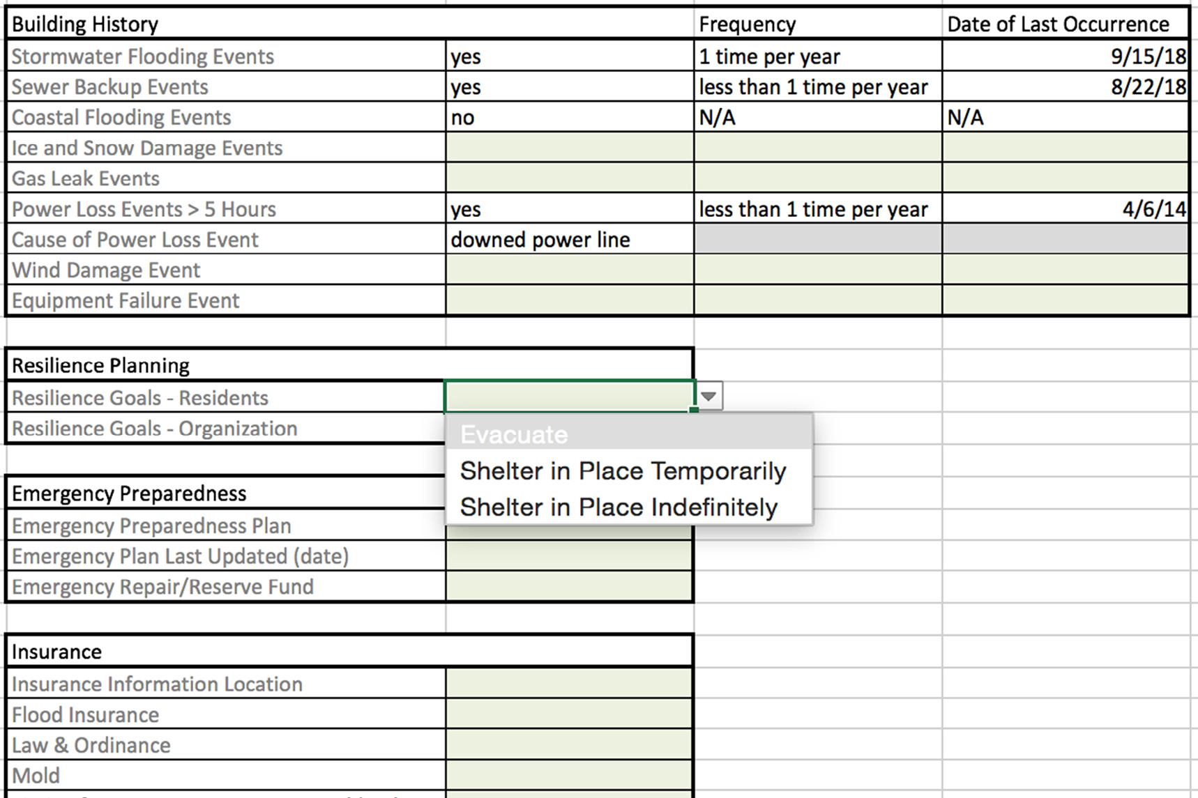
Resiliency
Notes:
Big picture of what/where – DC selected NEI on competitive basis; all projects are competitive

Slide 7
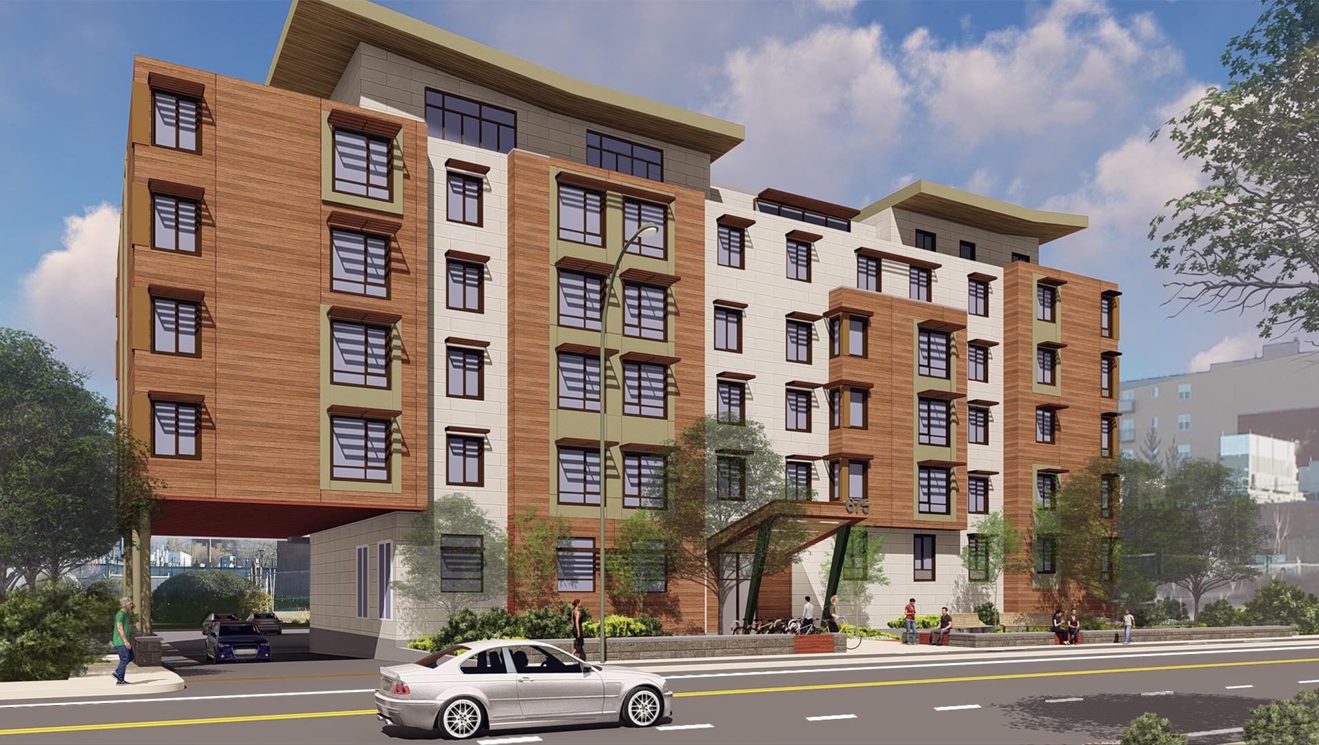
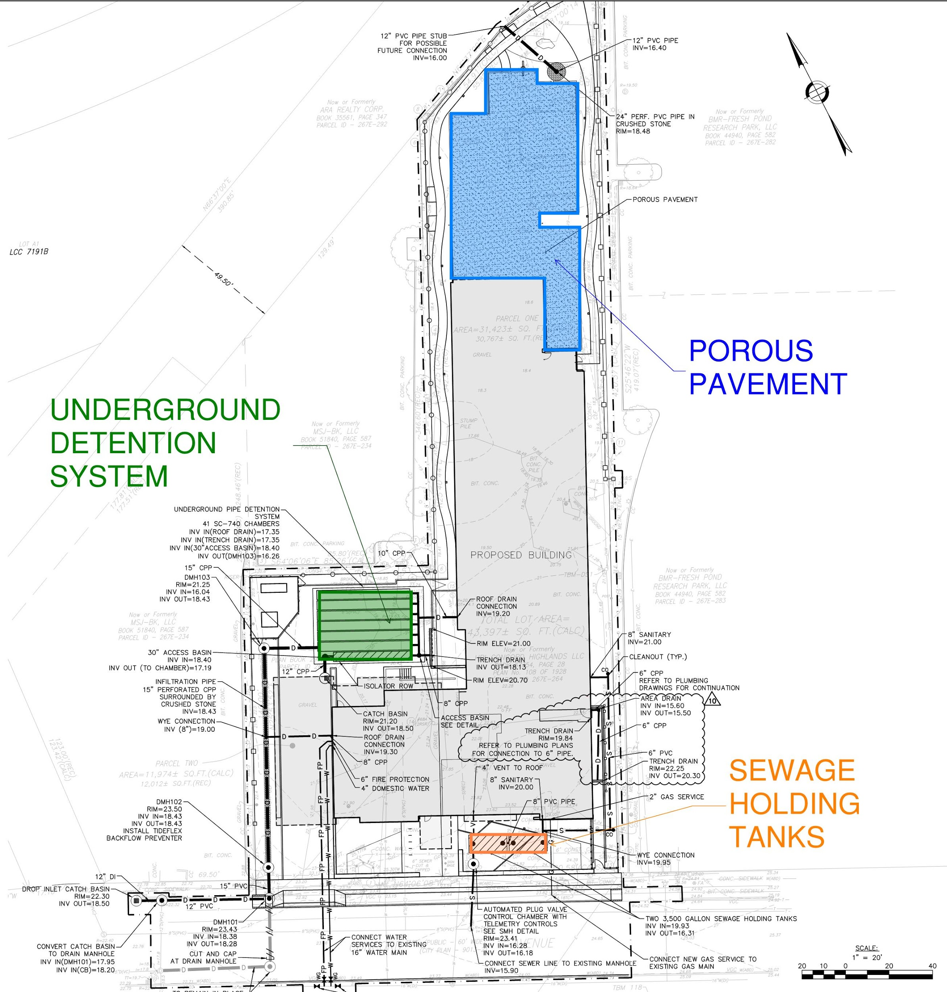
Passive House New Construction
Resiliency

Slide 8
Old Colony Apartments
South Boston, MA
Health
Notes:
Boston Housing Authority – public housing
First 2 phases – 285 units; 4 different green building certifications -
Not well integrated into the neighborhood, really rough shape
- Natural experiment for HSPH: surveyed residents on behavior and health, inspected units for environmental exposures, measured the IAQ

Slide 9
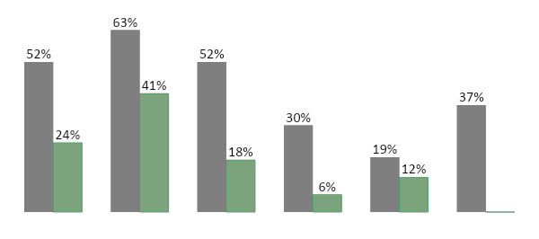
Health Outcomes for Asthmatic Children in
Conventional and Green Housing
Asthma
Symptoms
Medication
Use
Asthma
Attacks
Hospital
Visits
Overnight
Hosp Visits
Missed
School

Slide 10
Efficiency
>150,000
housing units, and counting
Notes:
This work led us to what I came to talk about tonight – context is Mfam Hsng

Slide 11
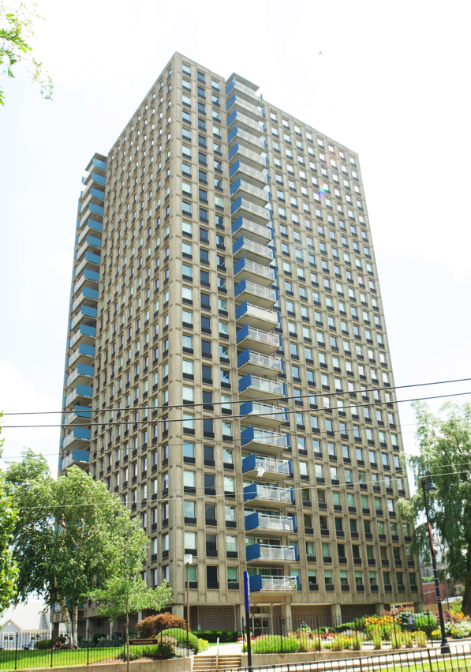
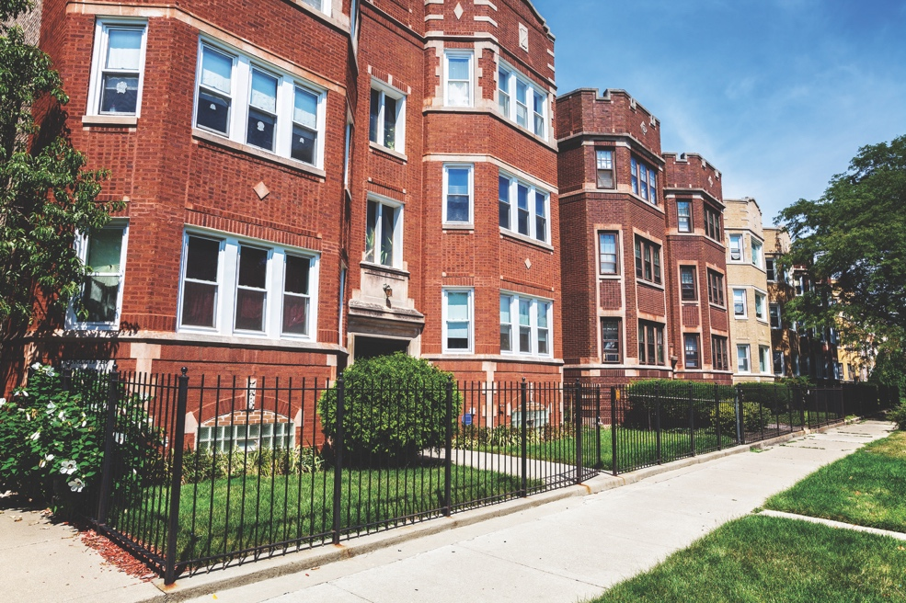
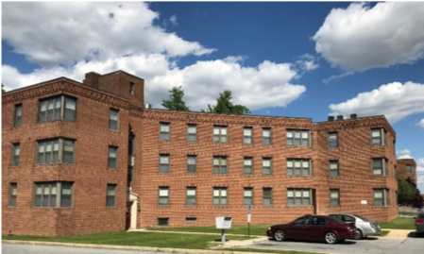
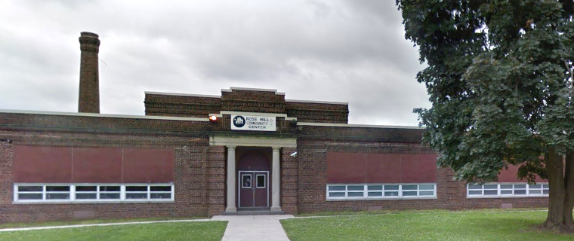
Most Buildings Have Poorly Performing HVAC Systems
Notes:
Venture a guess as to why?

Slide 12
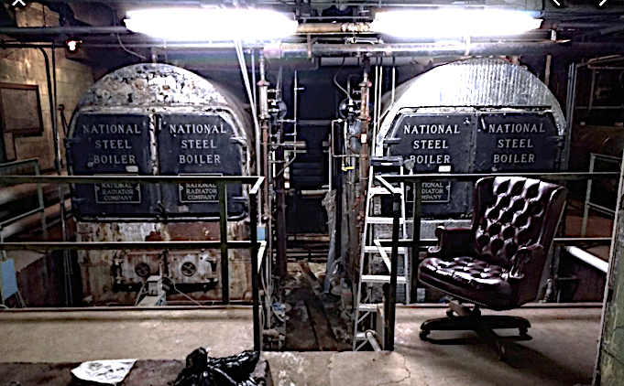
New Ecology’s Approach
Develop a low cost system to deliver recommendations (not just data) to mid-sized building owners
Comprehensive, wrap-around services that result in Good Building Operations and Real Gas Savings
Notes:
Take the place of the guy that used to sit in this chair. The guy that spent his career really getting to know the ins and outs of his building. This guy doesn’t exist anymore. Today’s operating staff isn’t able to invest the time needed to get the insight this guy had. So replacing this guy with a low cost monitoring system is the next best thing. (Actually, a better thing …)

Slide 13
Monitoring Based Commissioning
2. Analyze the data and identify opportunities (ECMs) to optimize systems
1. Install sensors, collect data, send it to the cloud
3. Implement ECMs and save energy
4. Continue monitoring to maintain savings and reduce maintenance costs

Slide 14
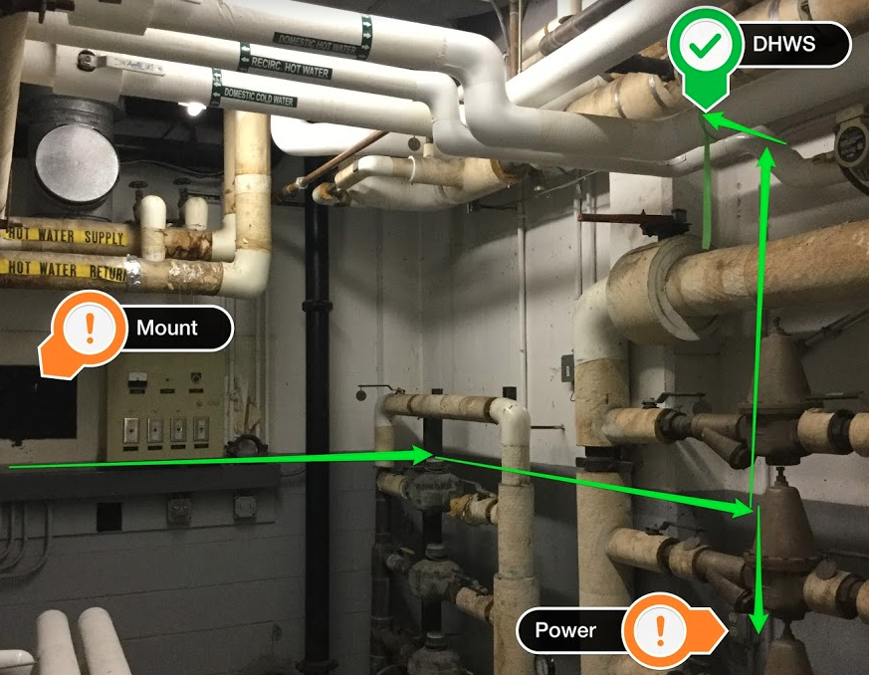
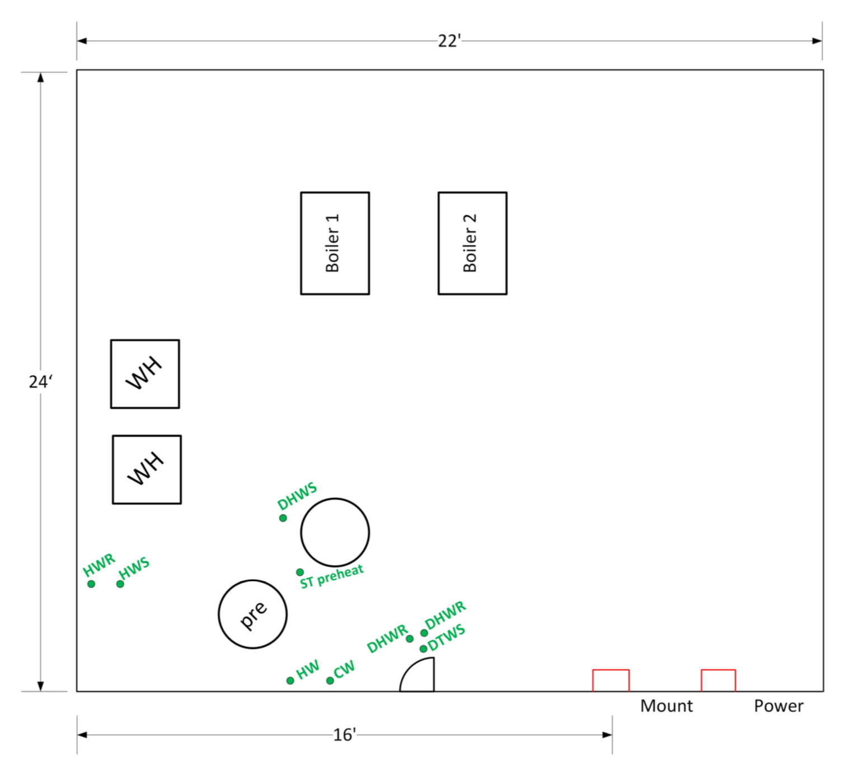
Assess
System Schematic
Mechanical Room Layout
Equipment List; Settings
Sequence of Operations
Photos
Notes:
Systems Operational Assessment – deliverable; Valuable to maintenance, future consultants

Slide 15
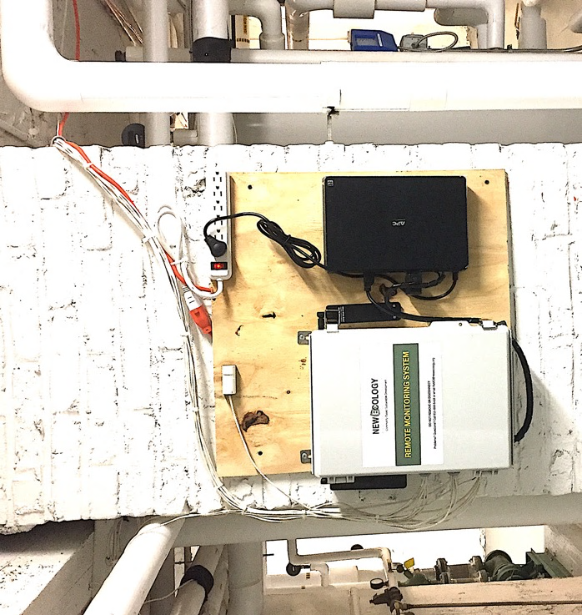
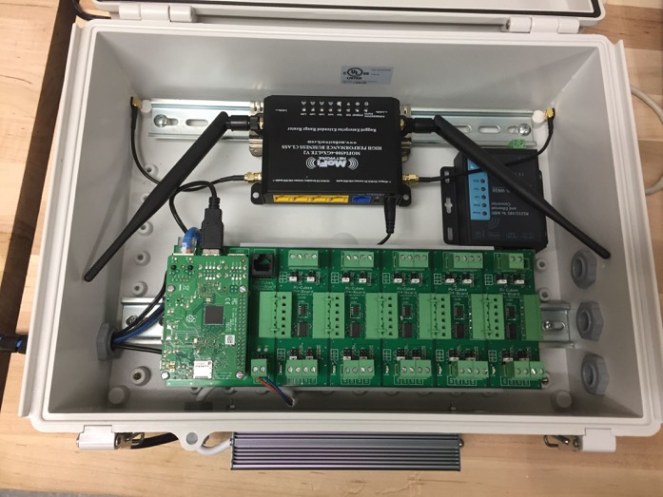
Install
Custom Build and Test
Install & Configure
Establish Connectivity
NEI Database Set-Up
Notes:
Picking projects where measures will be impactful w/ existing equipment and controls (not always money to spend)
THINK about the JOB Creation potential here!

Slide 16
Monitor
Data Validation
Data Collection for Proper Duration
Engineering Analysis
Connectivity Maintenance
Apply Alerts
Notes:
(go through bullets)

Slide 17
Optimize
Optimization Strategy Developed
Recommendations Communicated with Owner/Operator
Optimization Site Visit
Continued Monitoring
Notes:
(go through bullets)

Slide 18
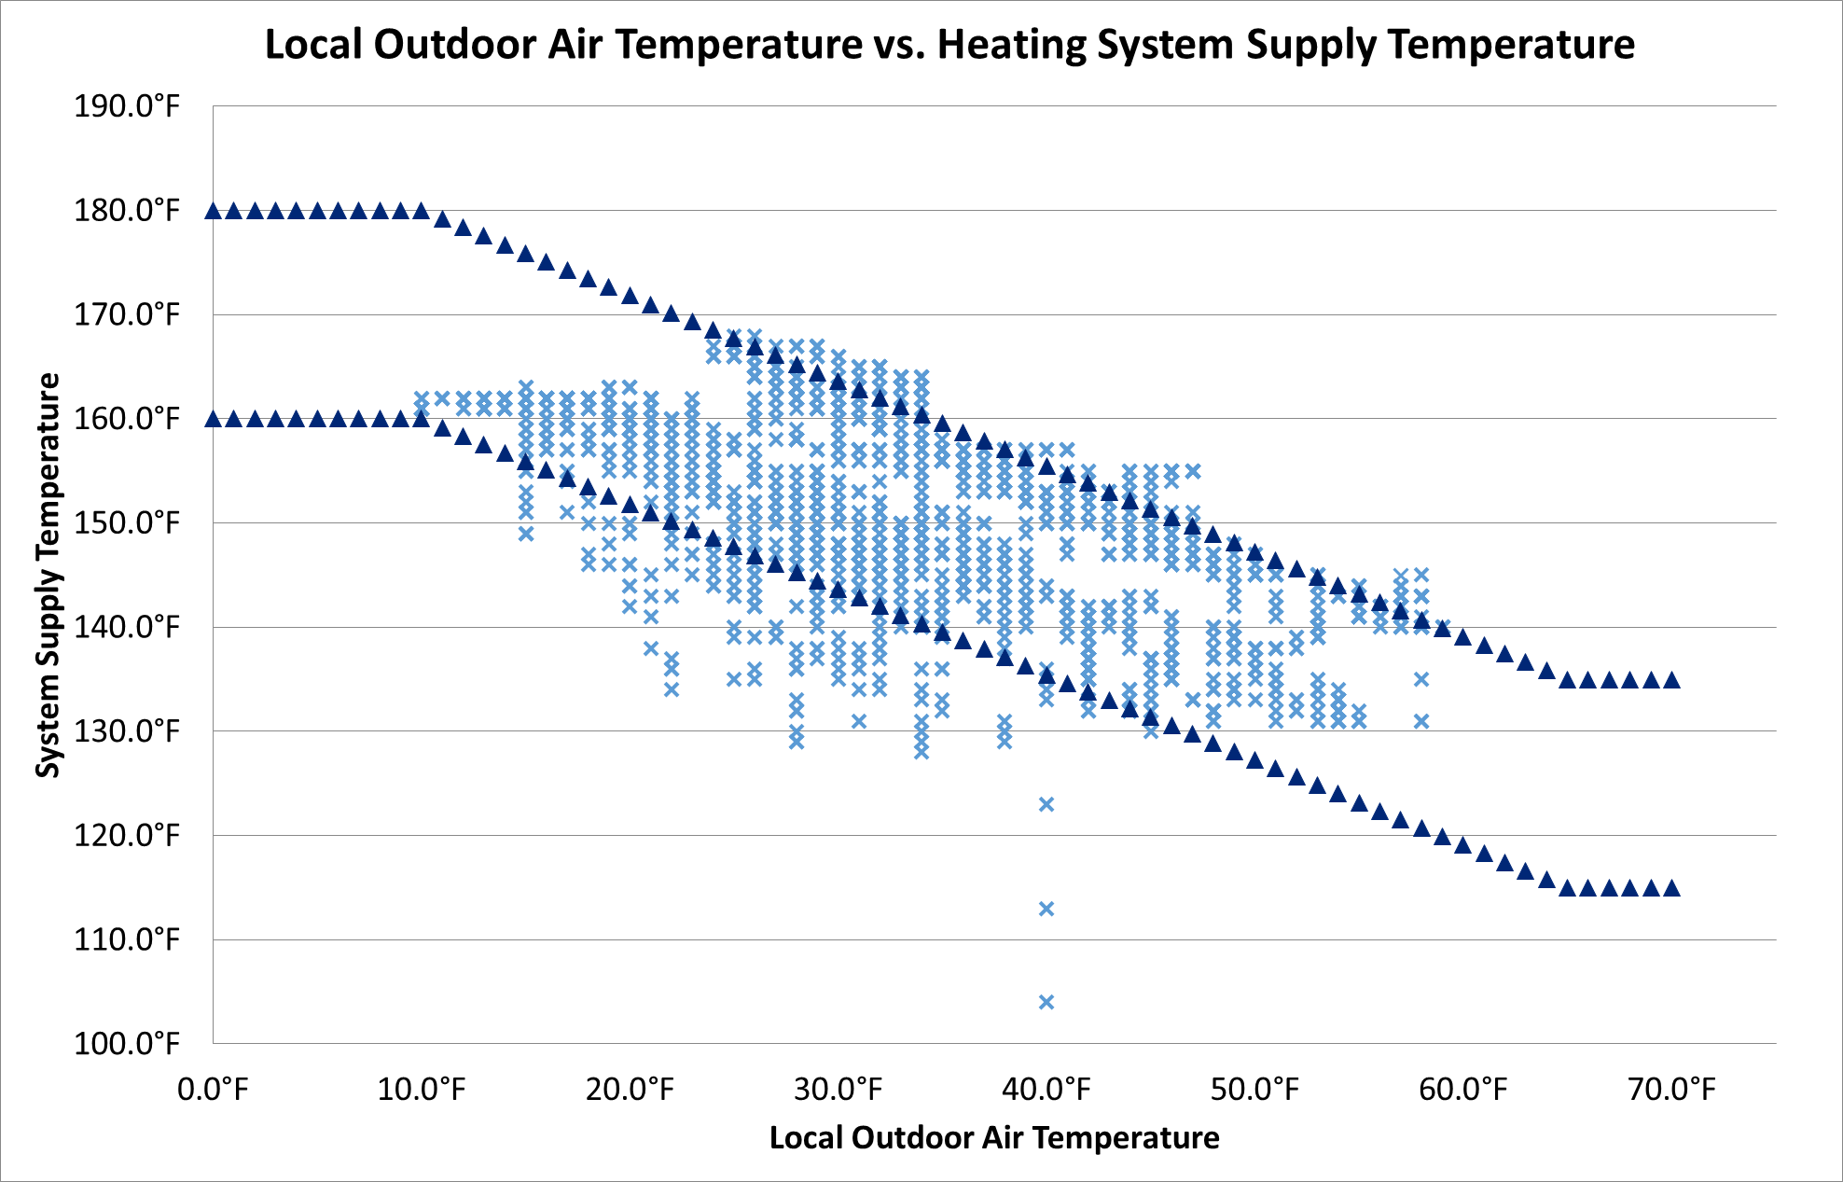
Existing Conditions
Outdoor Air Reset Optimization
Parameter | Existing Settings (°F)
Space Heating Setpoint (°F) | 170
Outdoor Low (°F) | 10
Outdoor High (°F) | 65
Setpoint at Outdoor Low (°F) | 170
Setpoint at Outdoor High (°F) | 125
Warm Weather Shutdown | 70
Existing Settings, upper limit
Existing Settings,
lower limit
Notes:
Each data point is a point in time which has a heating supply temperature and outdoor air temperature

Slide 19
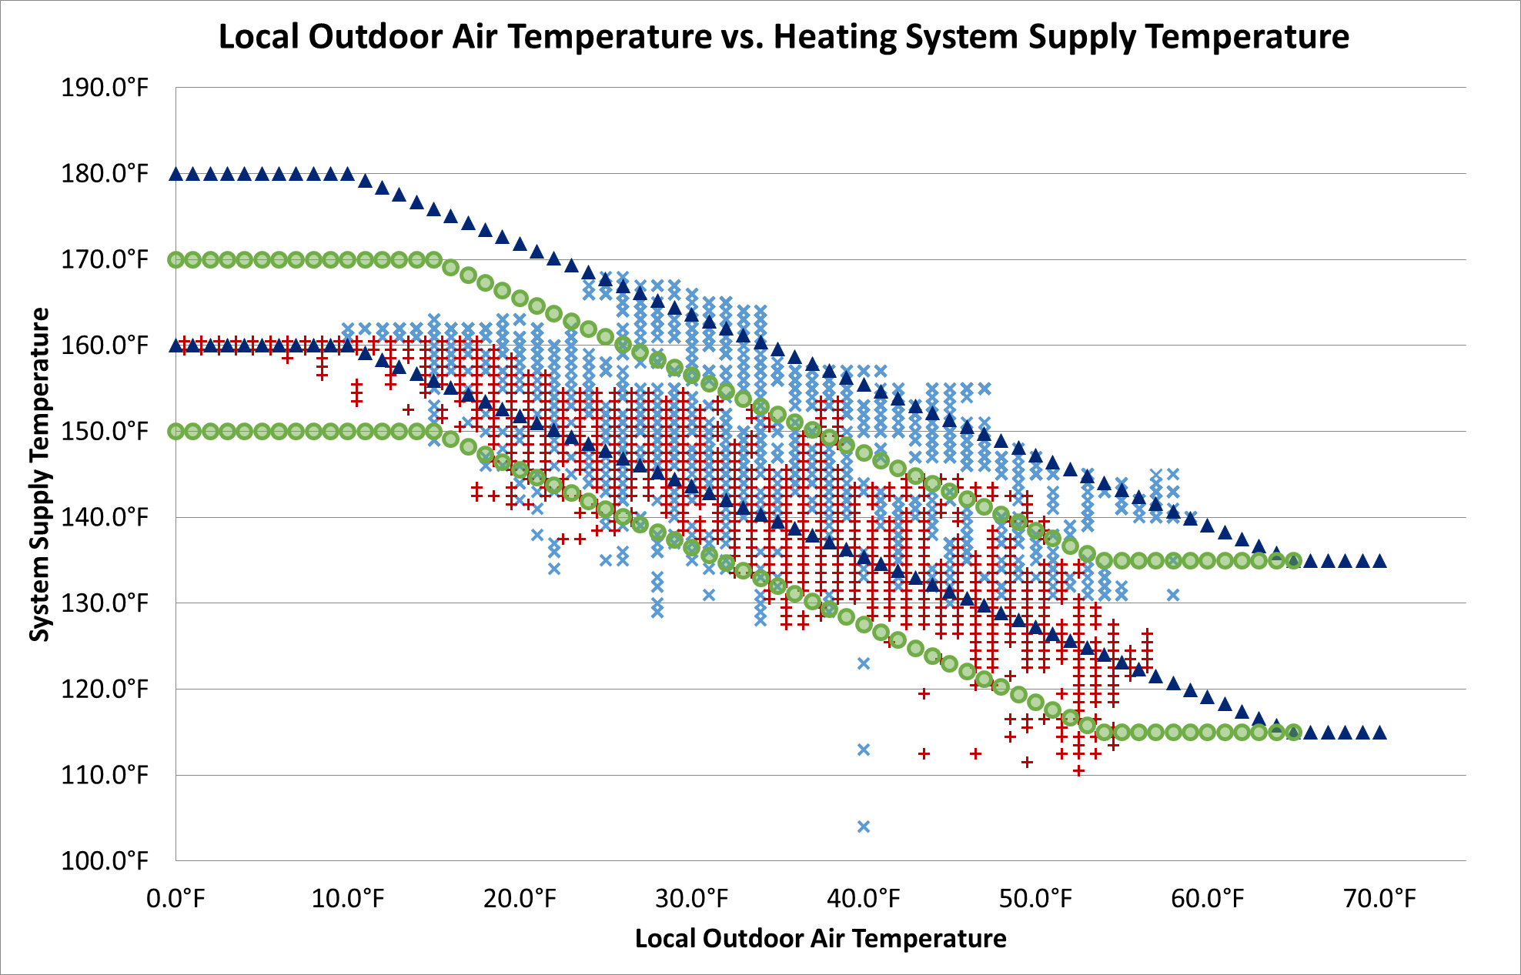
Settings Changes
Outdoor Air Reset Optimization
Parameter | Existing Settings (°F) | New Settings (°F)
Space Heating Setpoint (°F) | 170 | 160
Outdoor Low (°F) | 10 | 15
Outdoor High (°F) | 65 | 65
Setpoint at Outdoor Low (°F) | 170 | 160
Setpoint at Outdoor High (°F) | 125 | 115
Warm Weather Shutdown | 70 | 65
Existing Settings, upper limit
New Settings, upper limit
Existing Settings,
lower limit
New Settings,
lower limit
Notes:
Strategy: lower heating water temperatures based on collected data
This graph shows the new settings we proposed (green) AND the new data collected after settings were changed (red data)
The red data points are almost completely within the settings bands, due to the outdoor air temperature sensor reading more accurately

Slide 20
Optimization Results
Property Description:
9-stories
120 Units
120,736 gross square feet
Subsidized multi-family housing
Reduced gas use by 16.2% - 24,271 therms saved in 3 years. Even though:
Property managed by national, well-regarded property management firm.
Modular, condensing boilers less than 5 years old.
Project paid back in 1.6 years, based solely on gas savings.

Slide 21
Climate Impact of Case Study Building
76.4
Net tons of CO₂e reduced by ReMO (One Year)
= 14.8 Vehicles Off the Road

Slide 22
9%
average gas savings

Slide 23
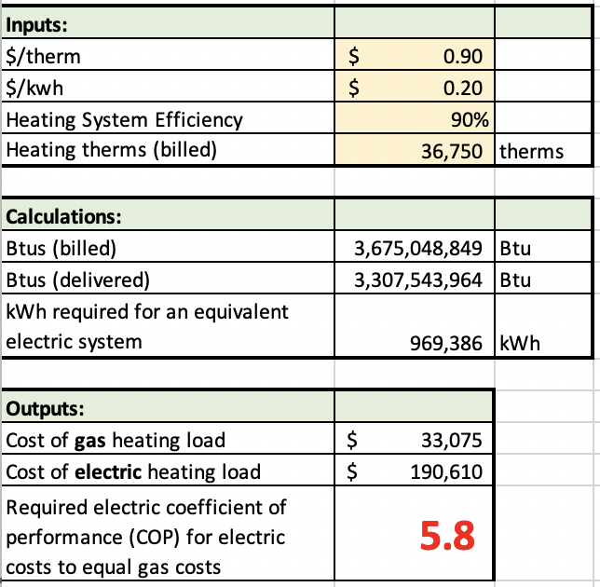
Case Study Building
- Electrified
Notes:
Back to electrification, and how hard implementation will be … Disparate impact on poor
capitalize on gas savings - or couple electrification with seriously deep ECMs – the likes of which are not currently subsidized; windows, super insulation, super air sealing, ERVs to replace RTUs …
1 therm of gas = 100,000 Btu: $.90
1 kWh of electricity = 3,412 Btu: $.20
kWh/100,000 Btu = 29.3 : $6.50 (5.8x)

Slide 24
Cold Climate Multifamily Buildings - Potential Impact
# of MF Buildings*
> 25 units
Potential Tons CO₂e/year** w/ 9% Savings
Philadelphia/Wilmington
Chicago
Baltimore/Washington DC
Boston
Providence
TOTAL
6,700
15,172
12,952
9,105
1,656
43,929
56,861
179,697 107,943
87,600
17,155
449,256
* -Extrapolation from American Community Survey, 2018
** -EPA Greenhouse Gas Equivalency Calculator
Notes:
87,000 cars

Slide 25
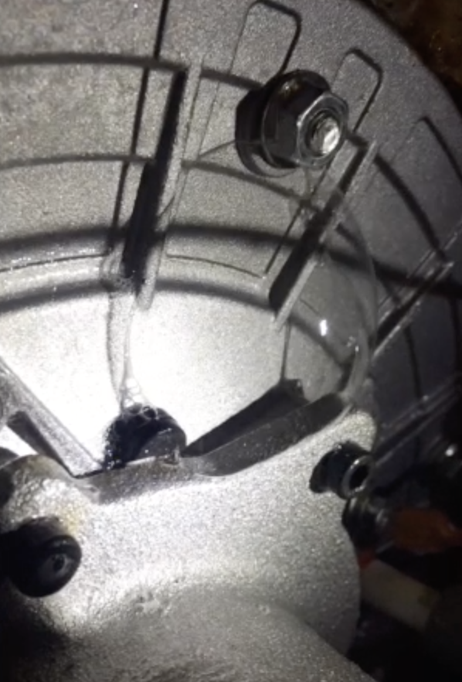
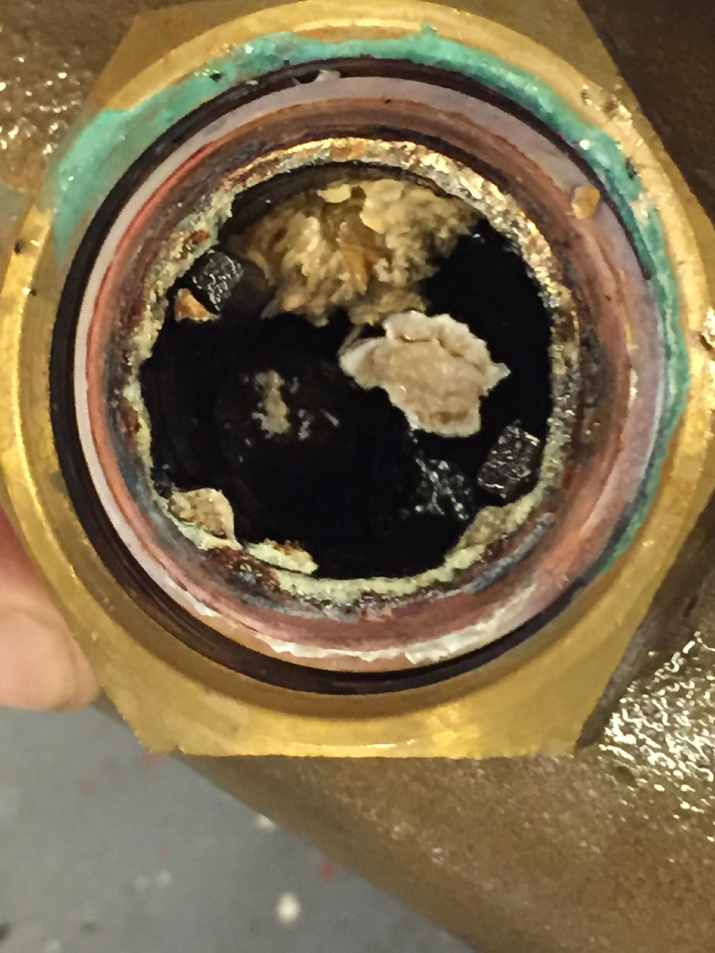
Undetected gas leak!
Boiler has been hotwired
Mixing valve as petri dish
Notes:
Mixing Valve – yuck – safety issues because it affects ability to function properly – scalding or Legionella
Gas leaks going undetected – clear safety issue – sign of poor workmanship
RI Heating boiler – one of several creative ways to bypass the built in ‘controls’ – massive waste of energy

Slide 26
Boiler 1 Firing Rate
Boiler 2 Firing Rate
Broken Balancing Valve
Broken System Supply Sensor – resulting in excessive Equipment Cycling
Cut Outdoor Air Sensor
Notes:
Broken balancing valve whose job it is to keep flow, therefore temp, balanced in the building – manuf defect, discovered thru our data, not by Cx
Broken system sensors – this case .. Supply sensor, nobody knew, no complaints
Cut/disconnected OA sensor – keeps boilers running
Poorly located OA – premature WWSD, complaints, setting jacked up …

Slide 27
What Can ReMO Do?
Reduce consumption and costs – Carbon!
Reduce risk from failures and emergencies
Save time and money spent on maintenance
Solve difficult, longstanding problems
Keep savings in place over time
Enable “eyes” on many buildings from a central location
Monitor and manage service contractors
Notes:
Adds up to superior operation of existing buildings, which in turn reduces gas consumption.

Slide 28
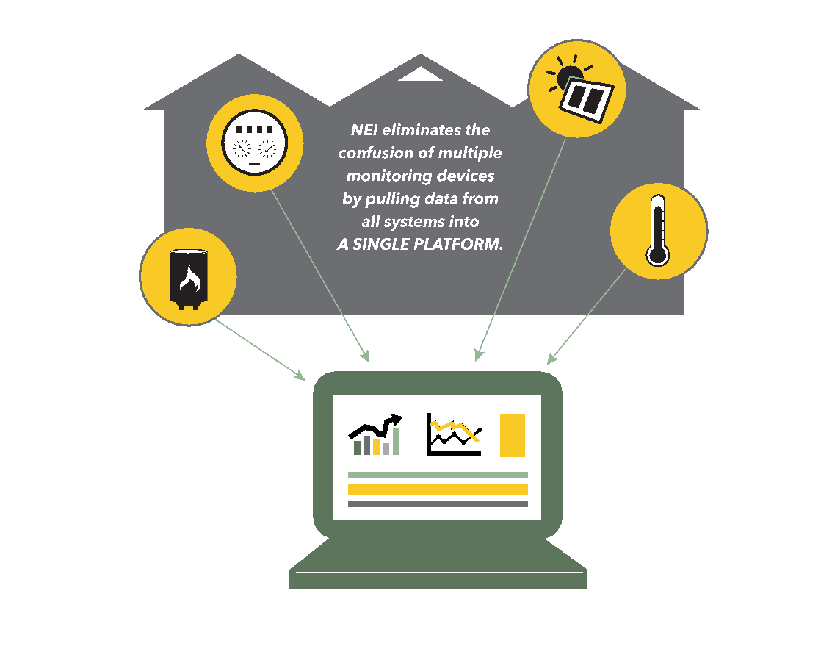
Our Goal
Connect ALL capable devices into a single platform.
Provide flexibility for future expansion
Not tied to a single manufacturer’s hardware
Allows change out of equipment
Single view of building systems
Single interface to learn
Data from devices offered by different manufacturers all feed into one place to see cause and effect in a way single device platforms cannot.
Notes:
Will still need to monitor heat pumps

Slide 29
Our Hope
Potential of building monitoring is embraced, and soon!
Reduce carbon emissions, NOW, while we work on electrification/low carbon grid
One of few impactful options for reducing gas use
Highly flexible – equipment and fuel types
Large scale applicability
Achieve societal benefits
Keep affordable housing affordable
Improve resident comfort, health & safety
Create jobs

Slide 30
Thank You!
Marty Davey
Director of Product & Service Development
davey@newecology.org
617-557-1700 x7071
www.newecology.org

