Slide 1
Lower Bills for Everyone: The Role of Equity in Energy Efficiency
Monday, December 9, 2019
Robert J. Higgins Welcome Center

Slide 2
Financing, Equity and Climate Change in RI’s Energy Efficiency Marketplace
SAM ROSS
Consultant, Optimal Energy
Sam will discuss the collaborative effort by Rhode Island’s Energy Efficiency and Resource Management Council work and the Office of Energy Resources to drive increased access and benefits from energy efficiency programs for low- and moderate-income Rhode Islanders. His presentation will focus on the potential contribution offered by financing products to increasing efficiency deployment, as well as the equitability and environmental benefits associated with this initiative.
Sam applies his experience in environmental economics and data science to a variety of complex challenges in the clean and efficient energy space. His areas of expertise include benefit-cost analysis, valuation of non-energy impacts, the application of financing products to energy efficiency, and policy and program design and oversight. Sam received his Master of Science in Environmental Economics from the London School of Economics, and is committed to working within the energy industry to overcome the threat presented by climate change. For more information about Sam’s work, please visit https://www.linkedin.com/in/samuel-ross-13085a69.

Slide 3
Sam Ross
He/Him/His
Consultant with Optimal Energy focused on energy & climate nexus
Environmental economist with MSc from London School of Economics
Life-long outdoors enthusiast
Strategy game fan (and player)

Slide 4
What we will cover today
Introduction to energy efficiency in Rhode Island
Energy and equity, including the concept of ‘energy burden’
The up-front cost challenge of capturing efficiency’s potential
How financing tools can help overcome the up-front cost challenge
Some potential risks of financing tools, and risk-mitigation approaches
Heat pumps, an increasingly popular efficiency technology, as a real-world example

Slide 5
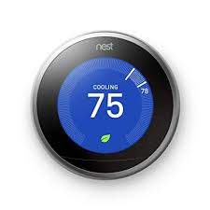
What is Energy Efficiency?
“Energy improvements that provide similar (or better) energy services while consuming less energy.”
Can take MANY forms. Here is a (very) incomplete list:
Replacing existing equipment with similar equipment that consumes less energy: LED lights, Energy Star appliances
Reducing ‘wasted’ energy: Adding insulation, capturing unused heat from industrial processes
Changing energy use patterns: motion-sensor lights, smart thermostats

Slide 6
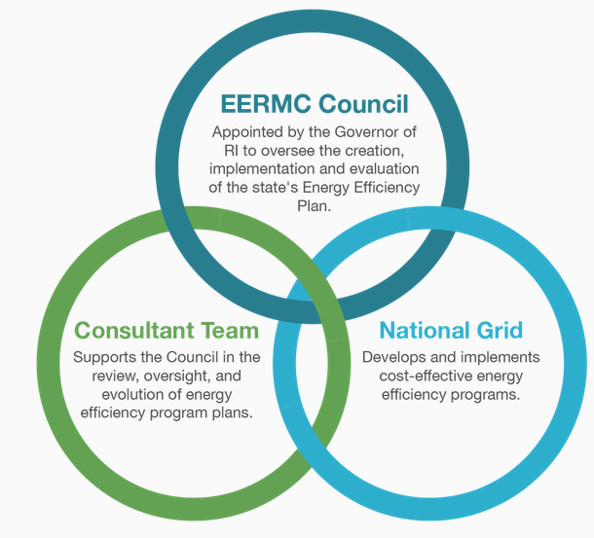
The Energy Efficiency & Resource Management Council (EERMC)
The Council’s mission is to serve Rhode Islanders in their homes and businesses.
It represents customers’ needs by providing integrated, comprehensive stakeholder feedback about energy decisions.
The Council’s goal is to ensure all Rhode Islanders get the least expensive and most environmentally healthy energy supply through energy efficiency, conservation, and resource management.

Slide 7
Why is Energy Efficiency Supported by Utility Programs: Part 1
It’s the law
In 2006, a law was passed requiring the utility to develop and submit cost-effective energy efficiency plans that are less than the cost of supply
Public Utilities Commission reviews and approves annual plans & three-year targets upon which plans are based
Lowest-cost resource
Efficiency reduces energy demand, so the utility can invest less $$$ in (more expensive!) poles, wires and pipes and still meet energy needs

Slide 8
Why is Energy Efficiency Supported by Utility Programs: Part 2
Energy production creates economic externalities
Economic Externality: When my economic activity (such as energy consumption) impacts others (such as through carbon emissions) in a way that is not included in the price of my activity
‘Negative’ externalities efficiency reduces: The most common forms of energy production produce greenhouse gasses and local air pollutants
‘Positive’ externalities efficiency produces: Increased indoor comfort, positive health impacts

Slide 9
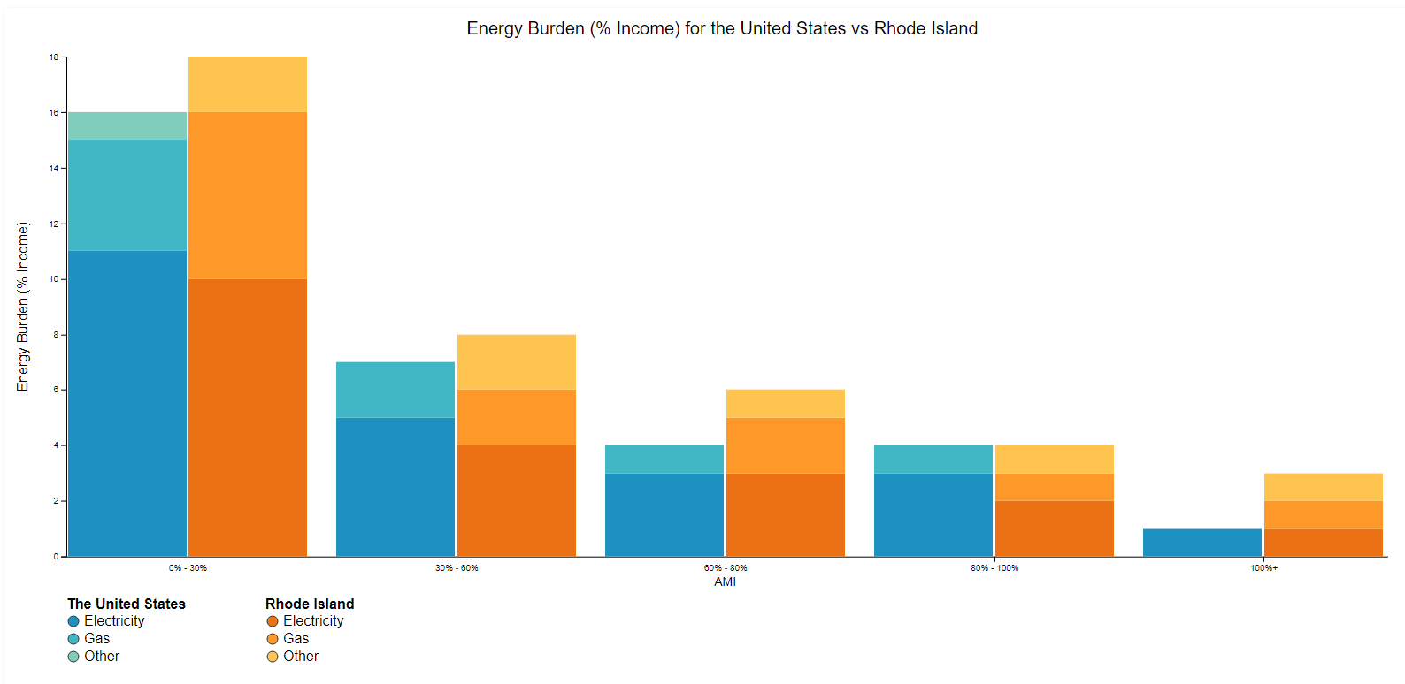
The Energy Burden
18%
= US
= RI
Energy Burden (% Income)
10%
0% - 30%
30% - 60%
60% - 80%
80% - 100%
100+%
Area Median Income
https://www.energy.gov/eere/slsc/maps/lead-tool

Slide 10
Equity and Income-Eligible Efficiency Programs
Income-eligible efficiency support critical for equity (in part due to disproportionate energy burden)
100% out-of-pocket costs covered for income-eligible ratepayers (<60% state median income)
Covers all eligible energy efficiency measures, plus applicable health and safety measures
Funded partly through RI efficiency programs, partly through RI Department of Health Services, which has programs with federal funding support
Customers with 60%-100% state median income still have sizeable energy burden
These customers have access to other efficiency programs, but these often still require out-of-pocket costs, which can be a barrier to participation

Slide 11
On to the Finance (Theory) Topics
(I.e. overcoming the challenge of up-front costs)

Slide 12
Example of Efficiency Improvement Costs and Benefits

Slide 13
The Challenge of Up-Front Costs
Need $ on hand…
…‘down’ $ at first…
…but ‘up’ $ overall!

Slide 14
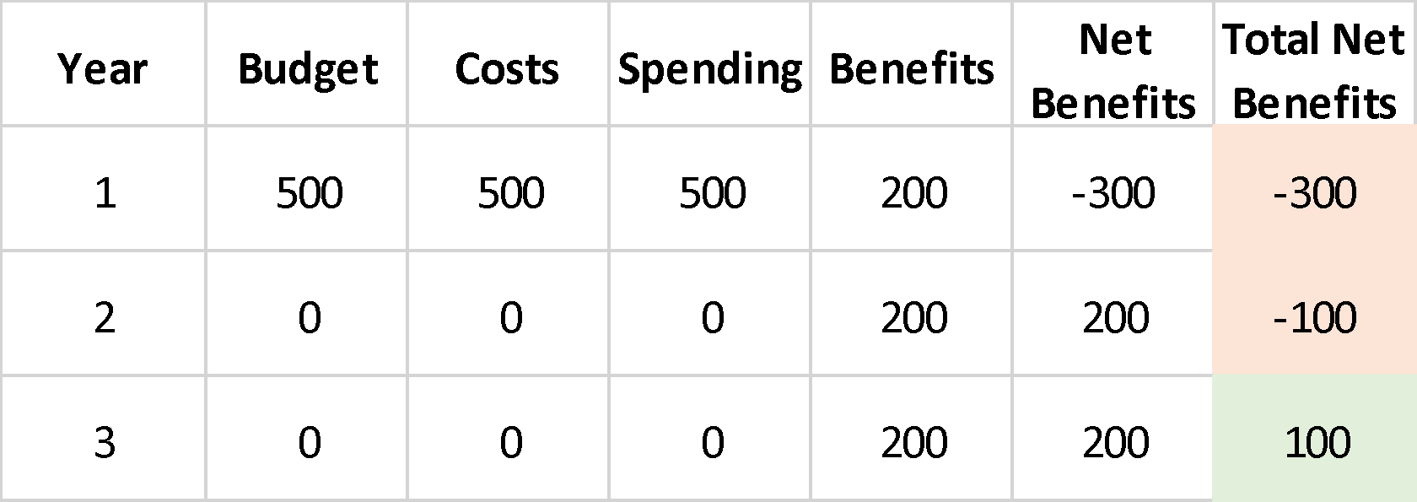
Great! If I have $500 to spare
If I have this much in year 1…
…I can earn this much (extra!) by year 3

Slide 15
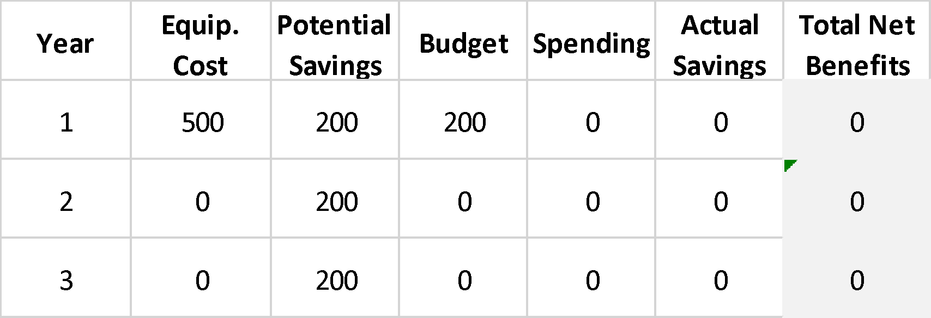
Not So Great if I don’t have $500 to spare!
If I only have this…
…I don’t receive potential benefits ☹

Slide 16
How Financing Can Help
(…can avoid being ‘down’ $ early on…)
Limited budgets, augmented with loans, cover up-front costs…
+
=
…and unlock benefits overall

Slide 17
Financing can also help at the Utility Program level
Bringing additional investment money into efficiency
Good for average customer, since program costs recovered through energy prices
Help those for whom up-front costs are still a barrier after program incentives
Help those for whom program participation requirements, which existing incentives typically don’t cover, are a barrier
E.g. ‘pre-weatherization’, which includes home improvements like asbestos removal, typically fall outside efficiency programs

Slide 18
But…what are the risks to borrowers?
I’ll cover two categories of borrower risk, certainly not exhaustive!
(I will only briefly touch on lender & utility risk from finance programs)

Slide 19
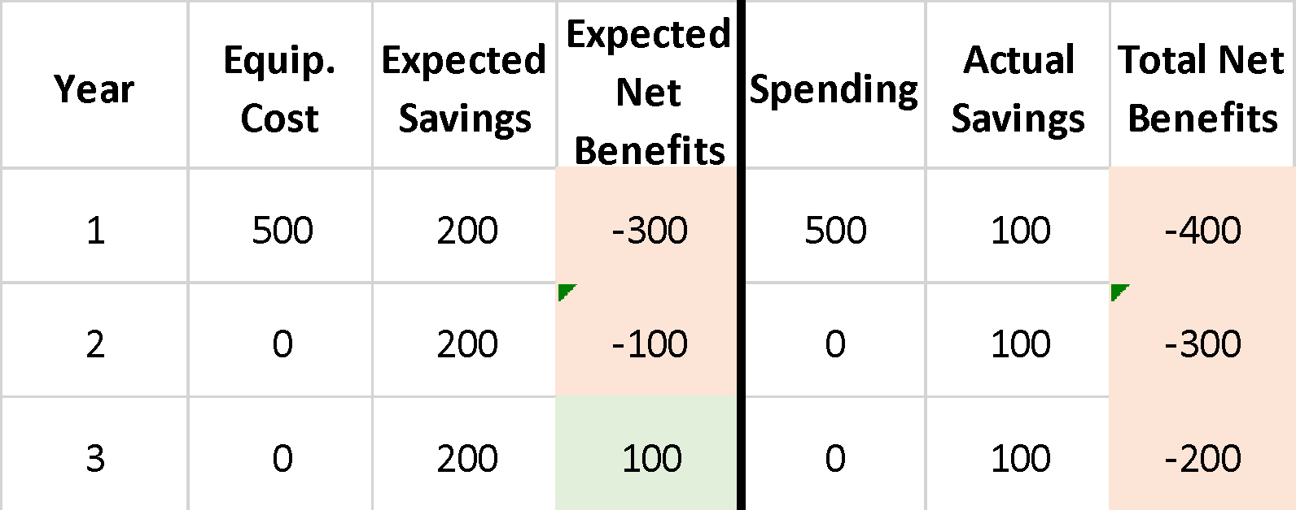
‘Performance Risk’ = the savings don’t show up!
CAN BE REALLY HARMFUL:
Loan default
Loss of utility service
Credit score impacts
Eviction
Expectations…
…not matching reality!

Slide 20
“Pushy Lending Practices” = Bigger loans mean bigger profits
There are some examples out there of financial product sales practices that put profits before people (not naming names here)
Concerns may include:
Promoting projects that homes don’t really need
Not working to ensure borrowers exhaust efficiency incentives before taking out loans
Taking advantage of weak, or weakly enforced, consumer protections

Slide 21
Can we mitigate the risks?
(A range of strategies exist, but devil is in the details)

Slide 22
A Note on Managing Lender Risk (or Improving Finance Terms)
Loan Loss Reserve
Other Credit Enhancements (e.g. Credit Guarantee)
Interest-Rate Buydowns
Energy Efficient Mortgage (EEM)

Slide 23
Traditional Approaches to Reducing Borrower Risk
Ensure existing consumer protections are rigorously applied
Ensure that efficiency programs engage in their own financing product oversight
Create lender approval requirements to participate in efficiency financing programs
Engage, educate, empower, and partner with members of borrowing communities
Ensure real enforcement against poor lending practices
Engage financial institutions, such as CDFIs, with experience working in these communities

Slide 24
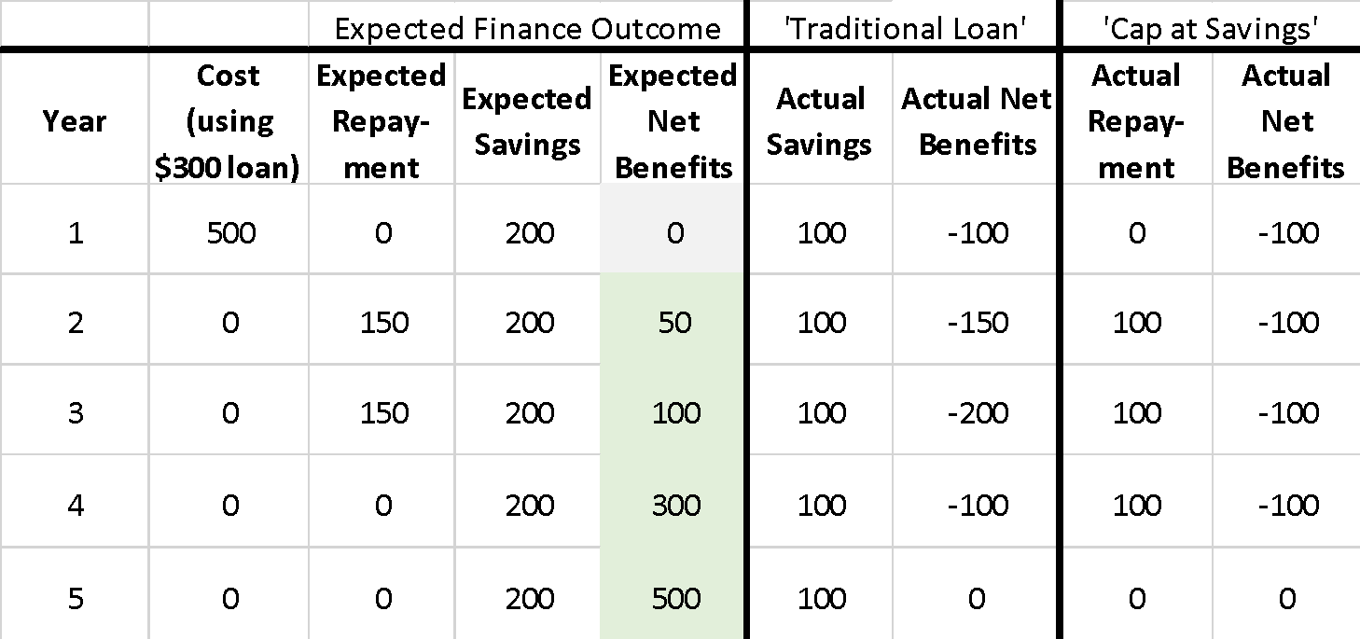
Emerging Approach: Cap Repayment at Savings to Reduce Risk
Poor equipment performance may still lead to ‘out of pocket’ short-term losses
But smart product design ensures loan does NOT create extra losses…
…making reaching this point more likely
(but the devil is still in the details!)
Notes:
E.g. California program – capped at 80% of estimated savings
Key point: financing should not exceed lifetime of efficiency improvement
Takeaway: A new, responsive paradigm

Slide 25
Bringing It Back to the Real World

Slide 26
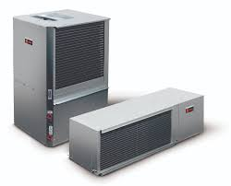
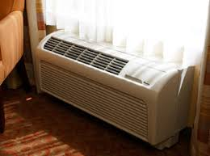
An Emerging Efficiency Equity Opportunity: Heat Pumps
Heat pumps create potential to enhance equity through:
Subject to up-front cost challenge (and its possible solutions!)
Can replace delivered fuel heating, which has less historical incentive support, broadening access to efficiency program benefits
Stated priority in Rhode Island as part of Heating Sector Transformation, one of Rhode Island’s Climate Change Initiatives
Provide summer cooling, which is increasingly important due to climate change’s disproportionate impacts on income-eligible households

Slide 27
Income-eligible efficiency programs are a stated priority for the EERMC and the Rhode Island Office of Energy Resources
Significant work expected in this space in coming years

Slide 28
References & Further Resources
Sample Academic References for Environmental Economics
General environmental economics principles
Tietenberg, T., & Lewis, L. (2014). Environmental & natural resource economics.
Externalities in Energy Efficiency
Gaterell, M.R., & McEvoy, M.E. (2005). The impact of energy externalities on the cost effectiveness of energy efficiency measures applied to dwellings. Energy and Buildings, Volume 37, Issue 10. https://doi.org/10.1016/j.enbuild.2004.12.004
Efficiency and Financing
The Up-Front Cost Challenge
https://aceee.org/topics/energy-efficiency-financing
Detailed Review of Financing and Efficiency Overall
https://aceee.org/sites/default/files/market-reassessment-0216.pdf
Income-Eligible Focused Review
https://emp.lbl.gov/sites/default/files/news/lmi-final0811.pdf
Lending practice risks (focus on PACE, but risks apply elsewhere)
https://www.nclc.org/issues/pace-energy-efficiency-loans.html
National Grid’s Efficiency Program Offerings
Overview & Comprehensive list
https://www.nationalgridus.com/RI-Home/Energy-Saving-Programs/
Example Existing Residential Financing Program
https://www.nationalgridus.com/media/pdfs/resi-ways-to-save/ri-steps-to-apply-0-financing.pdf
Heat Pump Support
https://www.nationalgridus.com/RI-Mini-split-Heat-Pump
Energy Efficiency in Rhode Island
Energy Efficiency and Resource Management Council (EERMC)
https://rieermc.ri.gov/
Introduction to energy efficiency in Rhode Island
https://rieermc.ri.gov/resources/information-at-a-glance/
Rhode Island Office of Energy Resources Efficiency Landing Page
http://www.energy.ri.gov/energy-efficiency/
Climate Change
Summary from United Nations International Panel on Climate Change
https://www.ipcc.ch/sr15/chapter/spm/
Current Rhode Island Efforts
http://climatechange.ri.gov/

Slide 29
Sam Ross, Consultant Optimal Energy 460 Harris Avenue, Unit 101 Providence, Rhode Island 02908 802-482-5631
Questions?

